Slide 1
Modelling eye tracking dynamics with quantum theory
Agnes Rosner (University of Zurich)
Irina Basieva (City, University of London)
Albert Barque-Duran (City, University of London)
Andreas Gloeckner (Max Planck Institute for Collective Goods)
Bettina von Helversen (University of Bremen)
Andrei Khrennikov (Linnaeus University)
Emmanuel Pothos (City, University of London)
Notes:
25 mins

Slide 2
Ambivalence
Sometimes there is back-and-forth, as we try to make up our mind.
This seems especially so for poorly matched options, e.g., spending money on a jumper vs. going to a movie.
Is there evidence that preference can ‘oscillate’ with time, prior to convergence to an eventual opinion?
A little bit: Walster (1964) and Brehm & Wicklund (1970) both reported up-and-down pattern of preference shifts.
Notes:
These days one can almost add heating a house…

Slide 3
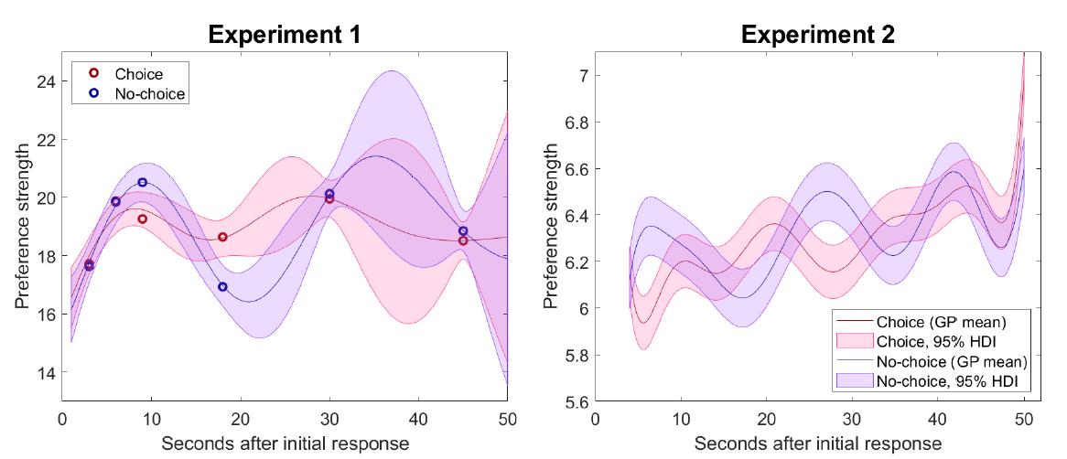
Ambivalence
But it is difficult to study the dynamics of preference change directly.
Kvam, Busemeyer, & Pleskac (2020) asked participants for preference ratings at different intervals.
They reported results like these:

Slide 4
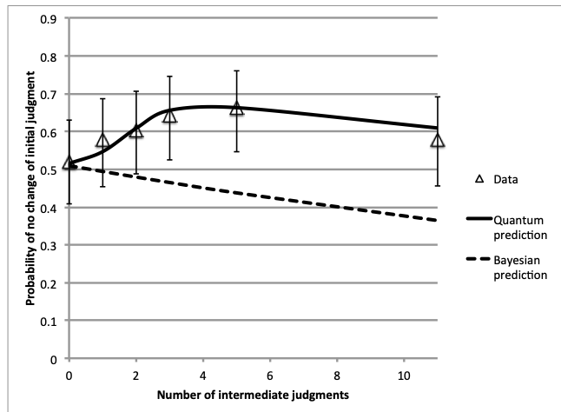
Ambivalence
The problem is that there is extensive evidence that just asking for a decision might change the relevant mental states (Sharot, Velasquez, & Dolan, 2010; White, Pothos, & Jarrett, 2020).
In fact, there is evidence that a high density of ‘intermediate’ judgments might slow down opinion change (Yearsley & Pothos, 2016).
Notes:
What we are looking at here is an increase in ‘survival probability’, with more measurements, but there are some nuances which prevent a straight picture (e.g., there is a probability that you’d just change opinion by chance on any response).

Slide 5
Eye tracking?
Instead of decision dynamics, we study ‘attentional’ dynamics, related to a poorly matched choice.
There are some known links between attention and decision. For example,
Suri & Gross (2015): attention can affect motivation for action.
‘Attentional biases’ can influence corresponding behaviour, e.g., in alcohol use (Cox, Fadardi, & Pothos, 2006) or eating behaviour Calitri et al. (2010).
The gaze cascade effect: increasing attentional focus for the eventually chosen option (Fiedler & Gloeckner, 2021; Krajbich, Armel, & Rangel, 2010).

Slide 6
Objectives
Collect eye tracking data for a poorly matched decision.
We expect some back-and-forth between Areas of Interest (AOIs) corresponding to the information for the different options.
Maybe unsurprising!
More subtly, explore modelling options for the eye tracking curves.
Corresponding models might serve as decision ones too?

Slide 7
Outline of paradigm
Three scenarios, participants have made a decisions as if ‘in the shoes’ of the protagonists.
buying a house
going to the cinema
keeping a stray dog
For each decision there are pros and cons.
Each pro would be a simple statement, summarized by the label.
In a pretest we had participants rate the pros, cons and we determined a final list with a view to achieve a better balance.

Slide 8
Outline of the paradigm
For each scenario:
Participants read the scenario.
Screen with pros, cons plus summary labels (information processing step).
Screen just with the labels (decision step), until decision.
Screen just with the labels (decision step 2), fixed time of 15s.
Confidence in decision.
Four personal relevance questions.
Ratings for each pro, con.

Slide 9
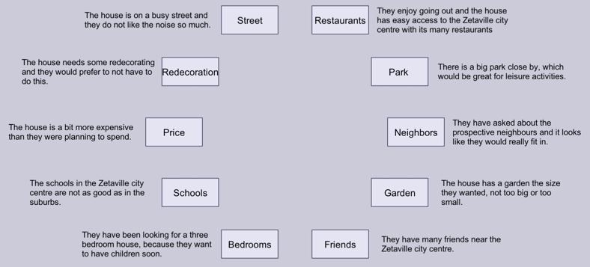

Slide 10
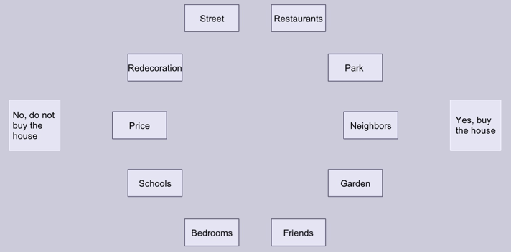
Notes:
If participants read the arguments first, clearly they might start processing the decision.
But we need this pre-processing step, since we do not want to contaminate a decision process, with a process of just reading the arguments.
Eye tracking was measured only in the second case.

Slide 11
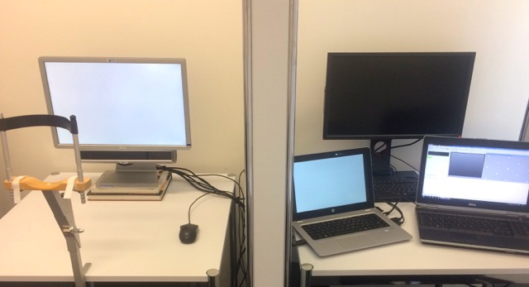
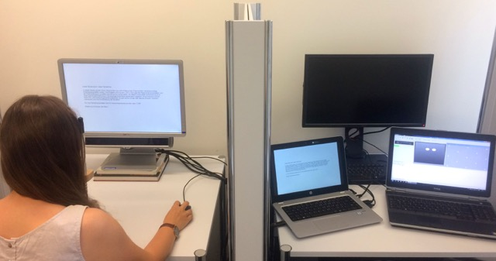

Slide 12
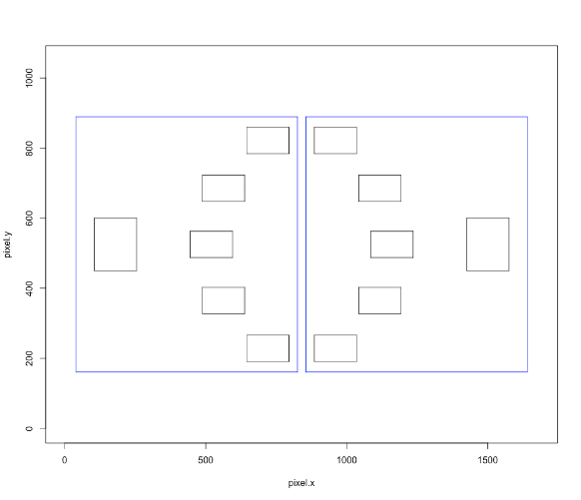
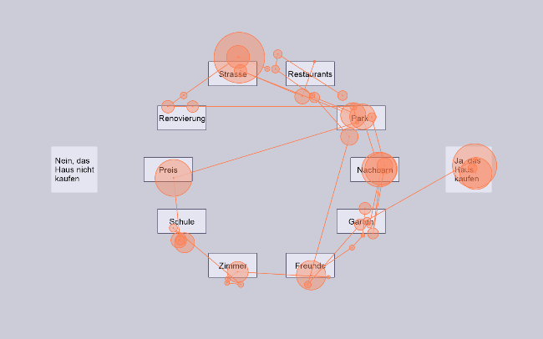
Eye movement analysis
Count fixation durations within time bins of 200ms.
Two AOIs, one for the pros, one for the cons.
Fixation durations in three categories:
pros
cons
neither (when pros, cons durations not sum to 1)
Notes:
Sample scan path.

Slide 13
Basic behavioural findings
Note, N=45, within participants relative to scenario (135 responses in total).
No yes/ no preference.
~15sec for a decision.
Number of transitions correlated with response time (for the first decision r=.83).
Two decisions correlated (r=0.86).
Signed average pros, cons difference related to first decisions (using mixed effects binary logistic repression, just intercepts – best model identified with BIC).
Notes:
general peace of mind results
correlations uncorrected (they are indicative)

Slide 14
Behavioural findings
Is there a pattern of gradually quenched oscillations?
We would like to know whether, if there are any oscillations, these are of progressively lower amplitude.
DV: the absolute value of the first derivative (via numerical approximations) of the pros and cons eye tracking curves.
Very difficult to get an intuitive impression of whether this is the case or not.
Notes:
This is useful to know for modeling…
First derivative: at different points tells us whether at that point the function is changing violently/ steeply vs. weakly. In trying to capture the idea of gradually quenched oscillations, a distinction between violent vs. weak oscillations is helpful because it informs whether oscillations are strong vs. weak.

Slide 15
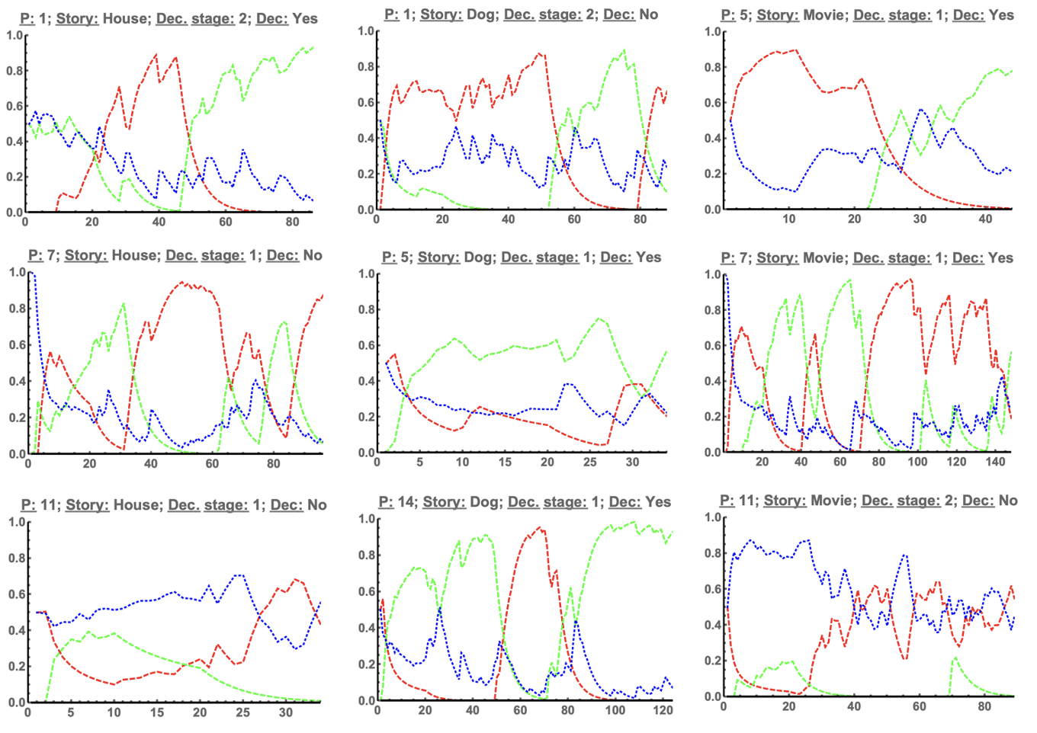
Examples of eye tracking curves
Notes:
With some smoothing!
The green line corresponds to fixations in the pros/ yes AOI, the red line to fixations in the cons/ no AOI, and the blue dotted line to neither (which includes eye blinks). The horizontal line is time bin, corresponding to 200ms; note, second stage decisions end shortly after 75 time bins (15s). The vertical line indicates fixation proportion.
There are 45 participants x 3 scenarios x 2 decisions stages charts like this.

Slide 16
Behavioural findings
Linear mixed effects regression.
DV: absolute derivatives (as above)
Random effect (no slopes): participants
Fixed effects: scenario (house, dog, movie), decision stage (1 or 2), and time period (1-5)
Linear trend analysis: examine whether the mean of the dependent variable in each of the time periods progressively decreased.
Notes:
Progressively more complex analyses…
This approach was repeated for the two dependent variables, probability of transitions and absolute derivatives (employing the R packages lme4, Bates, Maechler, Bolker, & Walker, 2015, afex, Singmann, Bolker, Westfall, Aust, & Ben-Shachar, 2020, and emmeans, Lenth, 2020).

Slide 17
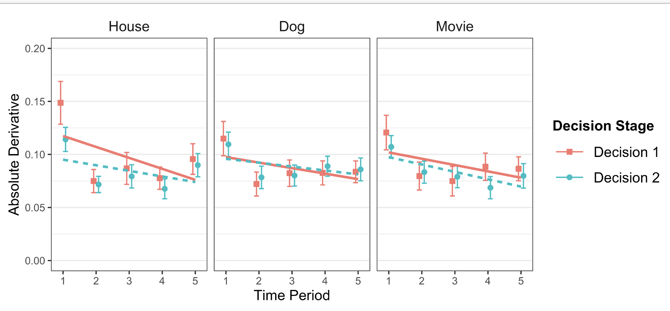
Behavioural findings
Reasonable evidence that this is the case.

Slide 18
Modelling
Plenty of apparent options from the decision literature, but few attempts to model eye tracking (or decisional dynamics) curves directly (exception, Tatler et al., 2018, model for saccades).
'Interactive activation’ models (Gloeckner & Herbold, 2011; Jekel et al., 2018).
Sequential sampling/ drift diffusion models (Brown & Heathcote, 2008; Johnson & Busemeyer, 2005; Ratliff & Smith, 2015).

Slide 19
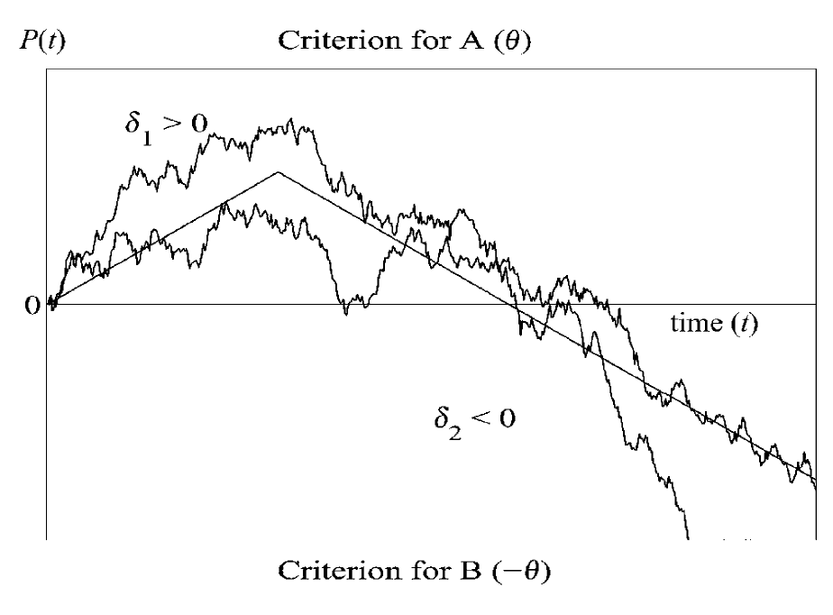
Modelling
There are two issues:
First, a lot of these models predict (semi-) monotonic convergence to the eventual decision.
Second, to fit curves directly, simulations are needed (as in Kohl et al., 2020).
Notes:
From Diederich (2003)
Reversals clearly possible, if one attribute may favour one option, but initial bias towards the other.

Slide 20
Modelling
Open Quantum Systems. Two components
Dynamics for ‘closed’ system – indefinite oscillation.
Dynamics for ‘interaction’ between system and environment – (usually) stabilisation.
What is system and what is environment?
This approach follows the application of quantum tools in cognition generally (Haven & Khrennikov, 2013; Pothos & Busemeyer, 2021).

Slide 21
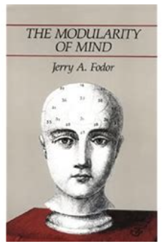
Modelling – system and environment
System might be the information and thoughts for a particular task at hand.
The environment, E, relevant to system S, corresponds to information and thoughts a person can have in general.
Maybe related to Fodor’s ideas?
Modularity of mind.
Higher cognition is isotropic and Quinean.
Notes:
The person can try to consider the problem in isolation, but, depending on the problem and the person’s ability to focus, problem specific information will interact with the person’s general knowledge (cf. Fodor, 1983).

Slide 22
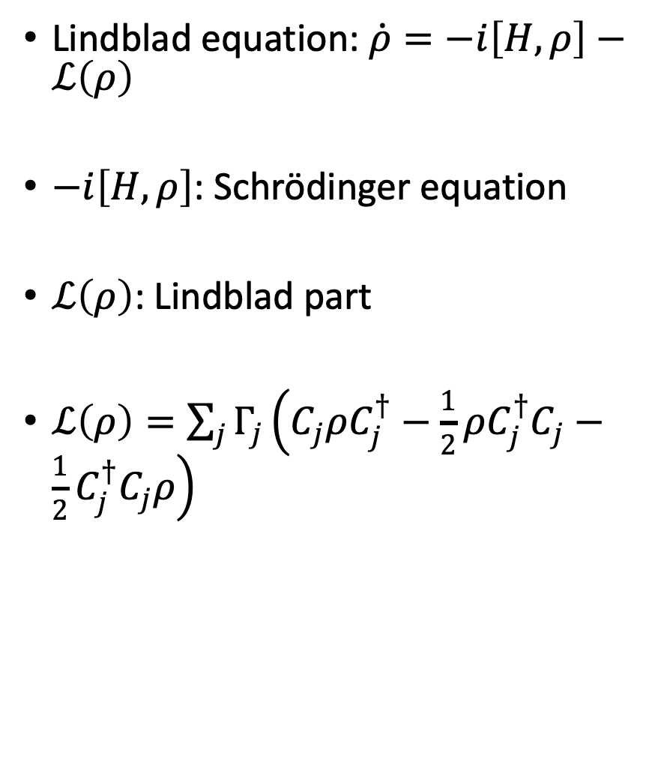
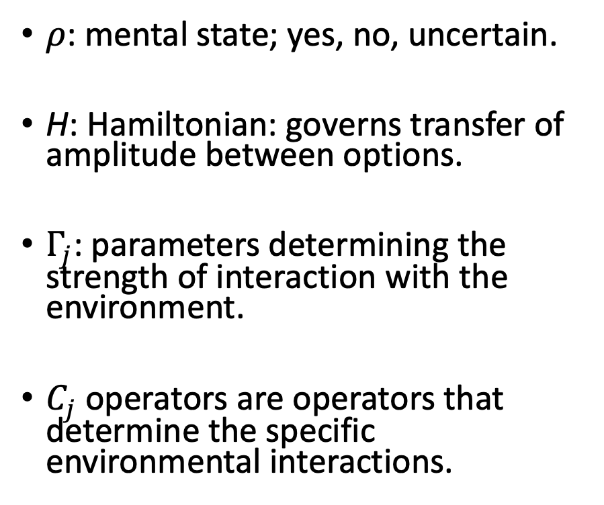
Modelling
Lindblad equation: $\dot{ρ}=−i\left[H,ρ\right]−ℒ\left(ρ\right)$
$−i\left[H,ρ\right]$: Schrödinger equation
$ℒ\left(ρ\right)$: Lindblad part
$ℒ\left(ρ\right)=\sum_{j}{Γ_{j}}\left(C_{j}ρC_{j}^{†}−\frac{1}{2}ρC_{j}^{†}C_{j}−\frac{1}{2}C_{j}^{†}C_{j}ρ\right)$
$ρ$: mental state; yes, no, uncertain.
H: Hamiltonian: governs transfer of amplitude between options.
$Γ_{j}$: parameters determining the strength of interaction with the environment.
$C_{j}$ operators are operators that determine the specific environmental interactions.
Notes:
S equation: quantum character (oscillation) retained indefinitely.
L: When $ℒ\left(I\right)=0$, then the Lindblad operator is called unital and it can be shown that purity (i.e., degree of quantumness) is monotonically decreasing with time (Lidar et al., 2006).

Slide 23
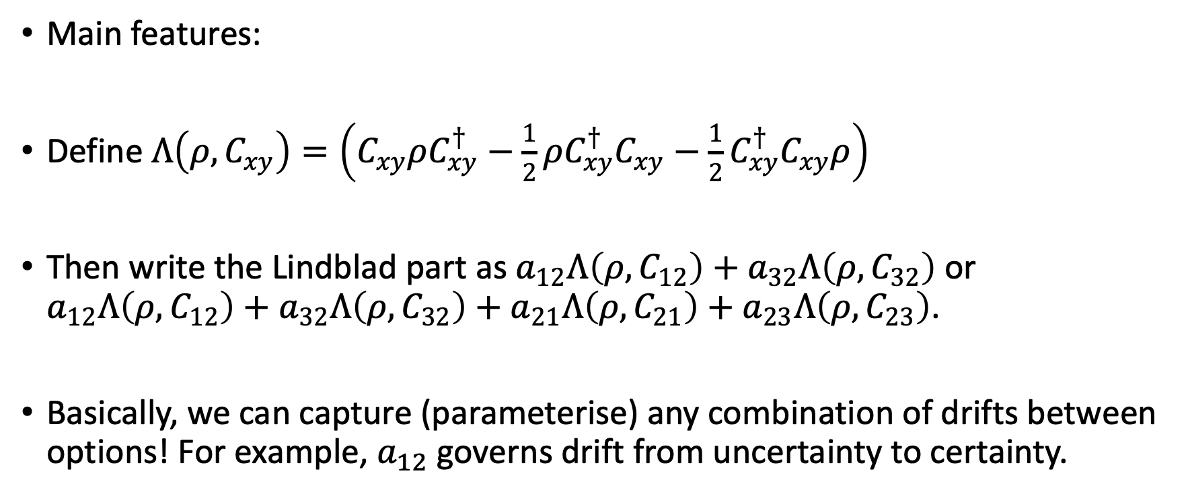
Modelling
Main features:
Define $Λ\left(ρ,C_{xy}\right)=\left(C_{xy}ρC_{xy}^{†}−\frac{1}{2}ρC_{xy}^{†}C_{xy}−\frac{1}{2}C_{xy}^{†}C_{xy}ρ\right)$
Then write the Lindblad part as $a_{12}Λ\left(ρ,C_{12}\right)+a_{32}Λ\left(ρ,C_{32}\right)$ or $a_{12}Λ\left(ρ,C_{12}\right)+a_{32}Λ\left(ρ,C_{32}\right)+a_{21}Λ\left(ρ,C_{21}\right)+a_{23}Λ\left(ρ,C_{23}\right)$.
Basically, we can capture (parameterise) any combination of drifts between options! For example, $a_{12}$ governs drift from uncertainty to certainty.
Notes:
Irina Basieva came up with the model.
Parameters $a_{12}$, $a_{32}$, $a_{21}$, $a_{23}$ are analogous to drift rates in a standard drift diffusion formalism

Slide 24
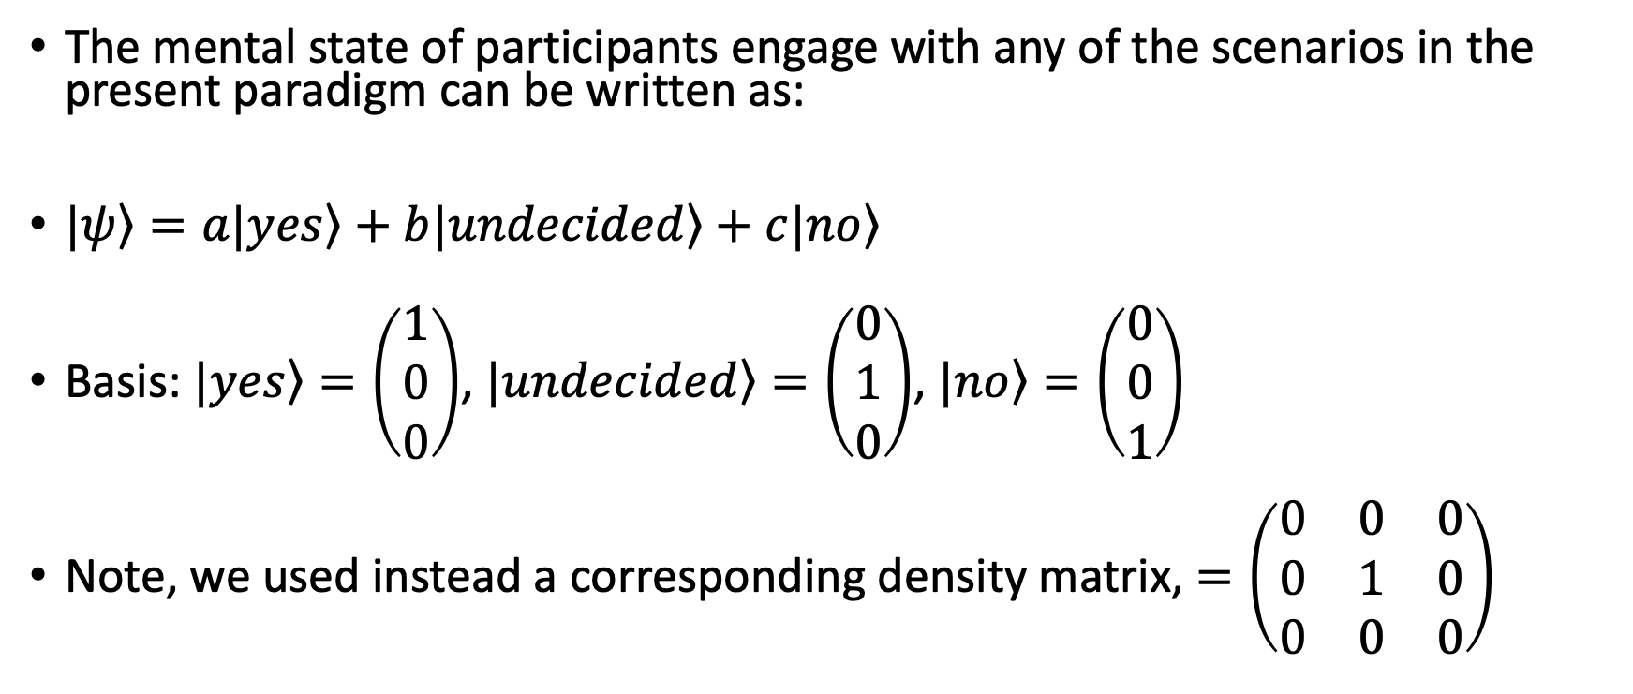
Quantum approach
The mental state of participants engage with any of the scenarios in the present paradigm can be written as:
$\left.|ψ\right\rangle =a\left.|yes\right\rangle +b\left.|undecided\right\rangle +c\left.|no\right\rangle$
Basis: $\left.|yes\right\rangle =\left(\begin{matrix}1 \\ 0 \\ 0\end{matrix}\right)$, $\left.|undecided\right\rangle =\left(\begin{matrix}0 \\ 1 \\ 0\end{matrix}\right)$, $\left.|no\right\rangle =\left(\begin{matrix}0 \\ 0 \\ 1\end{matrix}\right)$
Note, we used instead a corresponding density matrix, $=\left(\begin{matrix}0 & 0 & 0 \\ 0 & 1 & 0 \\ 0 & 0 & 0\end{matrix}\right)$

Slide 25
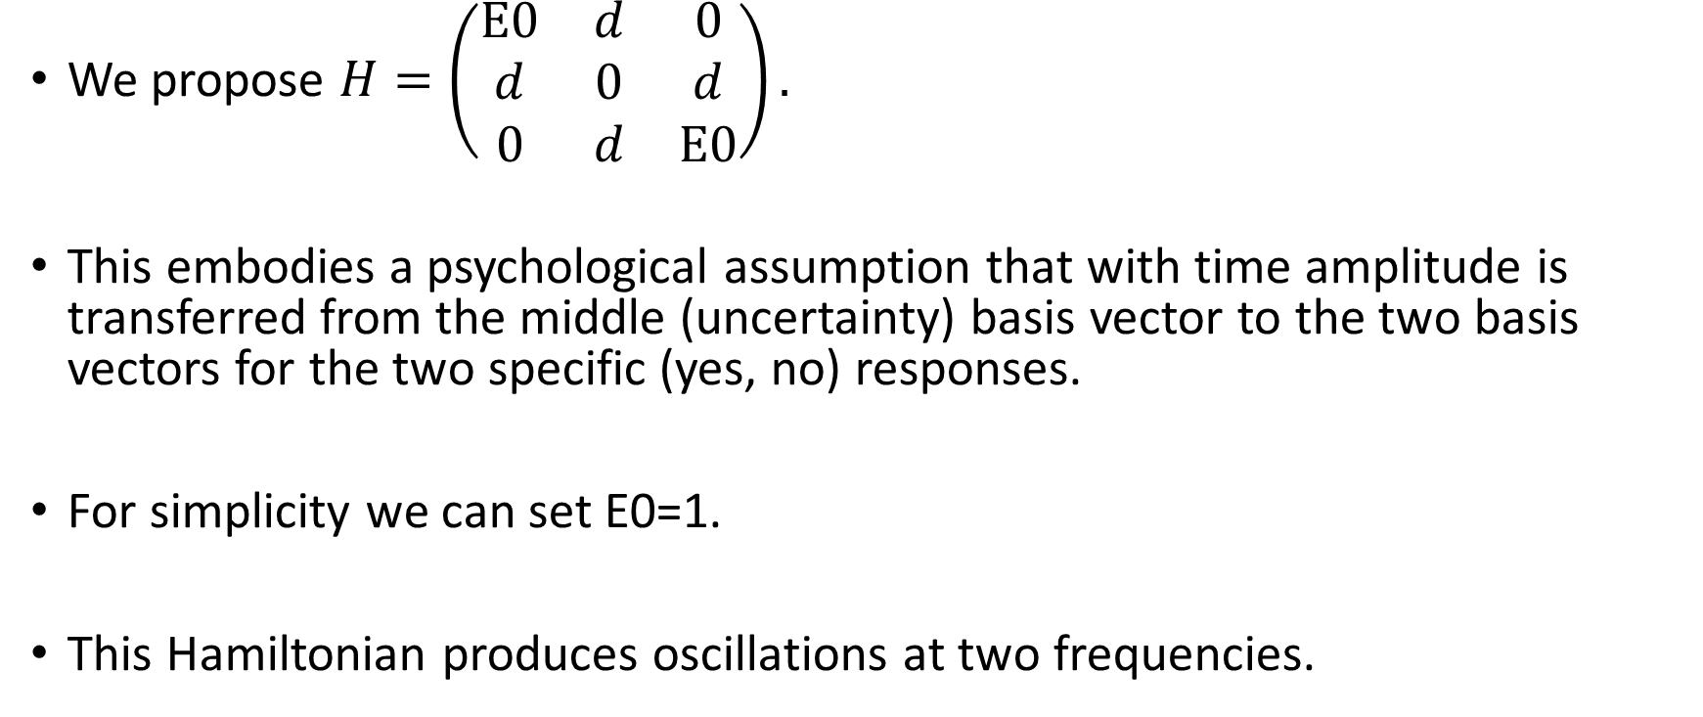
Quantum approach – unitary part
We propose $H=\left(\begin{matrix}E0 & d & 0 \\ d & 0 & d \\ 0 & d & E0\end{matrix}\right).$
This embodies a psychological assumption that with time amplitude is transferred from the middle (uncertainty) basis vector to the two basis vectors for the two specific (yes, no) responses.
For simplicity we can set E0=1.
This Hamiltonian produces oscillations at two frequencies.

Slide 26
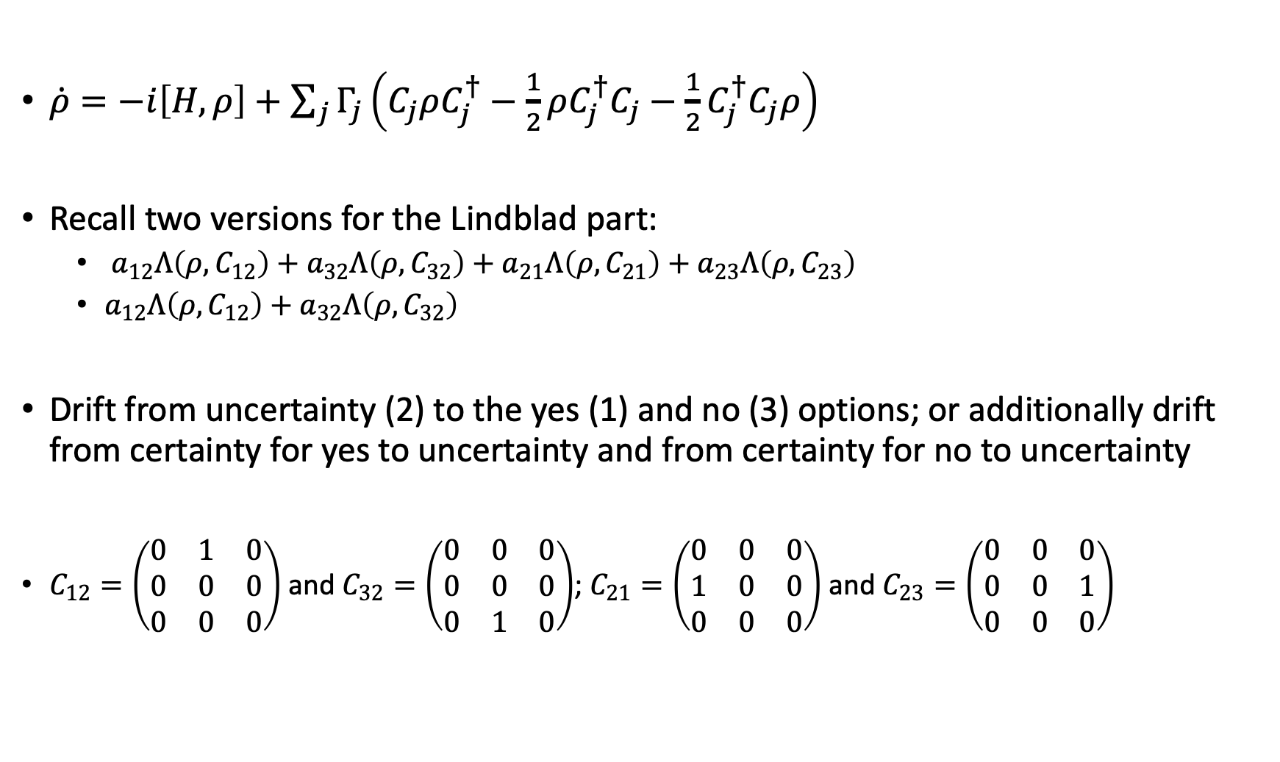
Quantum approach – open systems part
$\dot{ρ}=−i\left[H,ρ\right]+\sum_{j}{Γ_{j}}\left(C_{j}ρC_{j}^{†}−\frac{1}{2}ρC_{j}^{†}C_{j}−\frac{1}{2}C_{j}^{†}C_{j}ρ\right)$
Recall two versions for the Lindblad part:
$a_{12}Λ\left(ρ,C_{12}\right)+a_{32}Λ\left(ρ,C_{32}\right)+a_{21}Λ\left(ρ,C_{21}\right)+a_{23}Λ\left(ρ,C_{23}\right)$
$a_{12}Λ\left(ρ,C_{12}\right)+a_{32}Λ\left(ρ,C_{32}\right)$
Drift from uncertainty (2) to the yes (1) and no (3) options; or additionally drift from certainty for yes to uncertainty and from certainty for no to uncertainty
$C_{12}=\left(\begin{matrix}0 & 1 & 0 \\ 0 & 0 & 0 \\ 0 & 0 & 0\end{matrix}\right)$ and $C_{32}=\left(\begin{matrix}0 & 0 & 0 \\ 0 & 0 & 0 \\ 0 & 1 & 0\end{matrix}\right)$; $C_{21}=\left(\begin{matrix}0 & 0 & 0 \\ 1 & 0 & 0 \\ 0 & 0 & 0\end{matrix}\right)$ and $C_{23}=\left(\begin{matrix}0 & 0 & 0 \\ 0 & 0 & 1 \\ 0 & 0 & 0\end{matrix}\right)$

Slide 27
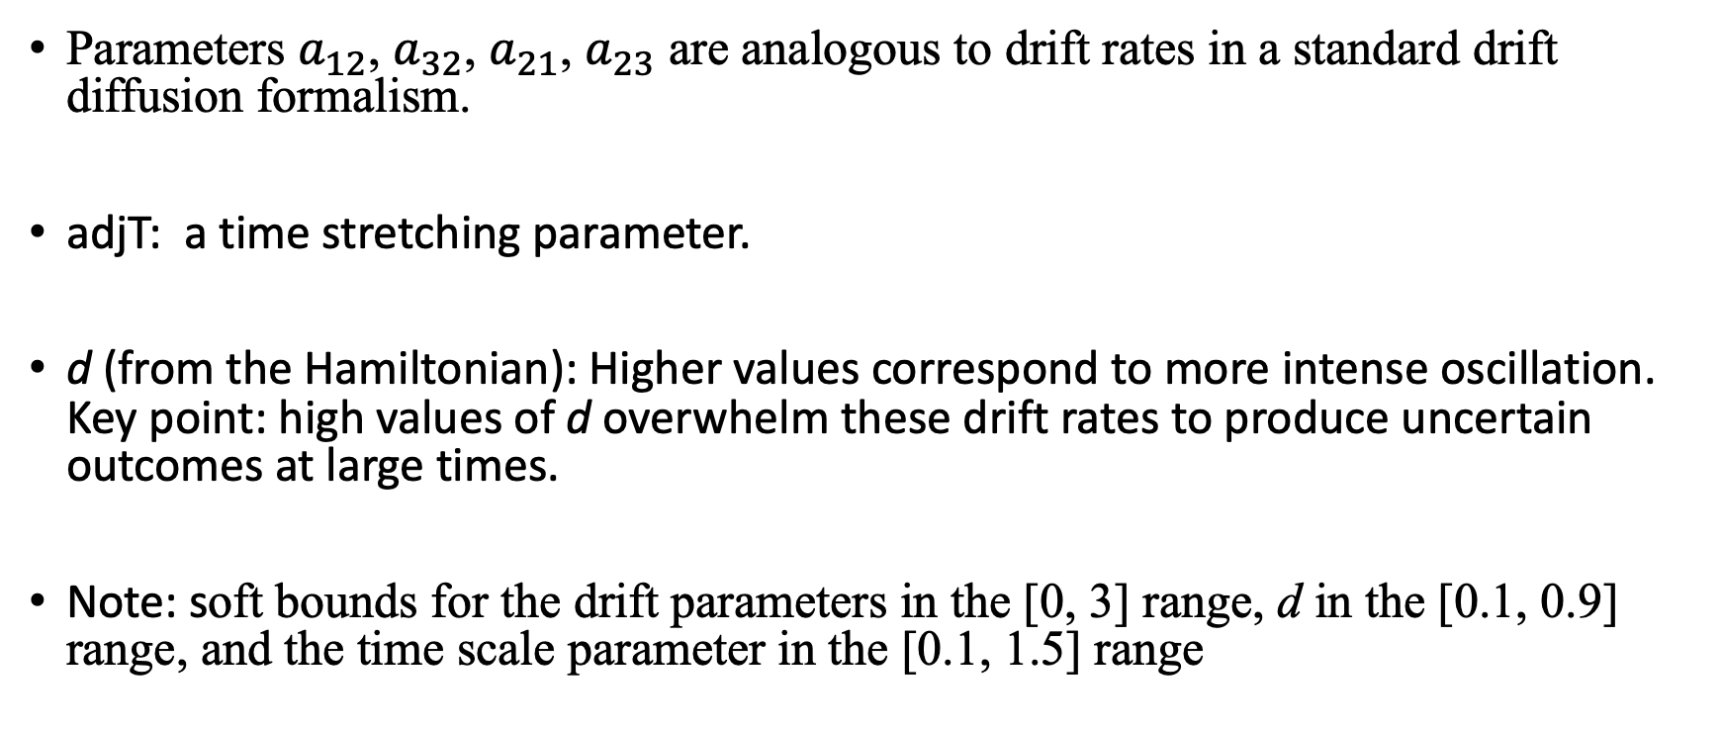
Quantum approach – open systems part
Parameters $a_{12}$, $a_{32}$, $a_{21}$, $a_{23}$ are analogous to drift rates in a standard drift diffusion formalism.
adjT: a time stretching parameter.
d (from the Hamiltonian): Higher values correspond to more intense oscillation. Key point: high values of d overwhelm these drift rates to produce uncertain outcomes at large times.
Note: soft bounds for the drift parameters in the [0, 3] range, d in the [0.1, 0.9] range, and the time scale parameter in the [0.1, 1.5] range

Slide 28
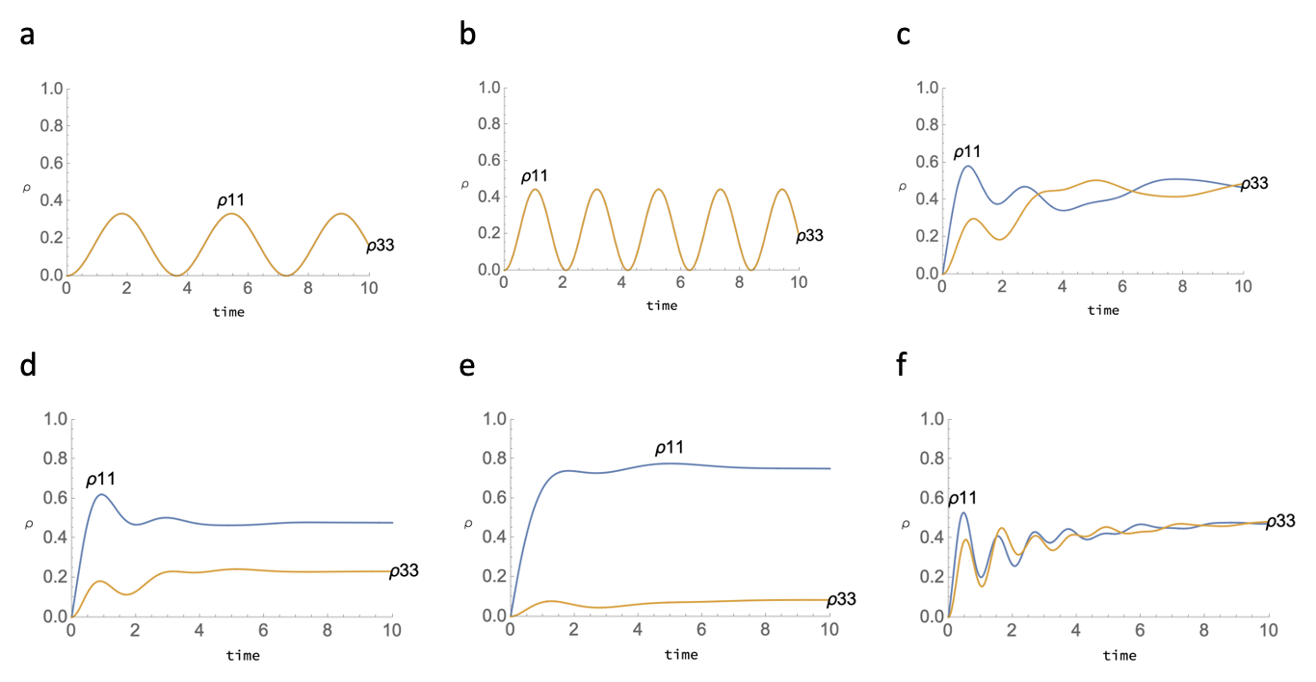
Modelling
Complex interaction between ‘oscillation’ and ‘open system’ parameters.
(a): d=0.5, all drifts=0.
(b): d=1.
(c): a₁₂=1
(d): a₂₃=1
(e): d=0.5 (relative to panel (d), observe
how reducing the strength of oscillations
results in stabilization at more
extreme levels).
(f): a₁₂=1, a₂₃=0, d=2 (this illustrates
gradually quenched oscillations).
Notes:
evidence accumulation towards particular options is balanced against the degree of intrinsic oscillation in the system

Slide 29
Model features
Evidence accumulation towards particular options is balanced against the degree of intrinsic oscillation in the system
There are no thresholds and no discrete decision points (contrasting with e.g. sequential sampling models).
Drifts can be specified towards any number (and any combination) of options.
Notes:
Note, other findings particularly from neuroscience, however, also support decision-to-threshold models (see Gold & Shadlen, 2007, for a review). It seems, therefore, that there is evidence in the literature for both kinds of processes

Slide 30
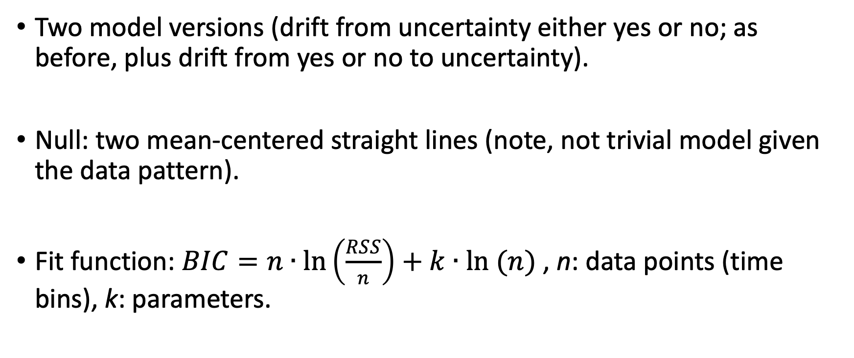
Model fits
Two model versions (drift from uncertainty either yes or no; as before, plus drift from yes or no to uncertainty).
Null: two mean-centered straight lines (note, not trivial model given the data pattern).
Fit function: $BIC=n∙\ln\left(\frac{RSS}{n}\right)+k∙ln (n)$ , n: data points (time bins), k: parameters.

Slide 31
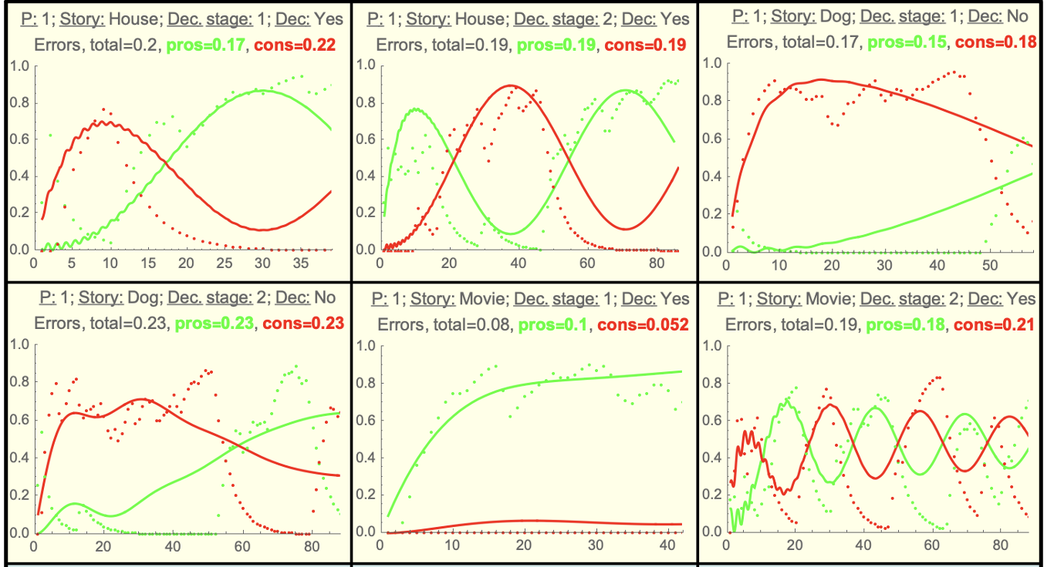
Variable | null BIC - QOSyD4 BIC | null BIC - QOSyD6 BIC | 6 param. relative to 4 param.
Decision 1, Bin 200 ms
Instances of better fit (BIC) | 98 | 60 | 10
Aggregate BIC | 1599.37 | 281.84 | -1317.53
Decision 2, Bin 200ms
Instances of better fit (BIC) | 104 | 70 | 39
Aggregate BIC | 2621.46 | 914.36 | -1707.10
Notes:
Both models better than null; simpler model better.
We can have fun spending the next 3 hours going through all 270 graphs…

Slide 32
Summary
Reasonable fit for the model with two drifts (away from uncertainty towards either option).
The idea of intrinsic oscillation balanced with drifts is, as far as we know, novel, as well as the possibilities of:
Indefinite oscillation
Drifts towards complex combinations of options
We would like further explore in decision making

Slide 33
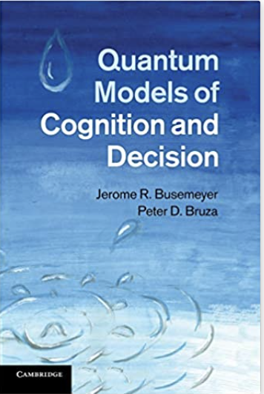
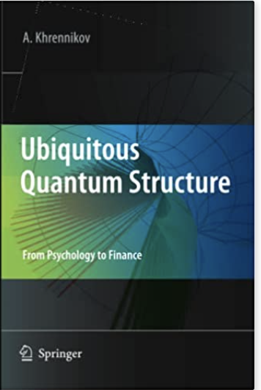
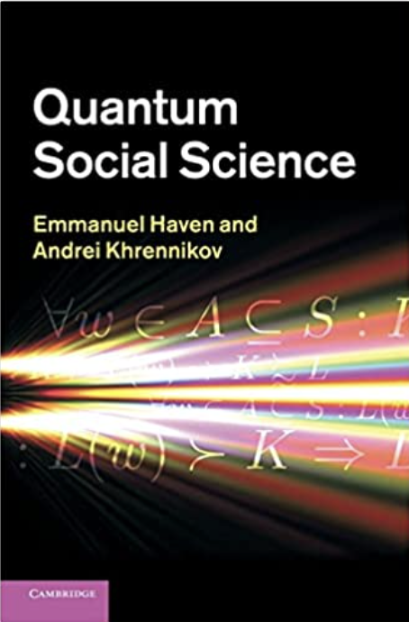
Thank you!
Rosner, A., Basieva, I., Barque-Duran, A., Glöckner, A., von Helversen, B., Khrennikov, A., & Pothos, E. M. (2022). Ambivalence in cognition. Cognitive Psychology, 134, 101464.
Pothos, E. M. & Busemeyer, J. M. (2022). Quantum cognition. Annual Review of Psychology, 73, 749-778.

Slide 34
Modelling – system and environment
Interaction between focus for a task at hand and ‘general knowledge’ has intrigued psychologists for a long time.
There are few concrete modeling proposals (e.g., Murphy & Medin, 1985, Psychological Review).
Open quantum systems represent an interesting approach, because of a promise to take into account the influence of general knowledge, without directly modeling it.
Notes:
Murphy, G. L.., Medin, D. L. (1985). The Role of Theories in Conceptual Coherence, Psychological Review, 92, 289-316.

Slide 35
Modelling – key features
No thresholds and no discrete decision points.
The model outputs probabilities for different options.
Drift rates for different options (or option combinations) can be separated out into several components, which are independently manipulated.
The number of states can also be flexibly manipulated.
Evidence accumulation towards particular options is balanced against the degree of intrinsic oscillation in the system (Schrödinger part vs. the Lindblad part).
Notes:
Inferring decisions from stabilization is not uncommon in the literature and, for example, is assumed by various models such as those of Glöckner and Betsch (2008), McClelland et al. (2014), or Thagard (1989

Slide 36
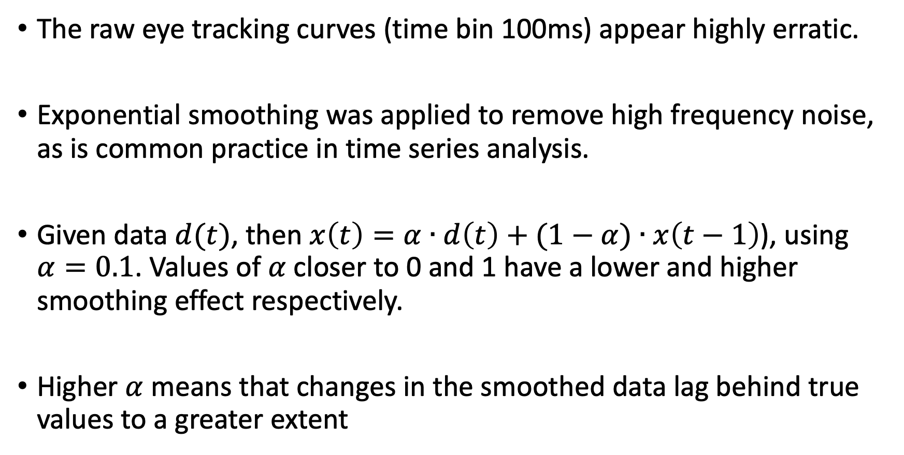
Smoothing
The raw eye tracking curves (time bin 100ms) appear highly erratic.
Exponential smoothing was applied to remove high frequency noise, as is common practice in time series analysis.
Given data $d(t)$, then $x\left(t\right)=α∙d\left(t\right)+(1−α)∙x\left(t−1\right)$), using $α=0.1$. Values of $α$ closer to 0 and 1 have a lower and higher smoothing effect respectively.
Higher $α$ means that changes in the smoothed data lag behind true values to a greater extent

