Slide 1
Modelling energy transitions: transition risks and changes in energy return on energy investment in a stock-flow consistent, input-output modelling framework.
Andrew Jackson & Tim Jackson
Centre for the Understanding of Sustainable Prosperity (CUSP), University of Surrey

Slide 2
Presentation outline
Background information and research question.
The Stock-Flow Consistent, (SFC) Input-Output model TranSim (TRANsition SIMulation).
Model simulation results.
Conclusions and policy implications.

Slide 3
1. Background information and research question
The TranSim model: An SFC-IO model for the study of transition risks

Slide 4
Background information: Competing narratives around net zero transitions
Energy transition narratives:
Higher growth: massive increase in green investment leads to growth.
Lower growth: increase in green investment crowds out other more productive investments and leads to less growth.
Financing issues: Can we finance the required investment? How do we finance these investments? What are the macro implications?
Transition risks:
  Financial instability: transition may negatively affect economy via financial markets (stranded assets).
  Stagnation/inflation: reduction in efficiency of energy sector (Energy return on energy invested – EROI) due to transition will lead to inflation and lower growth.

Slide 5
Research question
Research Question: What are the macroeconomic effects of different types of energy technology transitions?
In particular, we want to understand the impacts from:
Changes in investment, investment financing, investment financing timing.
Transition risks:
  Energy return on energy investment (EROI): Change in production techniques: capital intensities, intermediate goods requirements. Impact on energy prices.
  Stranded assets: Loan defaults, equity prices.
Speed of transition. Expectations of transition pathway.
Crucially, we want to understand the interactions between these factors. Are there any unexpected impacts?
Method: Stock Flow Consistent Input-Output (SFC-IO) model

Slide 6
2. The SFC-IO TranSim model
The TranSim model: An SFC-IO model for the study of transition risks

Slide 7
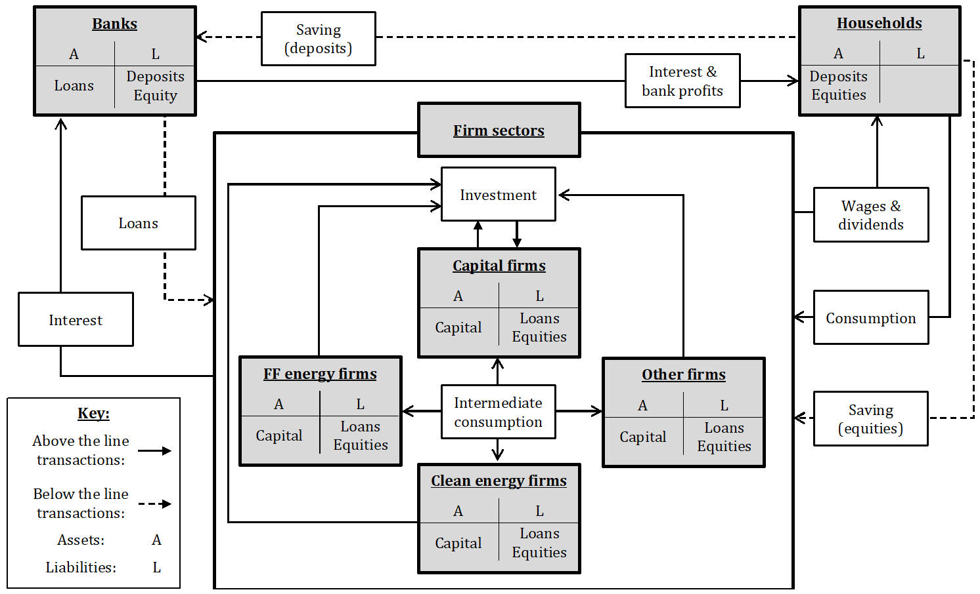
The SFC-IO model: TranSim (Transition Simulation)
Notes:
550 equations
Pure credit
6 sectors

Slide 8
The SFC-IO model: TranSim (Transition Simulation)
Notes:
Firms
4 firm sectors
Firms produce intermediate goods which they sell to themselves, via IO models, and consumption goods to HH.
require capital, labour, and intermediate goods to produce outputs
Capital is very important in this model. Each vintage produced in each period has embedded a level of labour and intimidate goods requirements
These change over time in response to productivity growth and changes in relative prices.
Firms finance themselves by 1 ) borrowing from banks – loans have sectoral specific interest rates
2) Issuing equities, bought by HH
3) Retained earnings. Breakdown depends on relative costs

Slide 9
The model: fixed capital
The capital sector produces a new vintage of fixed capital each year that lasts for an exogenously determined number of years (output declines with depreciation).
Technological characteristics of each new vintage are endogenously determined - intermediate goods requirements depend on relative prices, labour productivity depends on growth.
Technological characteristics are fixed for lifespan of capital asset, but can vary between capital vintages. Hence production process and economic growth alters as new capital produced and older capital depreciates.
Hence significant hysteresis in production process, costs, etc. Investment pace (in part) determines productivity growth (Boucekkine et al., 2011)
Different sectors have very different input requirements, so transitions cause a change in the structure of demand and aggregate productivities.

Slide 10
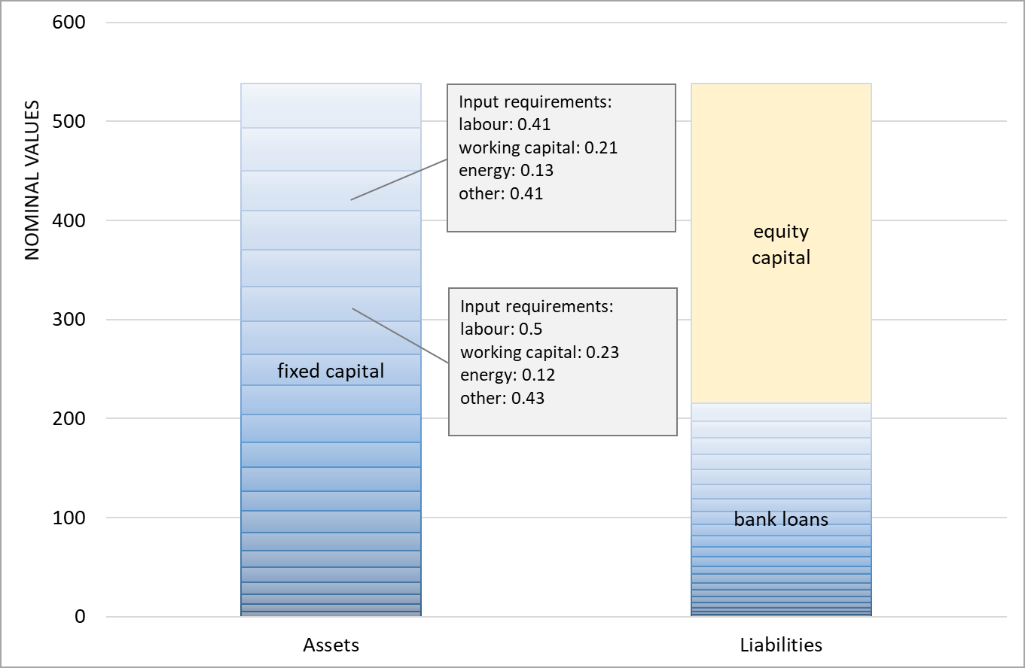
Illustrative firm sector balance sheet
t₍₋₁₎
t₍₋₂₎
t₍₋₃₎
t₍₋₄₎
t₍₋₅₎
t₍₋₆₎
…
Notes:
1 a matrix for every vintage of capital in the model.
Which means that there are 40 a matrixes in total
Actual IC requirements for each firm determined by weighting each capital vintages a matrix by quantity of remaining capital, and taking the average.

Slide 11
The SFC-IO model: TranSim (Transition Simulation)
Notes:
HH
HH sell labour to firms in exchange for a wage.
They also receive interest income on deposits and dividends from firms and the banking sector.
HH consumption function ensures HH consume less out of profits than out of wage incomes.
Relative HH consumption between the different goods depends on relative prices, and is determined by an almost ideal demand system so the higher energy prices the less energy is consumed, but demand is relatively inelastic.
Any income that isn’t spent on goods is saved in equites and deposits….HH allocate their wealth between the different assets based on Tobinesque principles

Slide 12
The model: households
Total consumption is a function of expected real disposable wage (yd_{w}^{e}) and profit (yd_{f}^{e}) income, an inflation loss/gain term (π_{l/g}) and real wealth (v₍₋₁₎):
c = ψ₀ + (ψ_{w} ∙ yd_{w}^{e}) + (ψ_{f} ∙ yd_{f}^{e}) - (ψ_{π} ∙ π_{l/g}) + (ψ_{v} ∙ v₍₋₁₎)
The proportion of household spending on each good type (c_{PROP j}) is determined as a function of an relative prices, using a modified version of the Almost Ideal Demand System (AIDS) (Deaton and Muellbauer, 1980).
c_{PROP j} = λ_{AIDS j} + λ_{AIDS 11} ∙ ln(p_{e}) + λ_{AIDS 12} ∙ ln(p_{o}) + λ_{AIDS 13} ∙ ln(p_{k})
The demand for financial assets by households follows Tobin (1969), and depends on the relative rate of return on money and firm equities:
p_{E} _{j} = V₍₋₁₎ ∙ [λ_{j} + (λ_{j1} ∙ r_{M}) + (λ_{j2} ∙ r_{FF} _{e}) + (λ_{j3} ∙ r_{G} _{e}) + (λ_{j4} ∙ r_{E} _{o}) + (λ_{j5} ∙ r_{E} _{k}) ] / e^{D} _{j}
M^{H} = V - (p_{E o} ∙ e^{D} _{o}) - (p_{E k} ∙ e^{D} _{k}) - (p_{E g} ∙ e^{D} _{g}) - (p_{E ff} ∙ e^{D} _{ff})

Slide 13
The SFC-IO model: TranSim (Transition Simulation)
Notes:
Banks
Lend to firms to finance investment, and issues deposits which are held by HH.
Banks target 10% Cap adequacy ratio, when firms default on loans due to debt burden increasing (or when they exit completely) bank capital is reduced, and this leads an endogenous increase in interest rates.

Slide 14
The model: banks
Banks lending creates deposits, banks charge interest on loans and pay interest on deposits.
Banks set the loan deposit spread in order to achieve a particular capital adequacy ratio (approximately 10%).
An increase in loans default by firms leads to an reduction in capital adequacy ratio and so an increase in interest rates on loans.
Banks also adjust the interest rate on loans to individual sectors, depending on the expected default rate on loans in each sector:
r_{L j} = r_{M} + spread_{bank} + spread _{j}
Firm default rate is a non linear function of debt burden (ratio of sector’s interest and principal payments to income net of production costs).

Slide 15
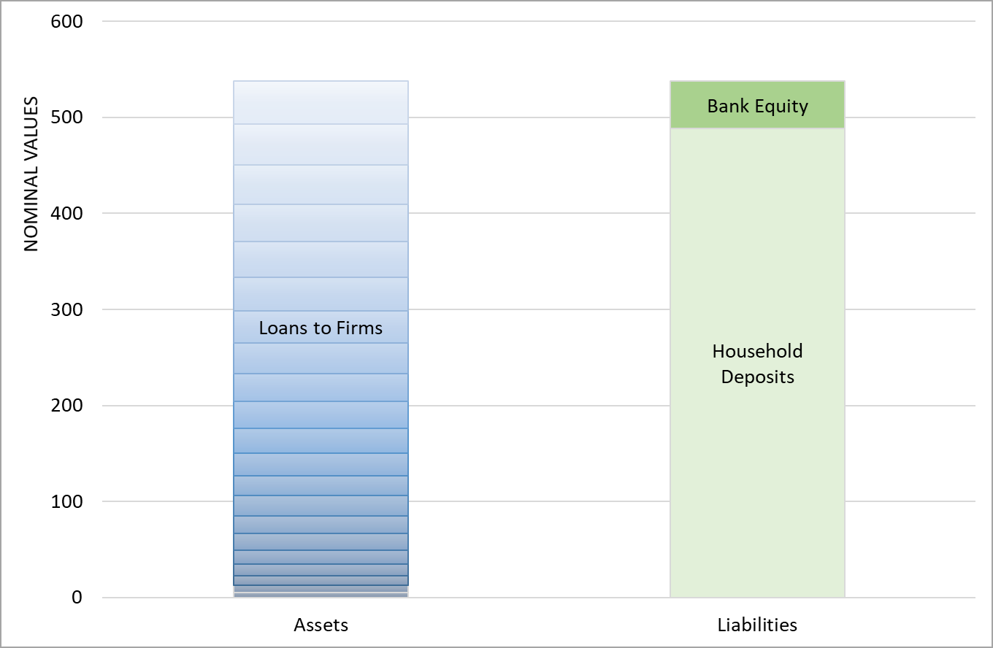
Illustrative bank sector balance sheet

Slide 16
The SFC-IO model: TranSim (Transition Simulation)
Notes:
Calibration
Firm sectors calibrated on IO tables supplemented with official UK government data for energy sector costs (capital, IC, labour)
Gives us system EROI of around 7 which is close to Brockway et al.

Slide 17
3. Model simulation results
The TranSim model: An SFC-IO model for the study of transition risks
Notes:
Simulation: fast (15 year) transition
Reasons – larger impact, likely to be necessary
Compare with slower transition

Slide 18
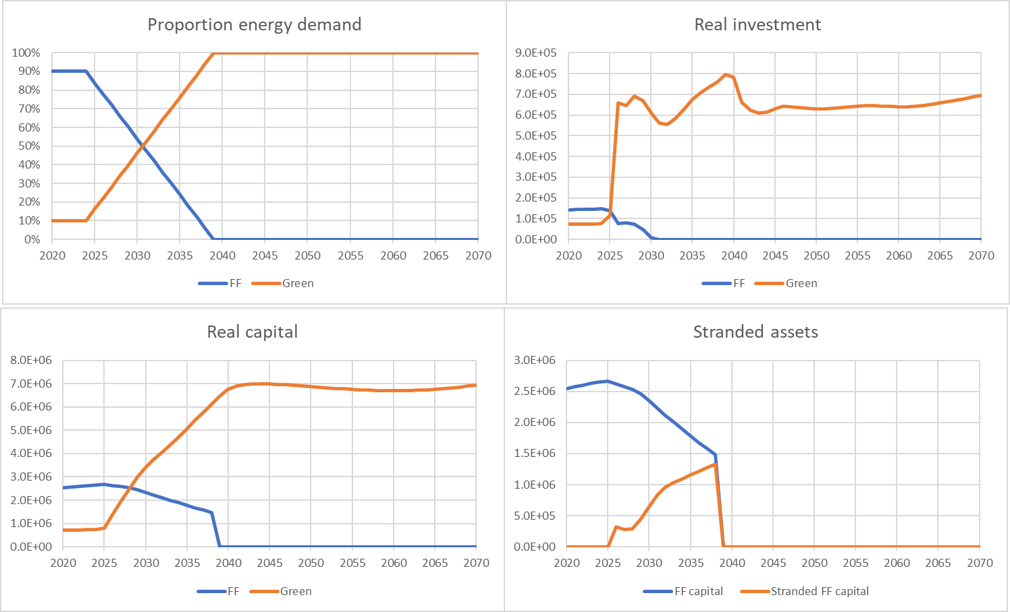
Energy sector impacts (15 year transition)

Slide 19
Total system EROI

Slide 20
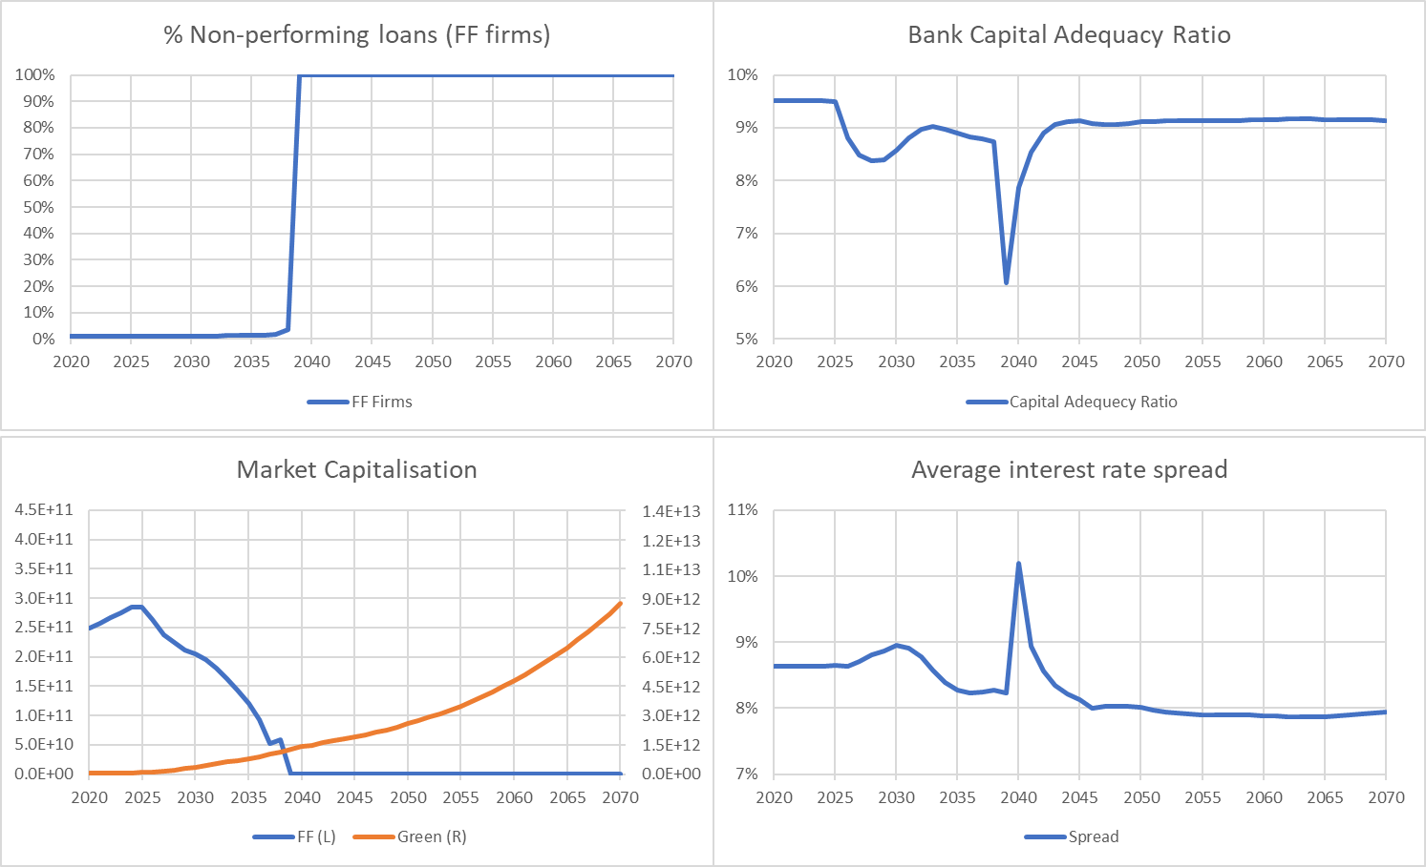
Energy sector/financial impacts (15 year transition)

Slide 21
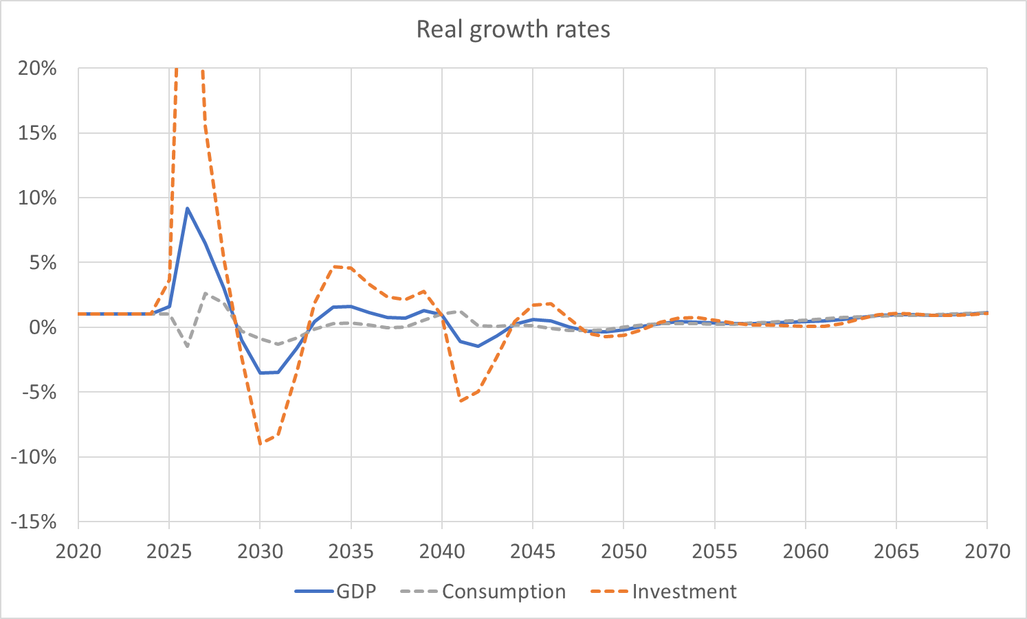
Macroeconomic impacts (15 year transition)
45% max investment growth rate
1% steady state growth rate
1
2
3
4
5

Slide 22
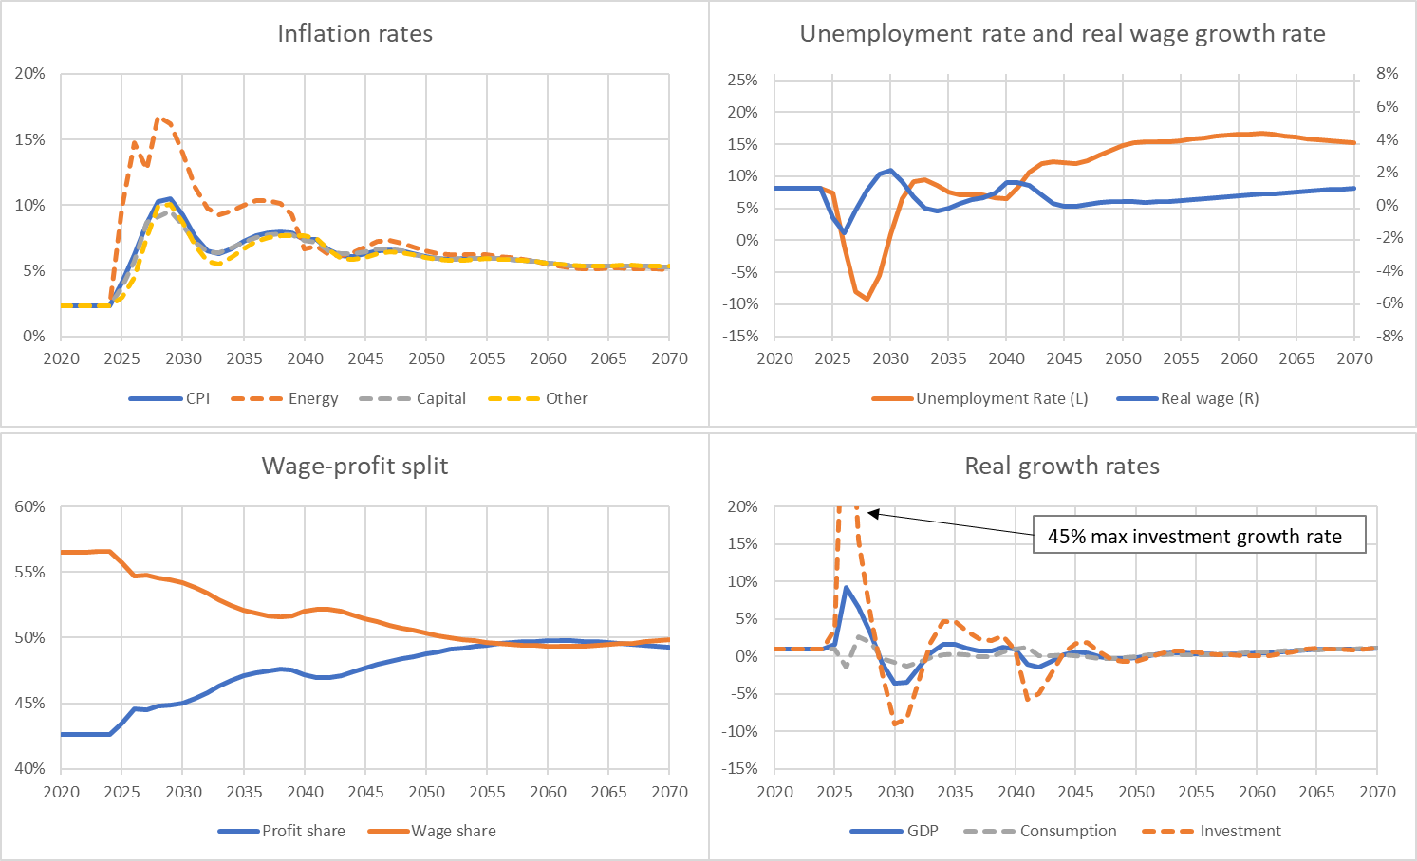
Macroeconomic impacts (15 year transition)
Notes:
1. Investment boom:
- Initial investment in green and capital firm capital increases growth.
2. Recession:
- Investment and changes in EROI affect energy prices and inflation.
- Higher prices then negatively affect real incomes, wealth and output.
- Asset stranding and fossil fuel firm affects asset prices, increases loan defaults, increases interest rates (which also affects prices and defaults) and lowers investment.
3. Recovery:
- Eventually, inflation stabilises (albeit at a higher level) as do asset prices, and defaults return to their normal level.
- Consequently real incomes and wealth stop falling, and the recovery begins

Slide 23
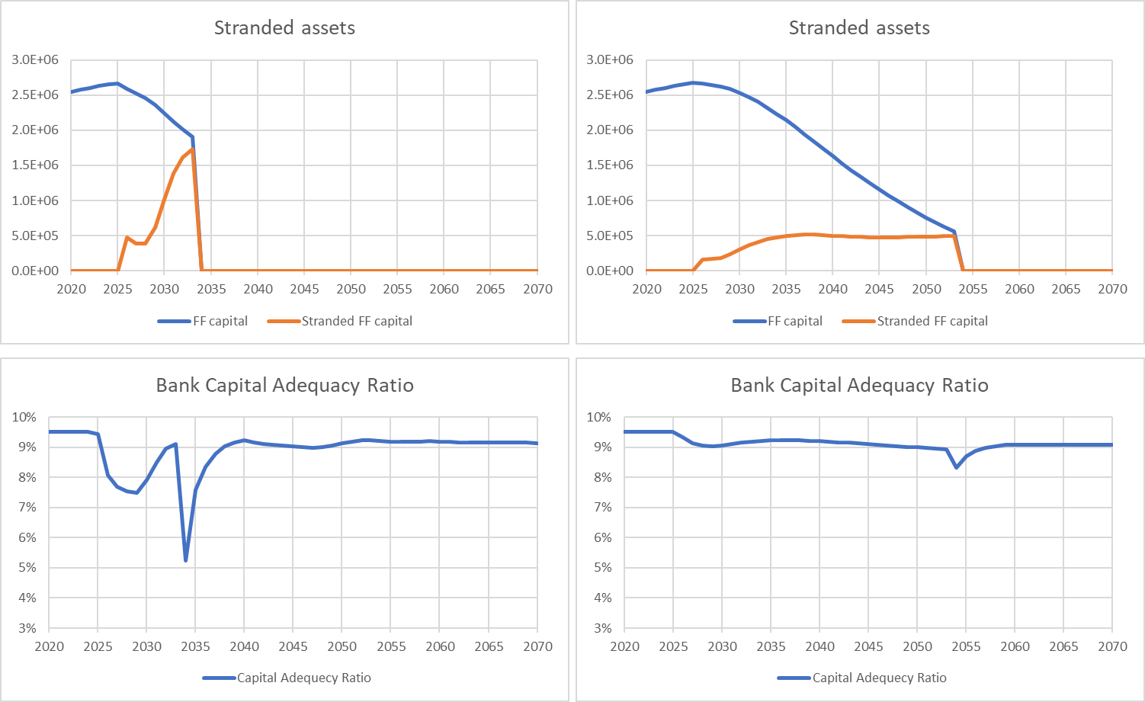
Fast (10 year) vs slow (30 year) transition
Fast (10 Year) | Slow (30 year)

Slide 24
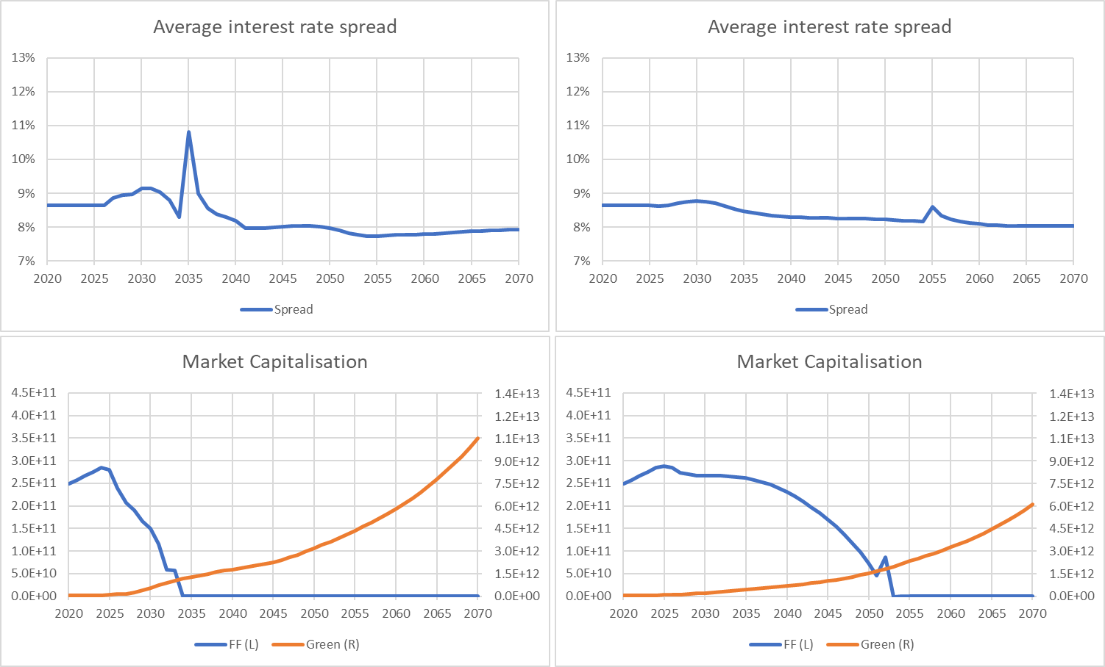
Fast/slow transition comparison
Fast (10 Year) | Slow (30 year)

Slide 25
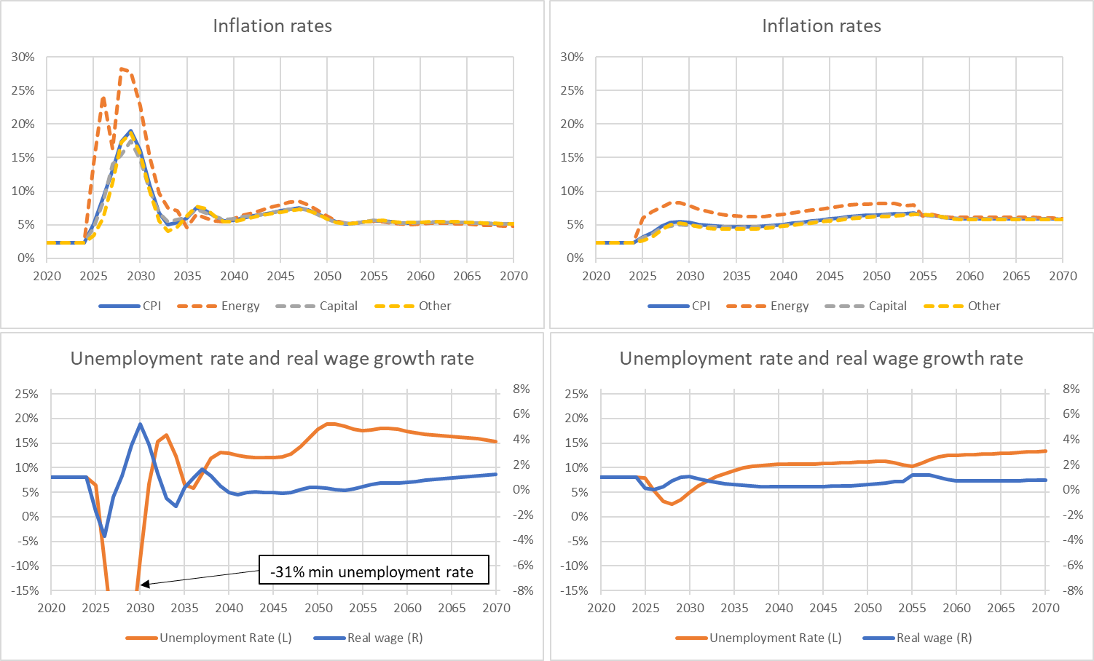
Fast/slow transition comparison
Fast (10 Year) | Slow (30 year)

Slide 26
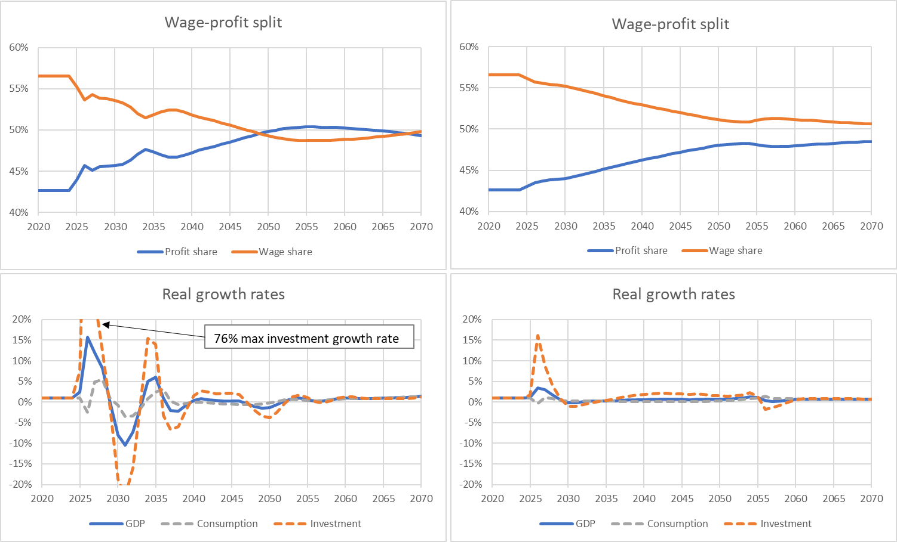
Fast/slow transition comparison
Fast (10 Year) | Slow (30 year)

Slide 27
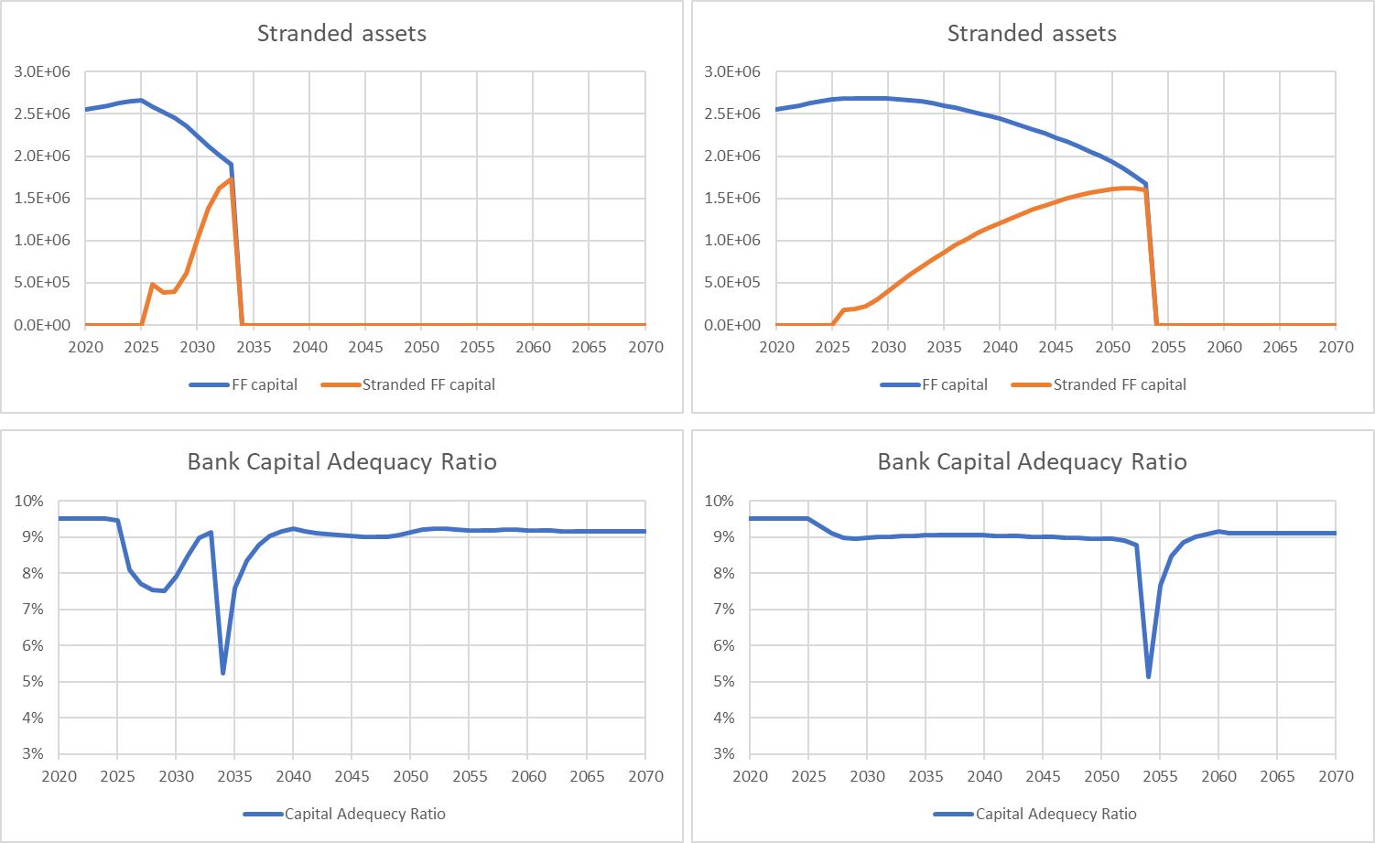
Fast vs slow transition + BaU expectations comparison
Fast (10 Year) | Slow (30 year) + wrong expectations
In the ‘wrong expectations’ simulation fossil fuel firms and financial market participants are less able to anticipate the transition.

Slide 28
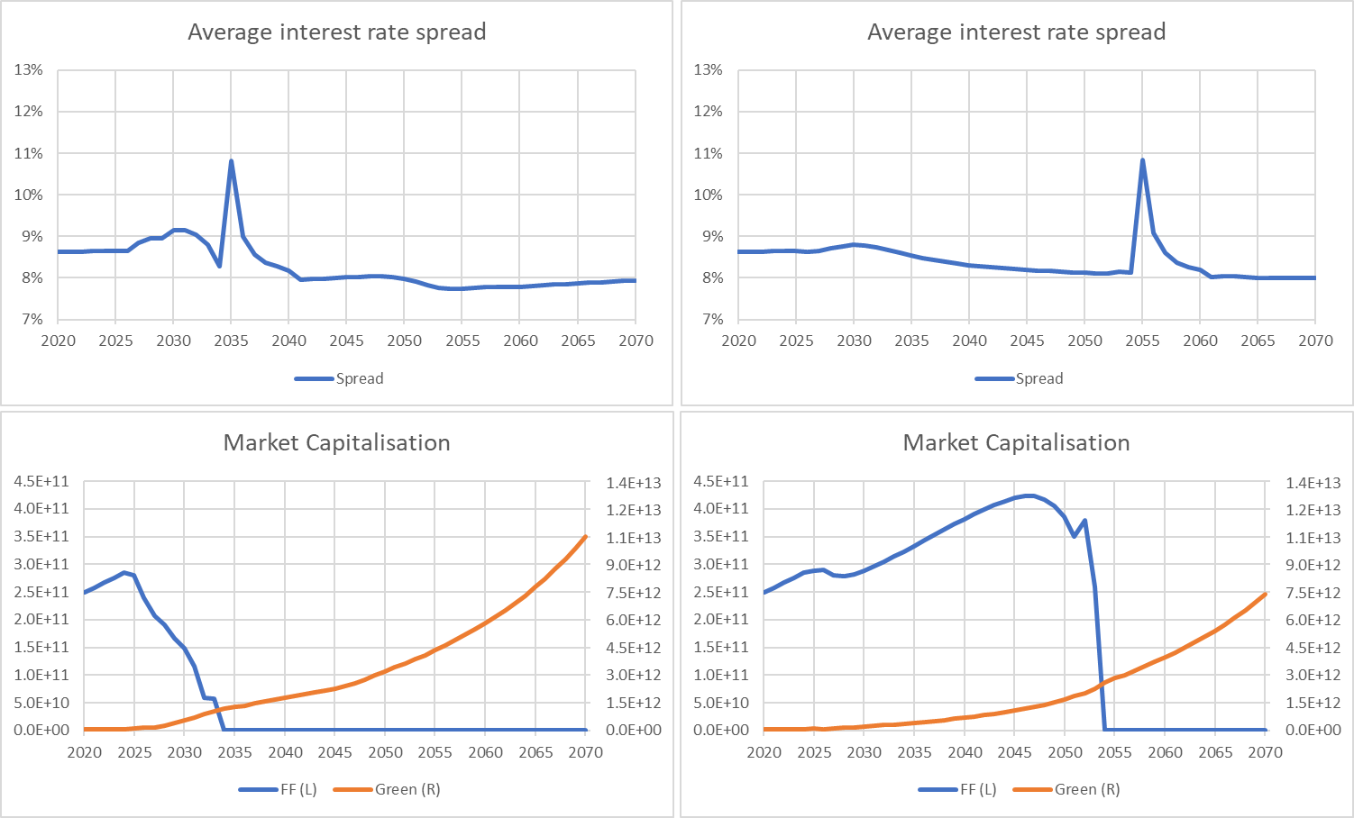
Fast/slow transition + BaU expectations comparison
Fast (10 Year) | Slow (30 year) + wrong expectations

Slide 29
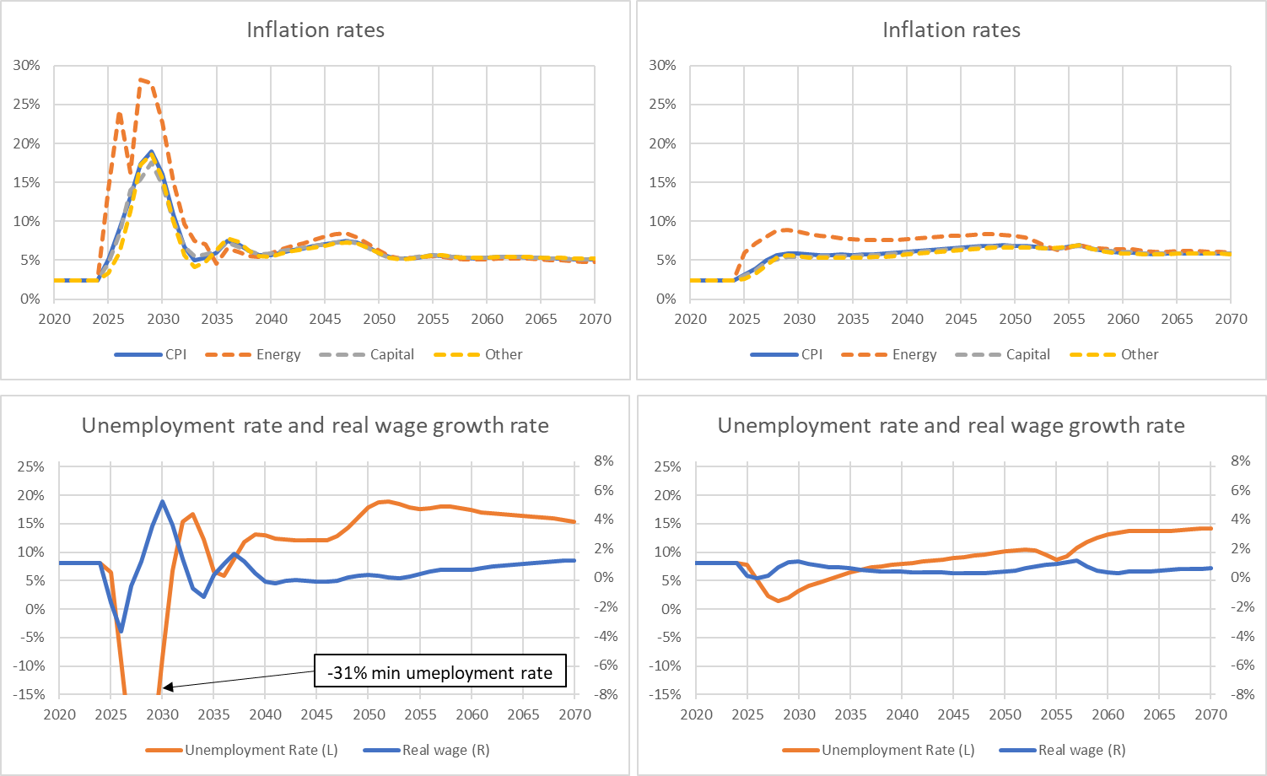
Fast/slow transition + BaU expectations comparison
Fast (10 Year) | Slow (30 year) + wrong expectations

Slide 30
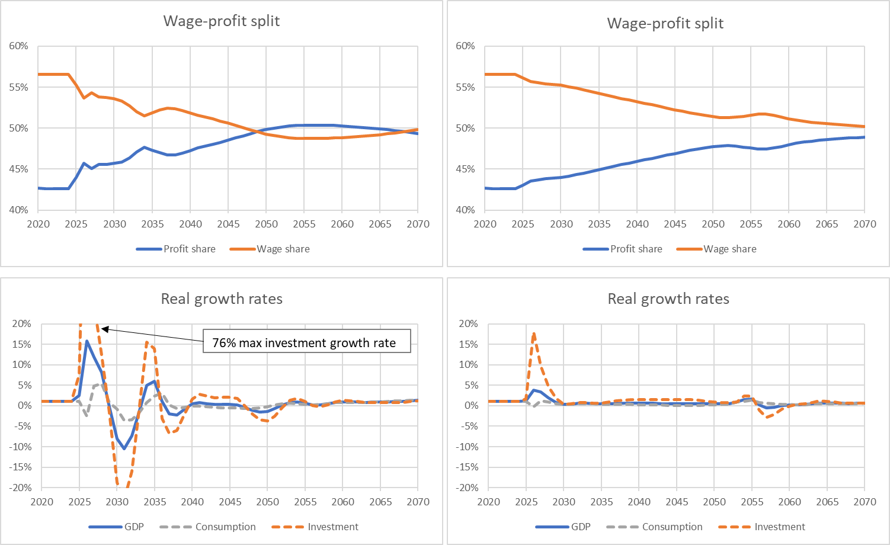
Fast/slow transition + BaU expectations comparison
Fast (10 Year) | Slow (30 year) + wrong expectations

Slide 31
4. Conclusions and policy implications
The TranSim model: An SFC-IO model for the study of transition risks

Slide 32
Model summary
SFC-IO model of green transition, investment, financing, fall in EROEI, asset stranding, transition risk.
Four main phases:
1. Investment boom:
- Initial investment in green and capital firm capital increases growth.
2. Recession
- Investment and changes in EROI affect energy prices and inflation.
- Higher prices then negatively affect real incomes, wealth and output.
3. Short recovery, followed by recession/stagnation:
- Financial transition risks generate recession, change in wage-profit split lead to stagnation.
4. Recovery:
- Inflation stabilises at a higher level, asset prices stabilise, defaults fall.
- Consequently real incomes and wealth stop falling, and the recovery begins.

Slide 33
Model conclusions
Model limitations:
no external sector, no government or central bank, so no offsetting policy action or public financing of investment. No resource limits.
Insights:
In the model, faster & less expected transitions are more economically disruptive, as are larger falls in EROI.
In shorter transitions negative impacts happen all at once, amplifying effects.
Price impacts from EROI/investment/financing somewhat outweigh financial impacts linked to stranding and default (but consider model limitations here).

Slide 34
Policy implications
Compounding of negative impacts in faster transitions mean it is important the transition is not delayed any further.
Importance of EROI for price impacts means that higher EROI technologies should be chosen.
The faster the transition/greater the fall in EROI the more government will have to act to offset negative impacts (e.g. by taking on some green investment and/or acting directly on prices).
The less anticipated the transition the larger the negative impact on financial markets. More guidance means less unneeded investment, less stranding and a reduced financial impact.

Slide 35
Thank you for listening.
Email: a.jackson@surrey.ac.uk

Slide 36
References
Bank of England. (2018). Transition in thinking: The impact of climate change on the UK banking sector.
Battiston, S., Mandel, A., Monasterolo, I., Schütze, F., & Visentin, G. (2017). A climate stress-test of the financial system. Nature Climate Change, 7(4), 283-288.
Boucekkine, R., de La Croix, D., & Licandro, O. (2011). Vintage capital theory: Three breakthroughs.
CTI. (2011). Are the World’s Financial Markets Carrying a Carbon Bubble.
Deaton, A., & Muellbauer, J. (1980). An almost ideal demand system. The American Economic Review, 70(3), 312-326
Kaldor, N. (1966). Causes of the slow rate of economic growth of the United Kingdom: an inaugural lecture. Cambridge University Press.
NCE 2018. Unlocking the inclusive growth story of the 20th Century – accelerating climate action in urgent times. 2018 Report of the Global Commission on Economy and Climate. New Climate Economy. Online at: https://newclimateeconomy.report/2018/.
Tobin, J. (1969). A general equilibrium approach to monetary theory. Journal of Money, Credit, and Banking, 1(1), 15–29

