Slide 1
A family of measurement matrices for generalized compressed sensing
(including low-rank matrix recovery)
Yaniv Plan
Joint work with
Chris Liaw, Abbas Mehrabian, Roman Vershynin, Ozgur Yilmaz,
Xiaowei Li, Halyun Jeong, Alireza Naderi, Sophie Jane, and Quang Vuong

Slide 2
Alternative title:
Some probabilistic tools for generalized compressed sensing, which may be applied to low-rank matrix recovery
General recovery error bounds
Restricted isometries for a new family of random matrices
(New Bernstein inequality)
(New Hanson-Wright inequality)

Slide 3
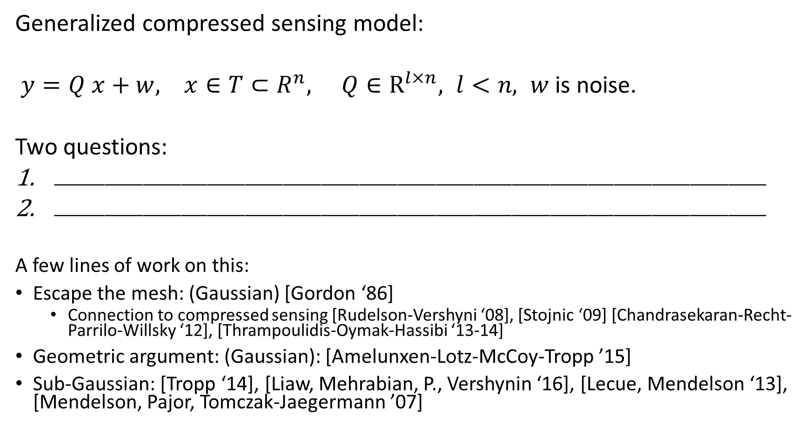
Generalized compressed sensing model:
$y=Q x+w, x∈T⊂R^{n}, Q∈R^{l×n}, l<n, w$ is noise.
Two questions:
$⎽⎽⎽⎽⎽⎽⎽⎽⎽⎽⎽⎽⎽⎽⎽⎽⎽⎽⎽⎽⎽⎽⎽⎽⎽⎽⎽⎽⎽⎽⎽⎽⎽⎽⎽⎽⎽⎽⎽⎽⎽⎽⎽⎽⎽⎽⎽⎽⎽⎽⎽⎽⎽⎽⎽⎽$
$⎽⎽⎽⎽⎽⎽⎽⎽⎽⎽⎽⎽⎽⎽⎽⎽⎽⎽⎽⎽⎽⎽⎽⎽⎽⎽⎽⎽⎽⎽⎽⎽⎽⎽⎽⎽⎽⎽⎽⎽⎽⎽⎽⎽⎽⎽⎽⎽⎽⎽⎽⎽⎽⎽⎽⎽$
A few lines of work on this:
Escape the mesh: (Gaussian) [Gordon ‘86]
Connection to compressed sensing [Rudelson-Vershyni ‘08], [Stojnic ‘09] [Chandrasekaran-Recht-Parrilo-Willsky ‘12], [Thrampoulidis-Oymak-Hassibi ‘13-14]
Geometric argument: (Gaussian): [Amelunxen-Lotz-McCoy-Tropp ’15]
Sub-Gaussian: [Tropp ‘14], [Liaw, Mehrabian, P., Vershynin ‘16], [Lecue, Mendelson ‘13], [Mendelson, Pajor, Tomczak-Jaegermann ’07]

Slide 4
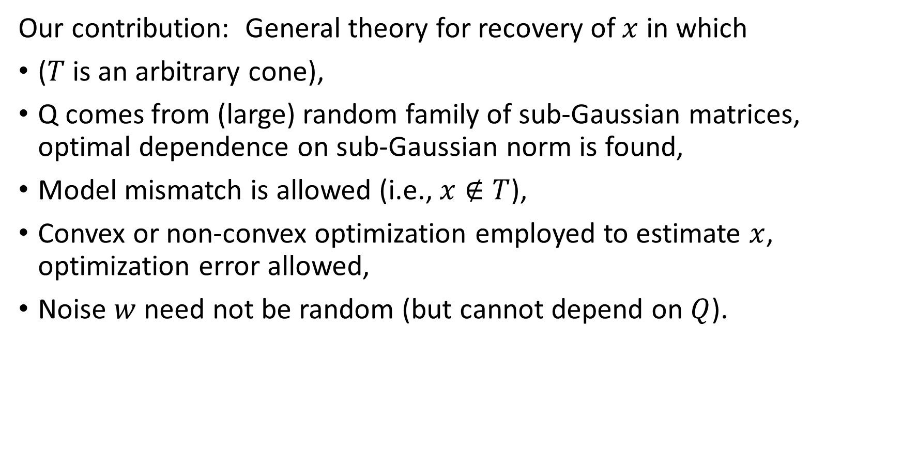
Our contribution: General theory for recovery of $x$ in which
($T$ is an arbitrary cone),
Q comes from (large) random family of sub-Gaussian matrices, optimal dependence on sub-Gaussian norm is found,
Model mismatch is allowed (i.e., $x∉T$),
Convex or non-convex optimization employed to estimate $x$, optimization error allowed,
Noise $w$ need not be random (but cannot depend on $Q$).

Slide 5
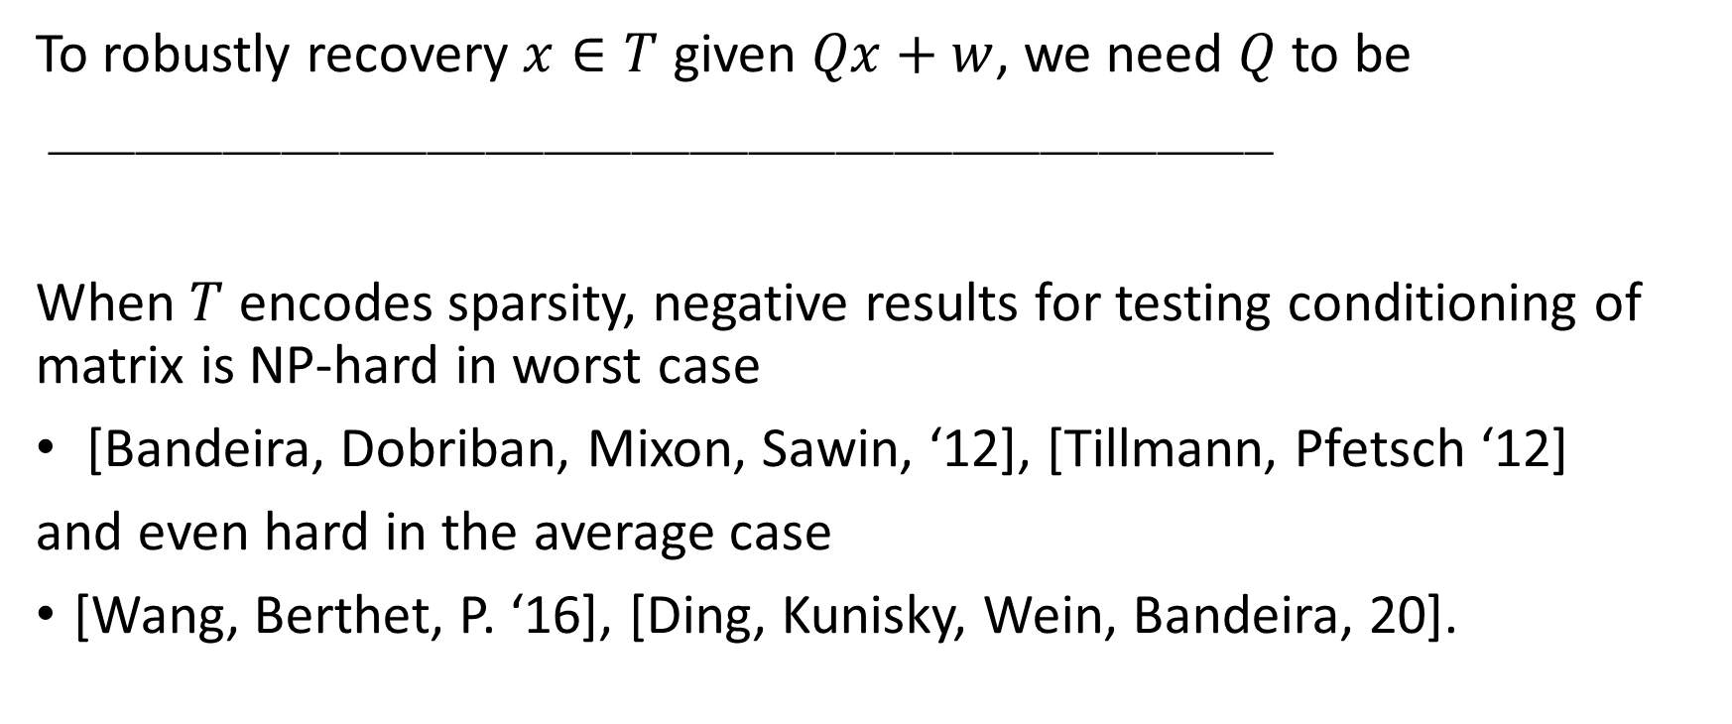
Why random measurements?
To robustly recovery $x∈T$ given $Qx+w$, we need $Q$ to be
$⎽⎽⎽⎽⎽⎽⎽⎽⎽⎽⎽⎽⎽⎽⎽⎽⎽⎽⎽⎽⎽⎽⎽⎽⎽⎽⎽⎽⎽⎽⎽⎽⎽⎽⎽⎽⎽⎽⎽⎽⎽⎽$
When $T$ encodes sparsity, negative results for testing conditioning of matrix is NP-hard in worst case
[Bandeira, Dobriban, Mixon, Sawin, ‘12], [Tillmann, Pfetsch ‘12]
and even hard in the average case
[Wang, Berthet, P. ‘16], [Ding, Kunisky, Wein, Bandeira‚ 20].

Slide 6
Why sub-gaussian?
A:

Slide 7
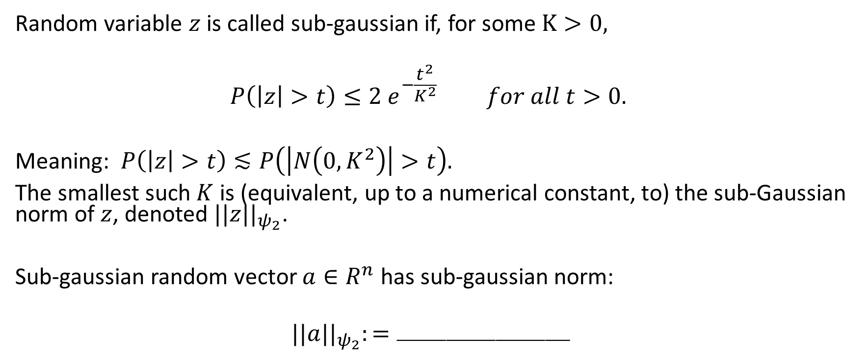
Definition of sub-gaussian (rough)
Random variable $z$ is called sub-gaussian if, for some $K>0,$
$$P\left(\left|z\right|>t\right)≤2 e^{−\frac{t^{2}}{K^{2}}} for all t>0.$$
Meaning: $P\left(\left|z\right|>t\right)≲P\left(\left|N\left(0, K^{2}\right)\right|>t\right).$
The smallest such $K$ is (equivalent, up to a numerical constant, to) the sub-Gaussian norm of $z$, denoted $||z||_{ψ_{2}}$.
Sub-gaussian random vector $a∈R^{n}$ has sub-gaussian norm:
$$||a||_{ψ_{2}}:=⎽⎽⎽⎽⎽⎽⎽⎽⎽⎽⎽⎽⎽⎽$$

Slide 8
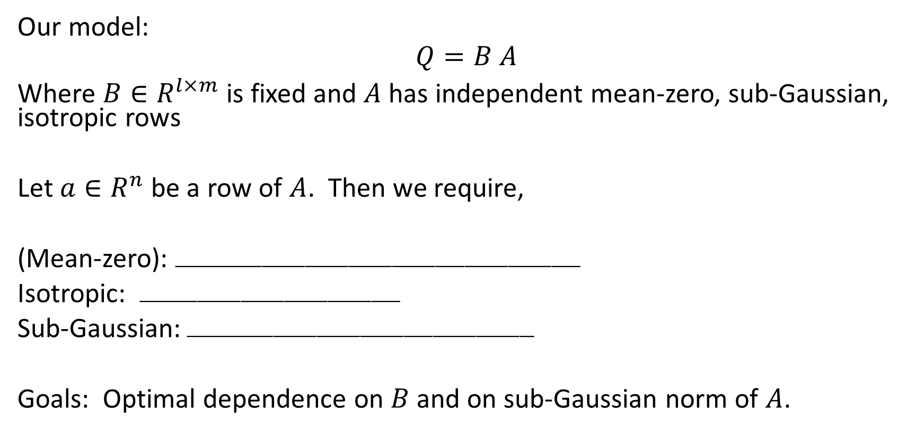
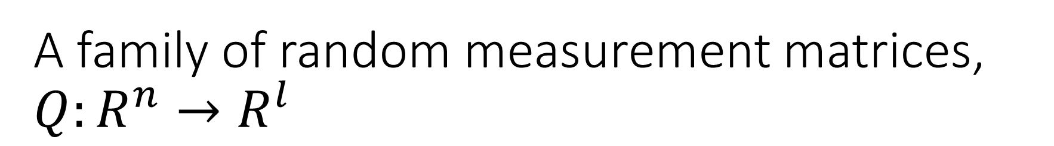
A family of random measurement matrices, $Q:R^{n}→R^{l}$
Our model:
$$Q=B A$$
Where $B∈R^{l×m}$ is fixed and $A$ has independent mean-zero, sub-Gaussian, isotropic rows
Let $a∈R^{n}$ be a row of $A$. Then we require,
(Mean-zero): $⎽⎽⎽⎽⎽⎽⎽⎽⎽⎽⎽⎽⎽⎽⎽⎽⎽⎽⎽⎽⎽⎽⎽⎽⎽⎽⎽⎽$
Isotropic: $⎽⎽⎽⎽⎽⎽⎽⎽⎽⎽⎽⎽⎽⎽⎽⎽⎽⎽$
Sub-Gaussian:$⎽⎽⎽⎽⎽⎽⎽⎽⎽⎽⎽⎽⎽⎽⎽⎽⎽⎽⎽⎽⎽⎽⎽⎽$
Goals: Optimal dependence on $B$ and on sub-Gaussian norm of $A$.

Slide 9


A few examples of $A$ satisfying the conditions
Vanilla Gaussian: $A_{i, j}∼N\left(0,1\right)$
Rademacher: $A_{i,j}∈\{+1, −1\}$
Bounded independent entries: $E A_{i,j }=0, E A_{i,j }^{2}=1, \left|A_{i,j}\right|≤α a.s.$
Sub-sampled orthonormal basis: E.g., each row of $A$ is uniformly chosen from ${\sqrt{n} \{e}_{1},e_{2},…e_{n}\}$
Sub-Gaussian norm: $⎽⎽⎽⎽⎽⎽⎽⎽⎽⎽⎽⎽⎽⎽⎽⎽⎽⎽⎽⎽⎽⎽⎽⎽⎽⎽⎽⎽⎽⎽⎽⎽⎽⎽⎽⎽⎽⎽⎽⎽⎽⎽$
Sparse Bernoulli: $A_{i,j }=\left\{\begin{aligned}1 w.p. p \\ 0 w.p. 1−p \end{aligned}\right.$

Slide 10

A simple example: Least squares
$B=I, y=Ax+w, A, w$have standard normal entries, $T=d$-dimensional sub-space.
Estimate of $x$: $\hat{x}=⎽⎽⎽⎽⎽⎽⎽⎽⎽⎽⎽⎽⎽⎽⎽⎽⎽⎽⎽⎽⎽⎽⎽⎽⎽⎽⎽⎽$
Pic:
Thm:
What if $x$ is not in $T$?

Slide 11


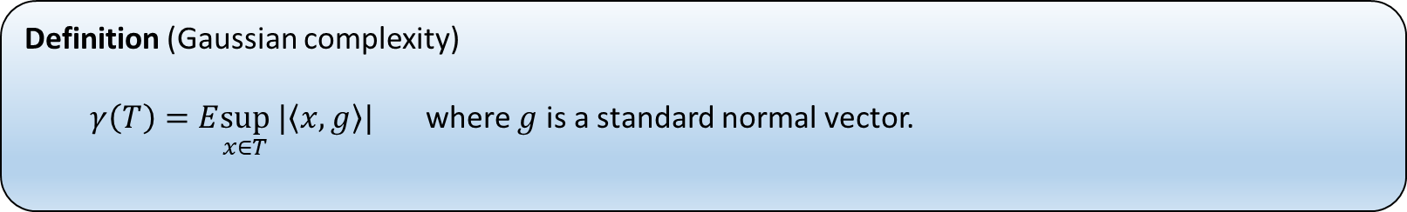
What replaces dimension $d$ when $T$ is an arbitrary cone?
Let us write $d\left(T\right)≔γ(\left\{T−T\right\}∩S^{n−1})$
We next move to general recovery results when $B=I$.
Definition (Gaussian complexity)
$γ\left(T\right)=E\sup_{x∈T} |\left\langle x, g\right\rangle |$ where $g$ is a standard normal vector.

Slide 12

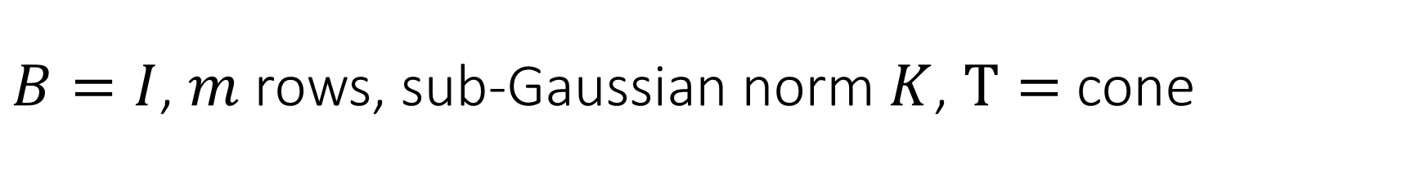
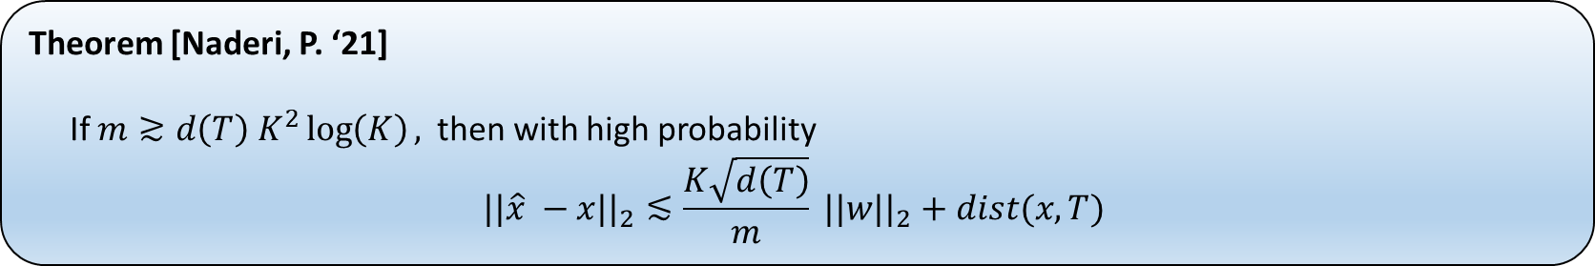
$B=I$, $m$ rows, sub-Gaussian norm $K$, $T=$cone
Let $y=Ax+w,$with $w, x$ not dependent on $A$ and
$$\hat{x}={\arg{\min_{x^{′}∈T}{||Ax−y||_{2}^{2}}}}_{}$$
Relies on RMT by [Liaw, Mehrabian, Vershynin, P. ’16], [Li, Jeong, P. Yilmaz, ‘20]
If optimization is sub-optimal by $ε^{2}$, then add $ε/\sqrt{m}$ to error bound.
Theorem [Naderi, P. ‘21]
If $m≳d\left(T\right) K^{2}\log\left(K\right),$then with high probability
$$||\hat{x} −x||_{2}≲\frac{K\sqrt{d\left(T\right)}}{m} {||w||}_{2}+dist(x, T)$$

Slide 13
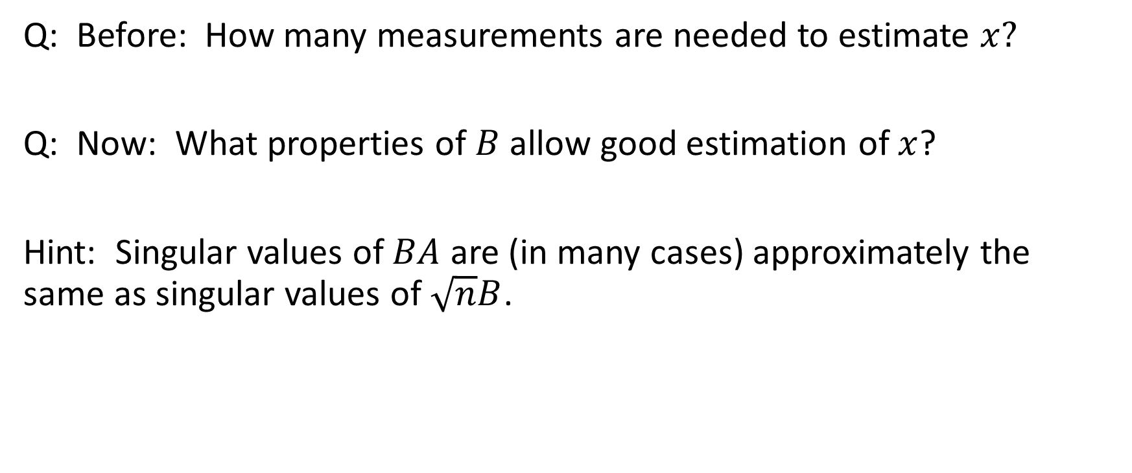

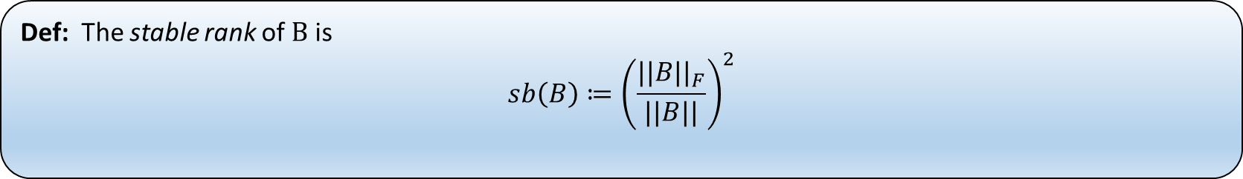
What if $B≠I?$ So $y=BAx+w$.
Q: Before: How many measurements are needed to estimate $x?$
Q: Now: What properties of $B$ allow good estimation of $x$?
Hint: Singular values of $BA$ are (in many cases) approximately the same as singular values of $\sqrt{n}B$.
Def: The stable rank of $B$ is
$$sb\left(B\right)≔{\left(\frac{||B||_{F}}{||B||}\right)}^{2}$$

Slide 14
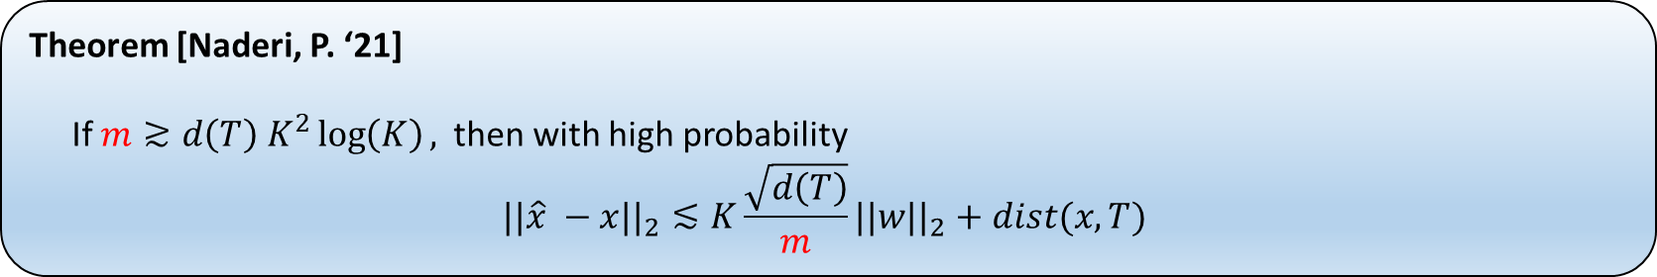

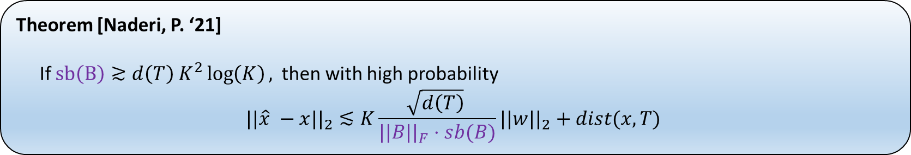

$$B=I$$
Theorem [Naderi, P. ‘21]
If $m≳d\left(T\right) K^{2}\log\left(K\right),$then with high probability
$$||\hat{x} −x||_{2}≲K\frac{\sqrt{d\left(T\right)}}{m}{||w||}_{2}+dist(x, T)$$
$$B≠I$$
Theorem [Naderi, P. ‘21]
If $sb\left(B\right)≳d\left(T\right) K^{2}\log\left(K\right),$then with high probability
$$||\hat{x} −x||_{2}≲K\frac{\sqrt{d\left(T\right)} }{||B||_{F}⋅sb(B)}{||w||}_{2}+dist(x, T)$$

Slide 15

Special case: low-rank
If $T=\{N_{1}×N_{2}$ matrices with rank at most $r\}$
$$T−T=\{⎽⎽⎽⎽⎽⎽⎽⎽⎽⎽⎽⎽⎽⎽⎽⎽⎽⎽⎽⎽⎽⎽⎽⎽⎽⎽⎽⎽\}$$
$$γ\left(\left(T−T\right)∩S^{N_{1}N_{2}−1}\right)=⎽⎽⎽⎽⎽⎽⎽⎽⎽⎽⎽⎽⎽⎽⎽⎽⎽⎽⎽⎽⎽⎽⎽⎽⎽⎽⎽⎽$$
$$d\left(T\right)≤⎽⎽⎽⎽⎽⎽⎽⎽⎽⎽⎽⎽⎽⎽⎽⎽⎽⎽⎽⎽⎽⎽⎽⎽⎽⎽⎽⎽$$

Slide 16
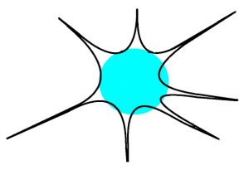


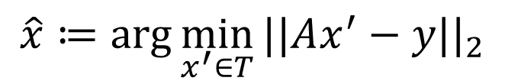

What if $T$ is not convex?
$T$ = signal structure.
$$\hat{x}≔arg{\min_{x^{′}∈T}{||Ax^{′}−y||_{2}}}$$
Convex set
$$x$$
Tangent cone

Slide 17

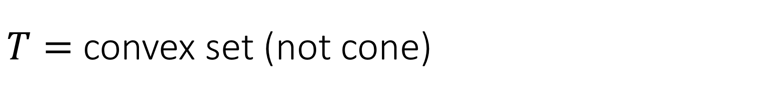
$T=$ convex set (not cone)
Update: $d\left(T\right)=γ\left(\left(T−T\right)∩S^{n−1}\right) =⎽⎽⎽⎽⎽⎽⎽⎽⎽⎽⎽⎽⎽⎽$
Example: When $x$ is $N_{1}$ by $N_{2}$, rank-$r$ matrix, and $T$ is a precisely scaled nuclear-norm ball,
$$d\left(T\right)≤⎽⎽⎽⎽⎽⎽⎽⎽⎽⎽⎽⎽⎽⎽$$

Slide 18
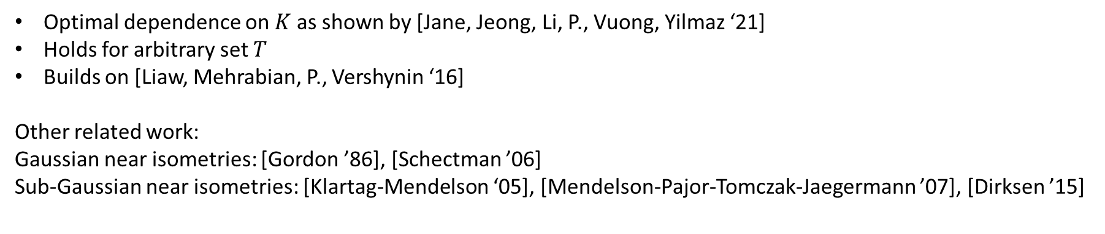
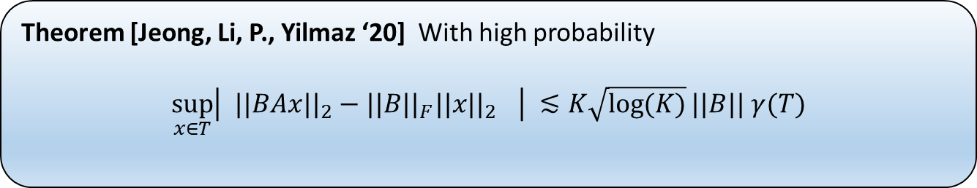
Underlying random matrix theory
Theorem [Jeong, Li, P., Yilmaz ‘20] With high probability
$$\sup_{x∈T}\left| ||BAx||_{2}−||B||_{F}||x|{|_{2}}_{}\right| ≲K\sqrt{\log{(K)}}||B|| γ(T)$$
Optimal dependence on $K$ as shown by [Jane, Jeong, Li, P., Vuong, Yilmaz ‘21]
Holds for arbitrary set $T$
Builds on [Liaw, Mehrabian, P., Vershynin ‘16]
Other related work:
Gaussian near isometries: [Gordon ’86], [Schectman ’06]
Sub-Gaussian near isometries: [Klartag-Mendelson ‘05], [Mendelson-Pajor-Tomczak-Jaegermann ’07], [Dirksen ’15]

Slide 19
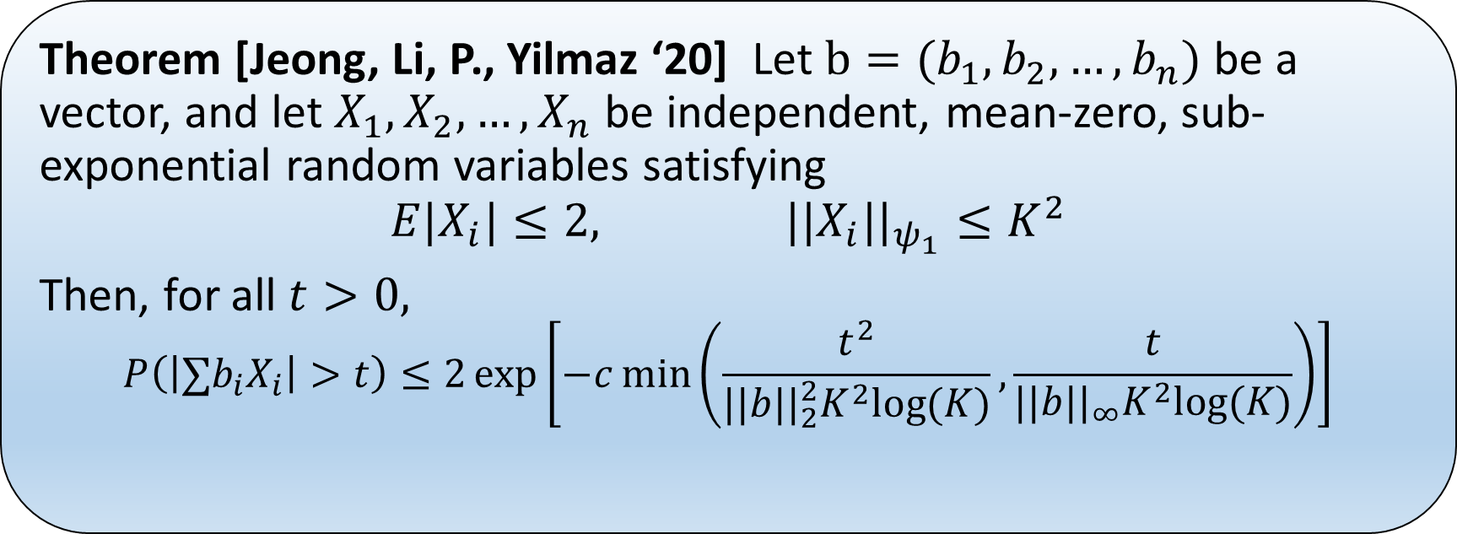
New Bernstein inequality
Theorem [Jeong, Li, P., Yilmaz ‘20] Let $b=(b_{1},b_{2},…, b_{n})$ be a vector, and let $X_{1},X_{2},…, X_{n}$ be independent, mean-zero, sub-exponential random variables satisfying
$$E|X_{i}|≤2, ||X_{i}||_{ψ_{1}}≤K^{2}$$
Then, for all $t>0,$
$$P\left(\left|∑b_{i}X_{i}\right|>t\right)≤2\exp\left[−c\min\left(\frac{t^{2}}{||b||_{2}^{2}K^{2}log⁡(K)},\frac{t}{||b||_{∞}K^{2}log⁡(K)}\right)\right]$$

Slide 20
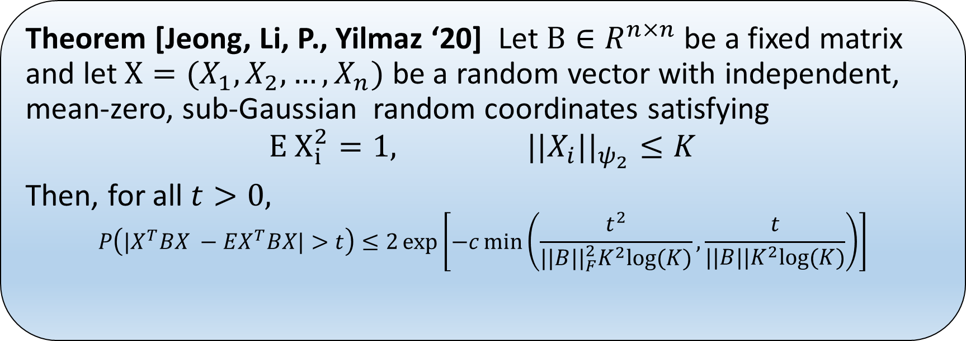
New Hanson-Wright inequality
Theorem [Jeong, Li, P., Yilmaz ‘20] Let $B∈R^{n×n}$ be a fixed matrix and let $X=(X_{1},X_{2},…, X_{n})$ be a random vector with independent, mean-zero, sub-Gaussian random coordinates satisfying
$$E X_{i}^{2}=1, ||X_{i}||_{ψ_{2}}≤K$$
Then, for all $t>0,$
$$P\left(|X^{T}BX −EX^{T}BX|>t\right)≤2\exp\left[−c\min\left(\frac{t^{2}}{||B||_{F}^{2}K^{2}log⁡(K)},\frac{t}{||B||K^{2}log⁡(K)}\right)\right]$$

Slide 21
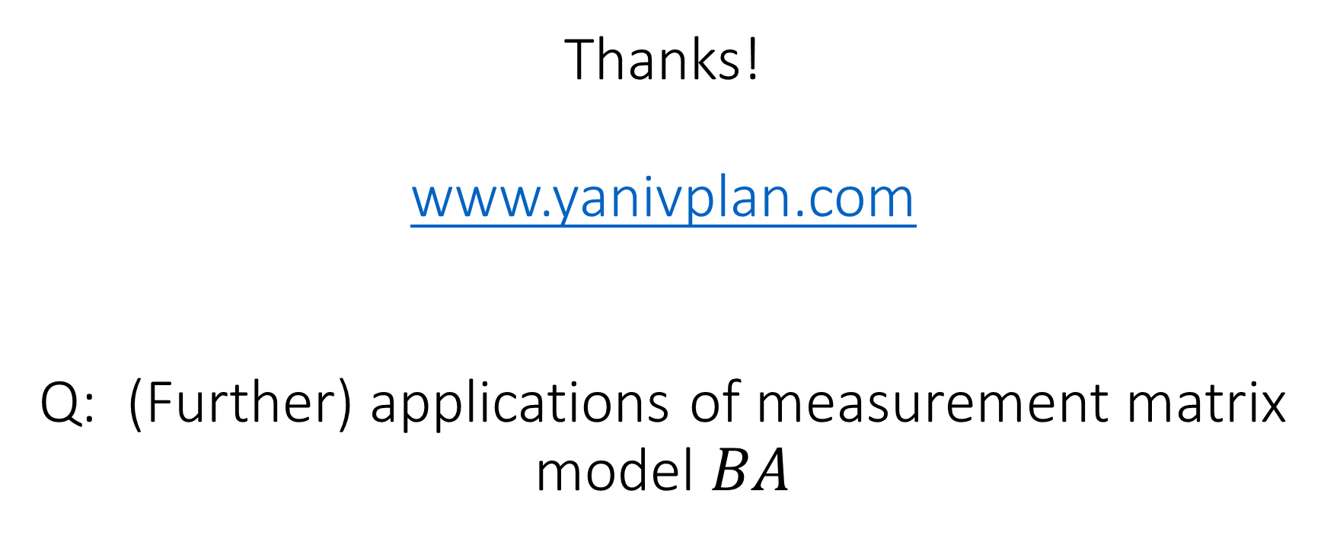
Thanks! www.yanivplan.com Q: (Further) applications of measurement matrix model $BA$

