Slide 1
Determinant of the stress matrix for pinned frameworks
Mikhail Kovalev
MSU
mdkovalev@mtu-net.ru

Slide 2
Hinged structure scheme (HSS)
An abstract connected graph G(V, E) without loops or multiple edges, whose edges correspond to the levers of the framework and whose vertices are of two kinds: the circles corresponding to the free (unfastened) hinges, and the crosses corresponding to the fastened hinges.
The subgraph of G(V, E) generated by the circles is connected, and there are no edges connecting two crosses.

Slide 3
Fastened HSS
An HSS is said to be unfastened if the set of crosses (fastened hinges) is empty, and fastened otherwise.
The vertices corresponding to the free (resp. fastened) hinges are said to be free (resp. fastened).

Slide 4
An example of HSS

Slide 5
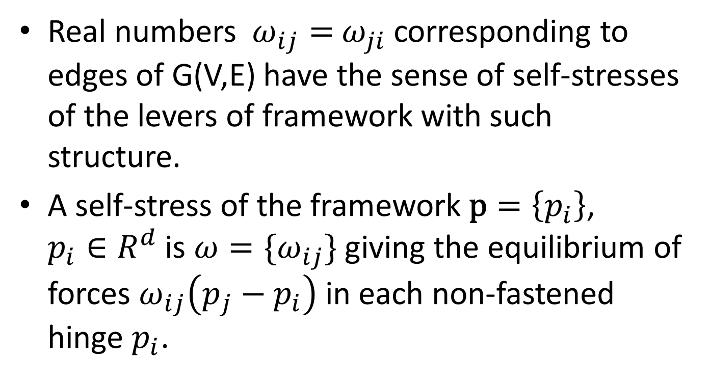
Stresses

Slide 6

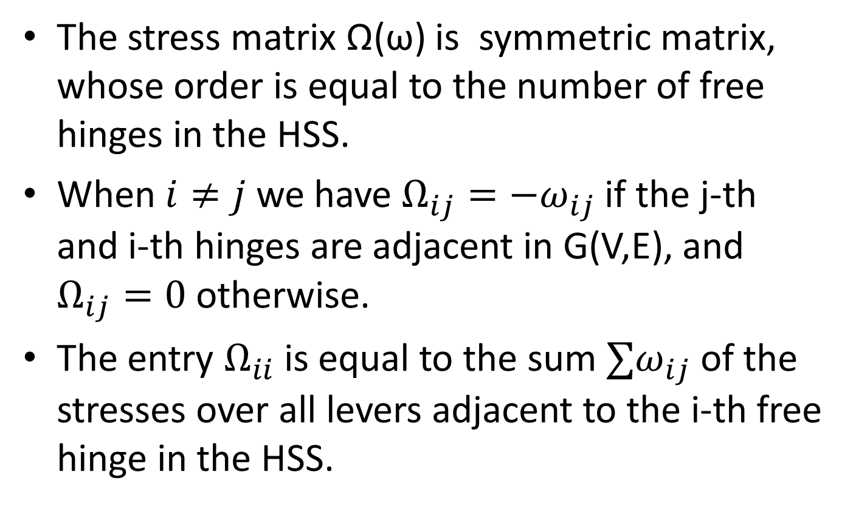
Ответ Кашина:
Михаил Дмитриевич,
посланное Вам письмо редколлегии родилось в итоге достаточно подробного обсуждения работы на заседании редколлегии.
Я рекомендую Вам максимально учесть мнение редколлегии при доработке статьи. Обсуждать использованные Вами обороты "судилище, подсудимый..." не вижу смысла. Не вижу смысла и в дополнительном рецензировании работы. Конечно, Вы можете в любой момент отозвать свою статью и направить ее в другой журнал. Но с учетом того, что в ней, по мнению специалистов, содержатся интересные результаты, а рецензентами статьи проделана значительная работа по корректировке изложения в соответствии с традициями Сборника, такое решение мне представляется ошибочным.
Б.С. Кашин

Slide 7
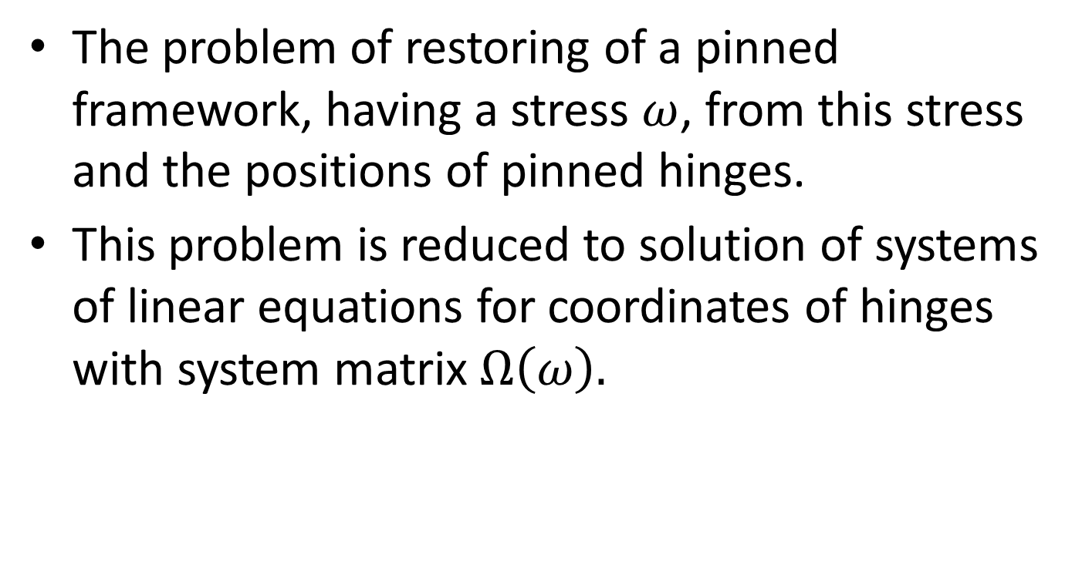

Where $\det{ Ω(ω)}$ appear?
The problem of restoring of a pinned framework, having a stress $ω$, from this stress and the positions of pinned hinges.
This problem is reduced to solution of systems of linear equations for coordinates of hinges with system matrix $Ω\left(ω\right).$

Slide 8

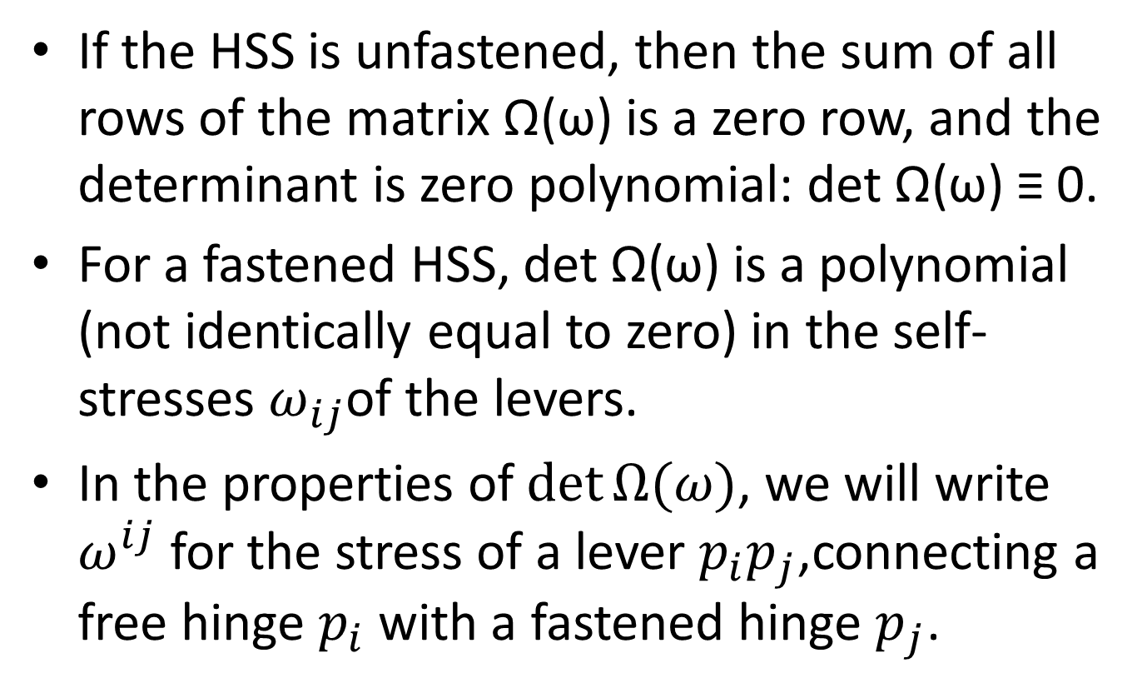

Slide 9

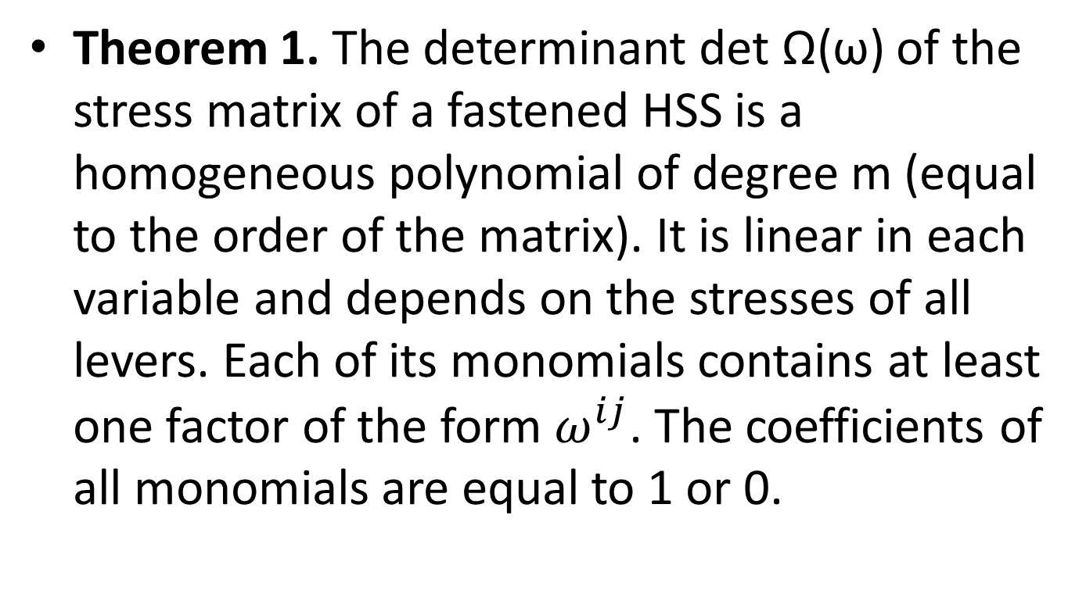

Slide 10

Corollary. For every fastened HSS, the determinant of the stress matrix is nonzero whenever all stresses have the same sign.
This is a known fact. It takes place for spider webs (R.Connelly). They are determined by their positive self-stress and positions of pinned hinges.

Slide 11
Associated graph G’
We associate with any fastened HSS G(V, E) another fastened HSS G’ whose only difference from G(V, E) is that every free vertex of G’ is adjacent to no more than one fastened vertex. If the graph G = G(V, E) had free vertices adjacent to more than one fastened vertex, then G’ would be obtained from G by deleting some edges adjacent to fastened vertices and, possibly, some fastened vertices.

Slide 12
Transformations of graph G

Slide 13
Associated graph G*
With every fastened HSS G(V, E) we associate the graph G’ , and with G’ the graph G* whose only fastened vertex is obtained by identifying all fastened vertices of G’ .

Slide 14

A vertex of a graph is said to be separating if removing it (along with the adjacent edges) yields a disconnected graph. (Graphs without separating vertices are often referred to as blocks.)
Theorem 2. The determinant of the stress matrix for a fastened HSS G is irreducible if and only if the corresponding graph G* has no separating vertices.

Slide 15
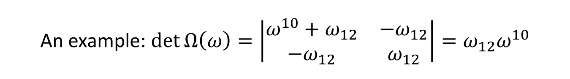

Slide 16
The proofs may be found in
Izvestiya: Mathematics 80:3 500–522 Izvestiya RAN: Ser. Mat. 80:3 43–66 (Russian)
2016 Russian Academy of Sciences (DoM), translation London Mathematical Society, Turpion Ltd

Slide 17
Thank you for the attention!
.

Slide 18

Addendum
Absolutely irreducible. (Over any algebraic extension of the field $Q.)$
Othervise, determinant is reducible over $Q.$

