Slide 1

Systemic Risk Driven Portfolio Selection
Agostino Capponi (Columbia University)
Alexey Rubtsov (Ryerson University, Global Risk Institute)

Slide 2
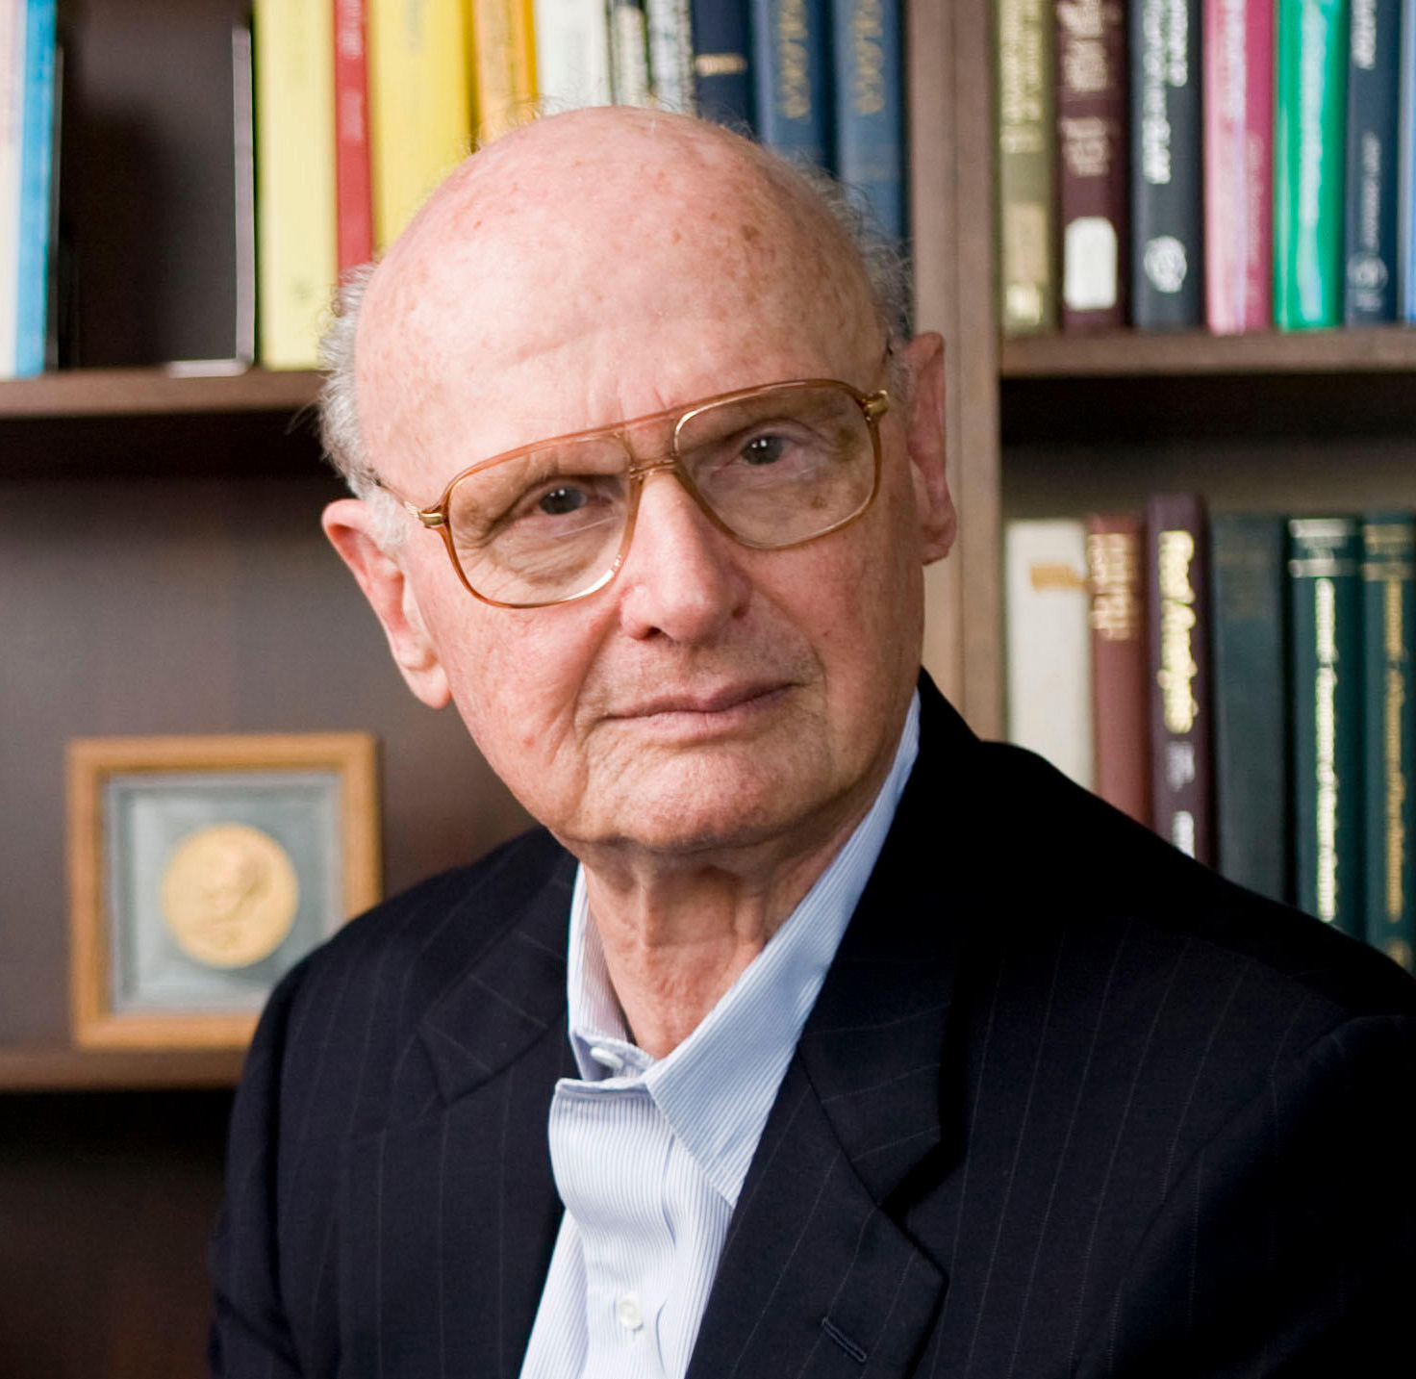


Introduction

Slide 3


The model has been extended and modified in a variety of ways …
Asymmetric risk: Use risk measures such as Value-at-Risk (VaR), instead of Variance
Area is 5%
Portfolio Loss
VaR

Slide 4


Systemic Risk

Slide 5
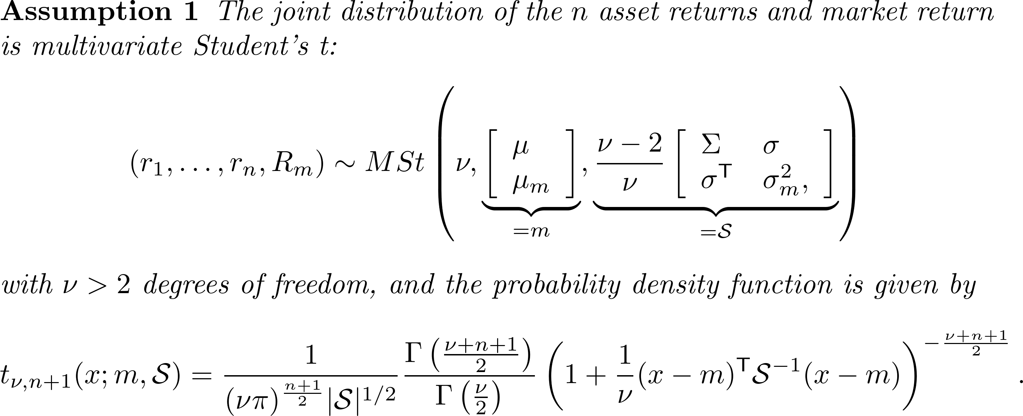

Slide 6


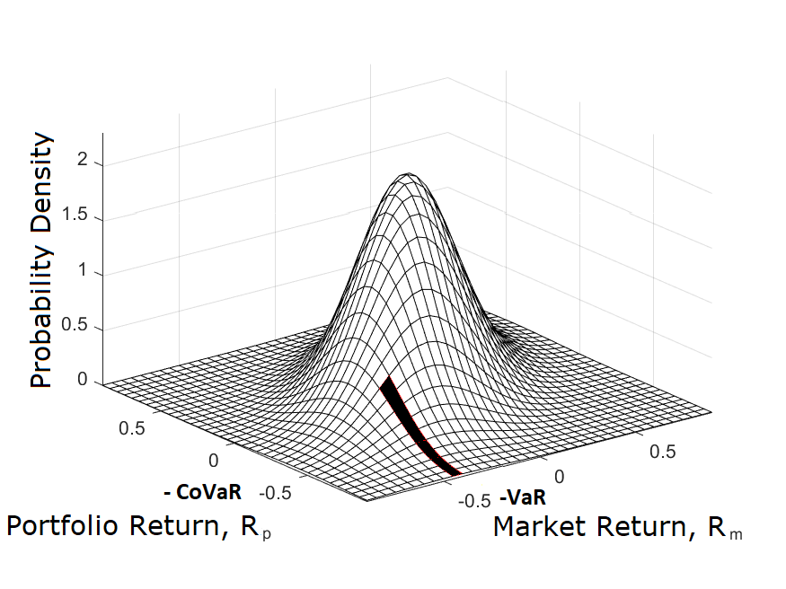
Market is at its VaR level

Slide 7



Slide 8


Slide 9


Slide 10

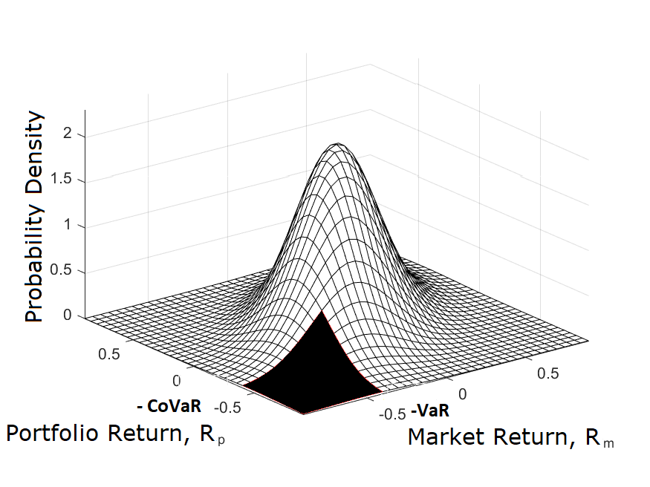
Market is at least at its VaR level

Slide 11



Slide 12


Slide 13
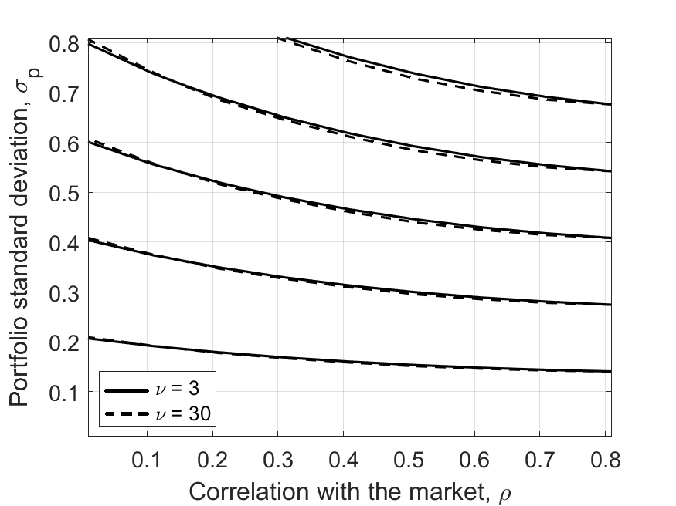
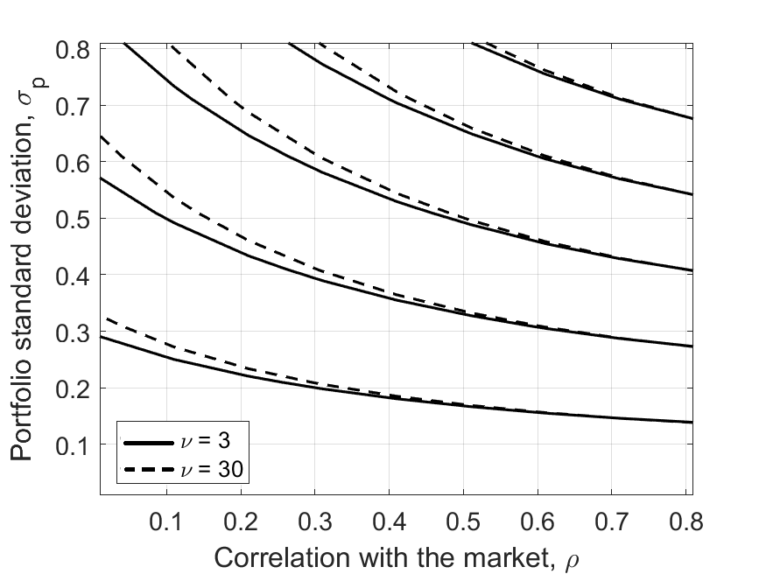
(a)
(b)

Slide 14



Slide 15


Slide 16


Slide 17

Systemic risk adjustment
Mean--Variance portfolio

Slide 18

Empirical analysis

Slide 19
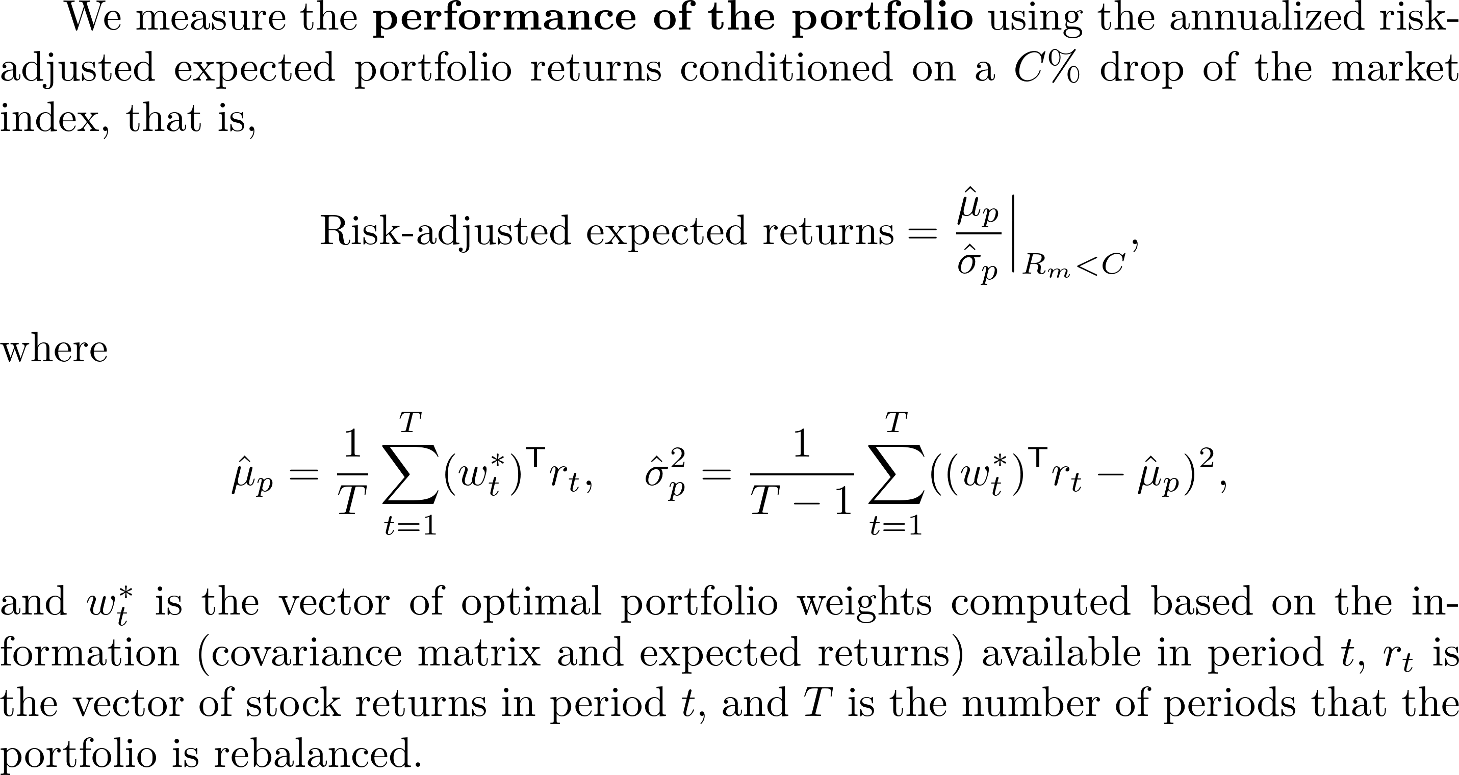

Slide 20


Slide 22
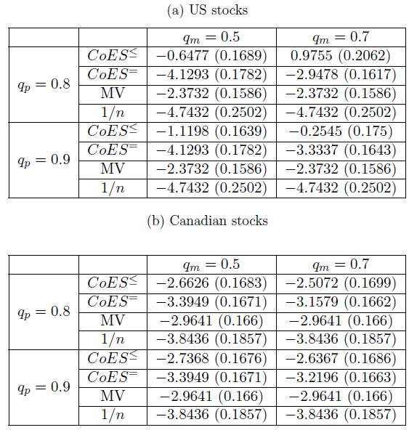


Slide 23
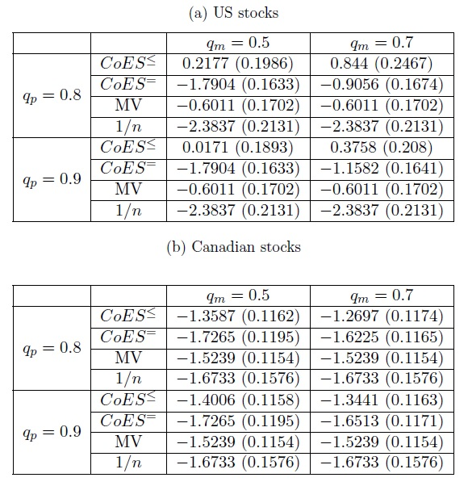


Slide 24
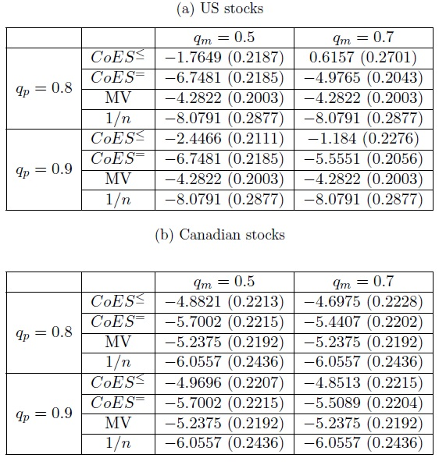


Slide 25
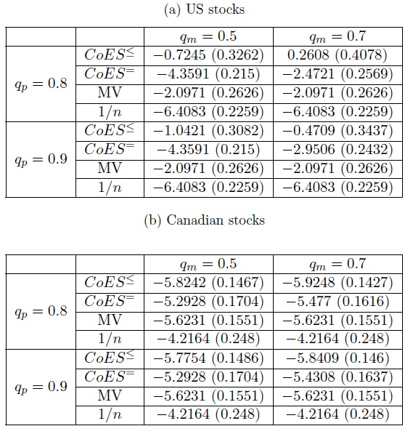


Slide 26


Slide 27
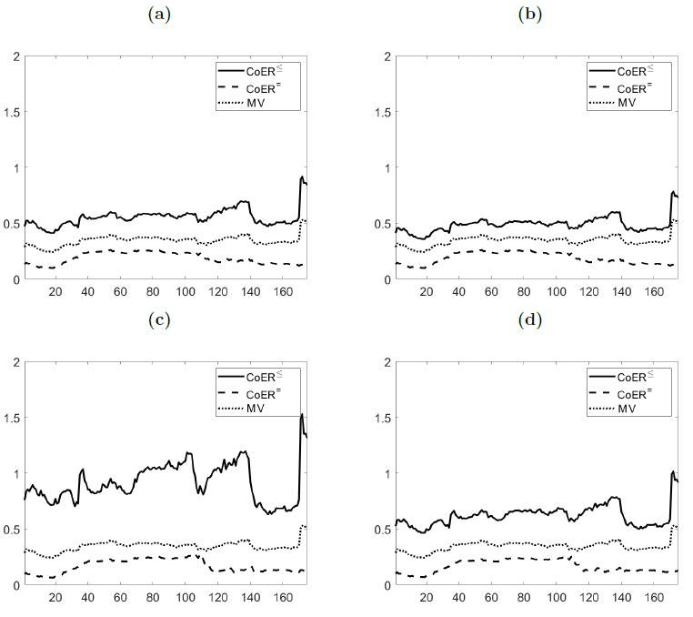





Slide 28
Thank you!

