Slide 1
Topological neuron synthesis: reconstructing trees from barcodes
Fields Workshop on Topological Data Analysis
16 June 2020

Slide 2
Outline
Trees to barcodes
  Introduction to the TMD, which associates to any tree embedded in ℝ³ a barcode and has proved its power for classification of neuron morphologies.
Barcodes to trees
  Overview of the TNS, a biologically meaningful partial inverse to the TMD.
A mathematical perspective

Slide 3
From trees to barcodes
Y. Deitcher et al, Cerebral Cortex, 2017.
L. Kanari et al, Neuroinformatics, 2018.
L. Kanari et al, Cerebral Cortex, 2019.

Slide 4
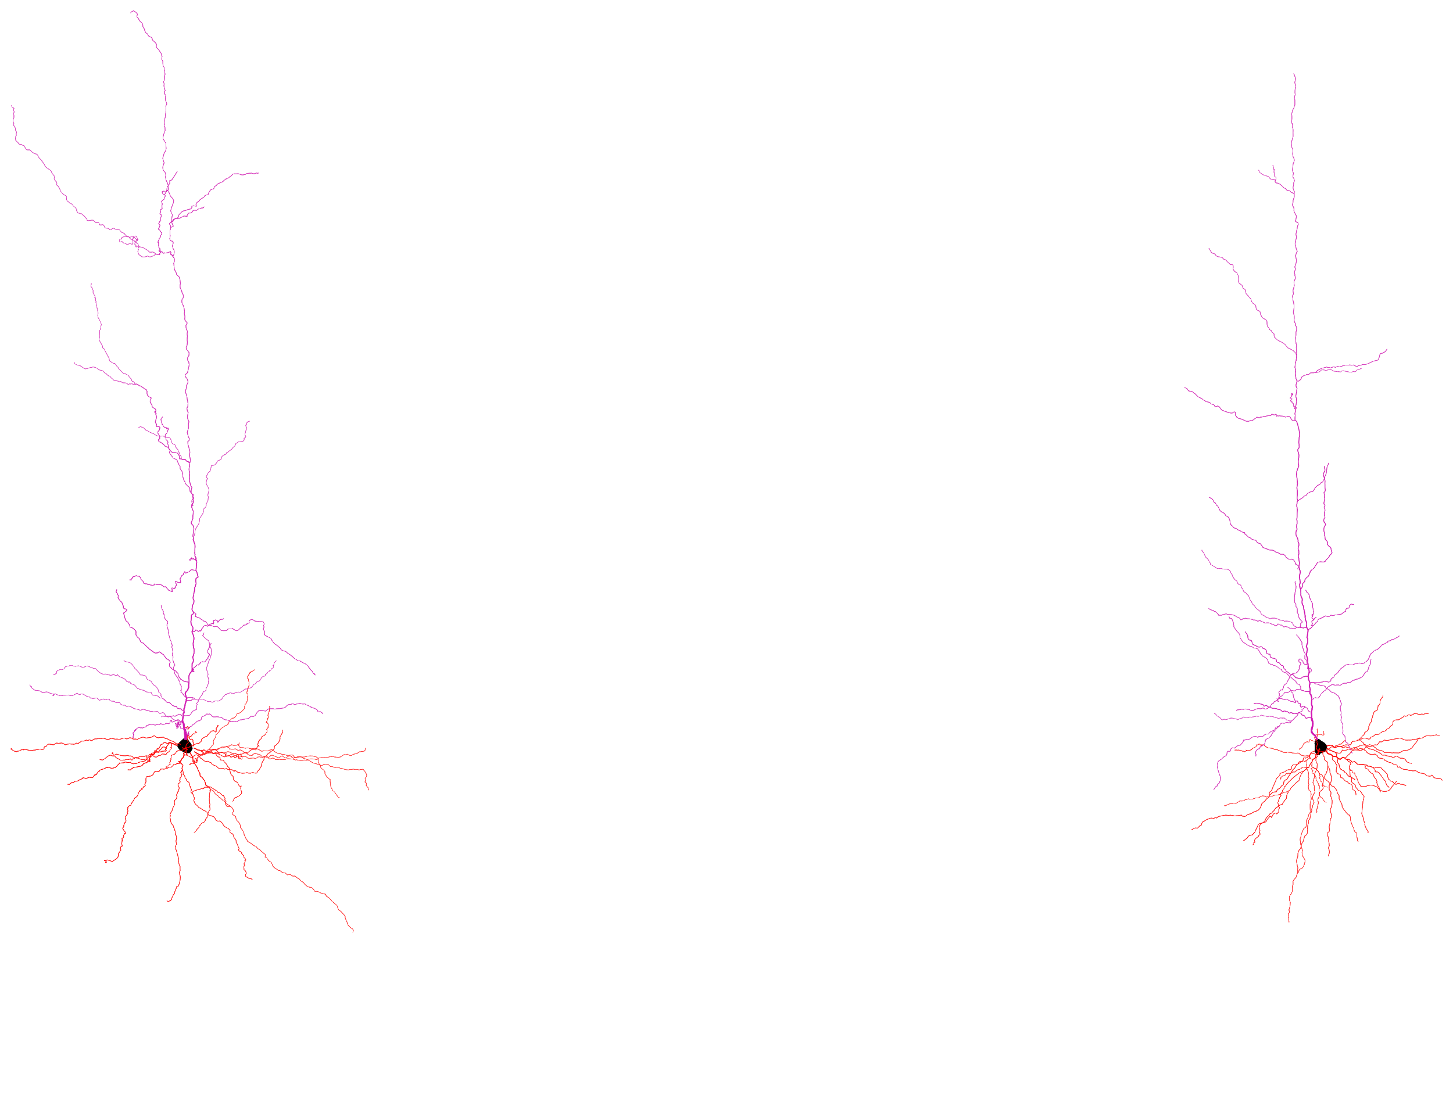
How to classify neuron morphologies?
vs

Slide 5
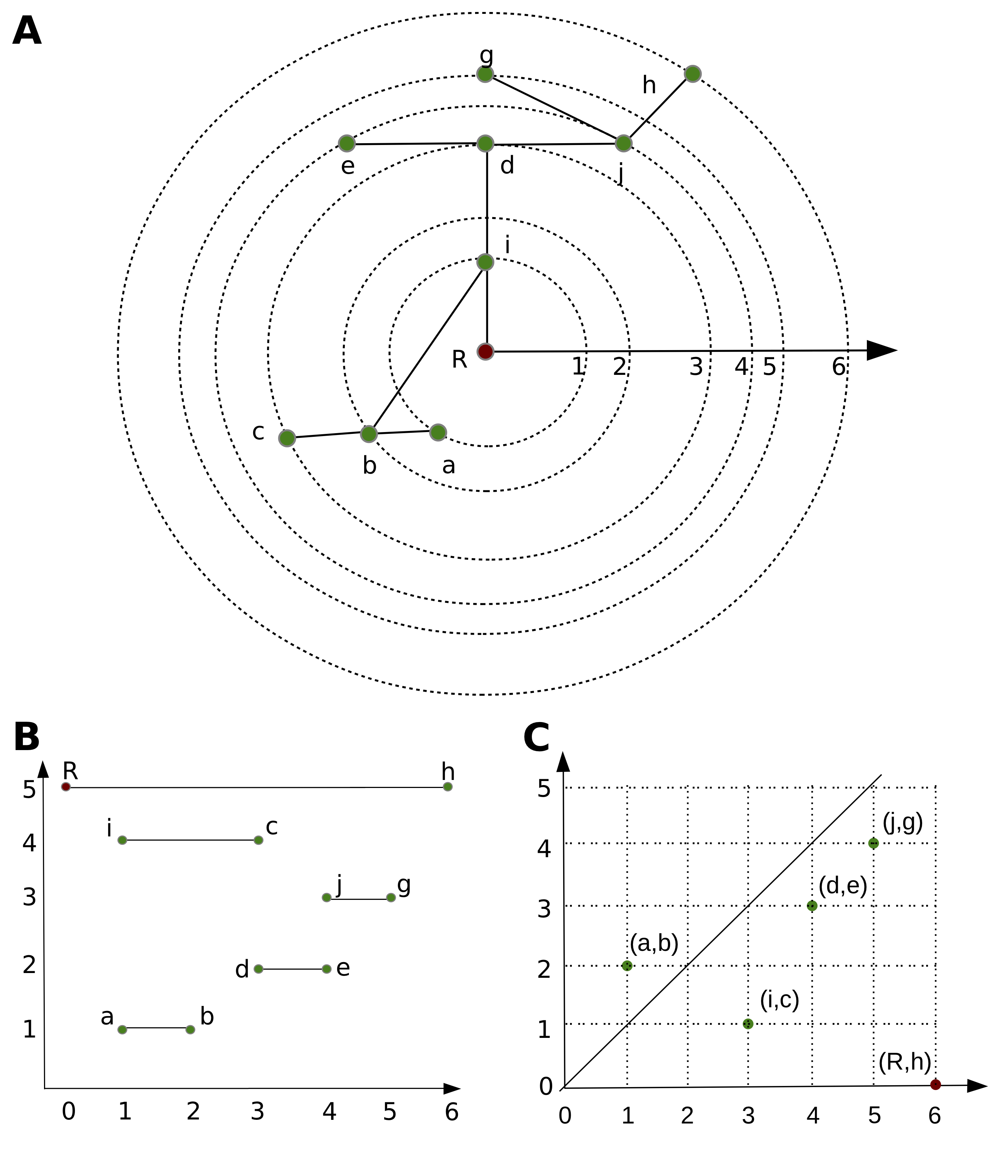
The TMD algorithm

Slide 6
Possible small errors and stability
Theorem: The TMD is stable with respect to small errors of reconstruction.

Slide 7
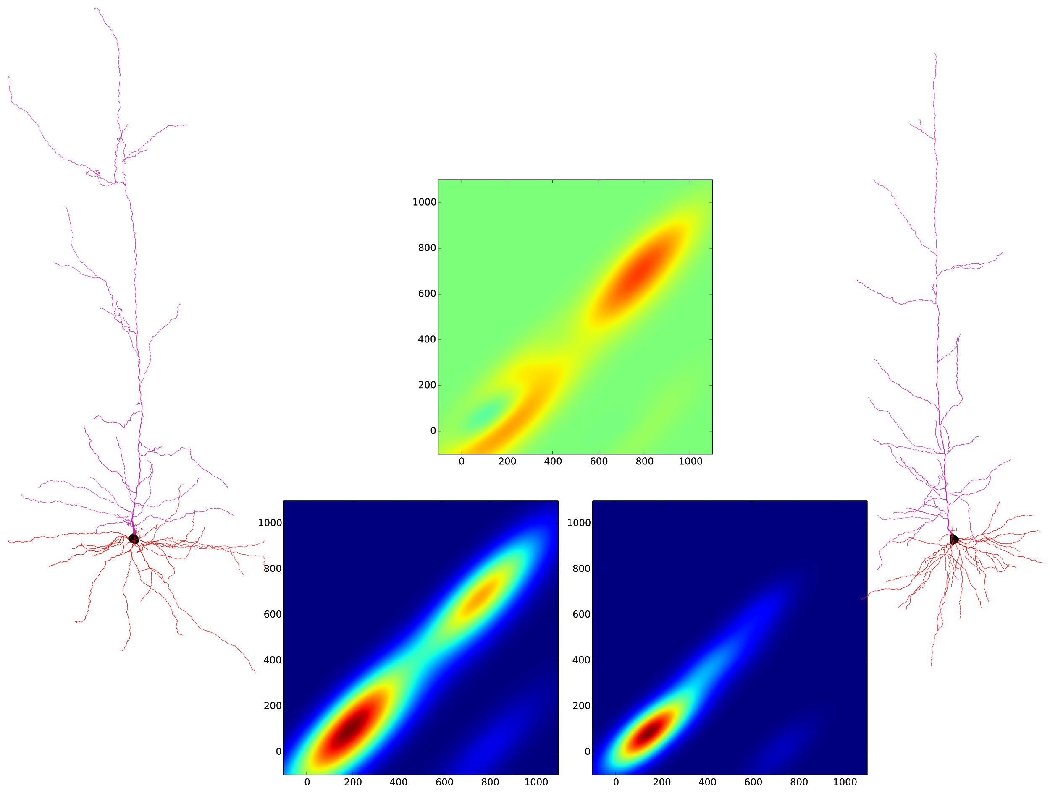
Classification by TMD

Slide 8
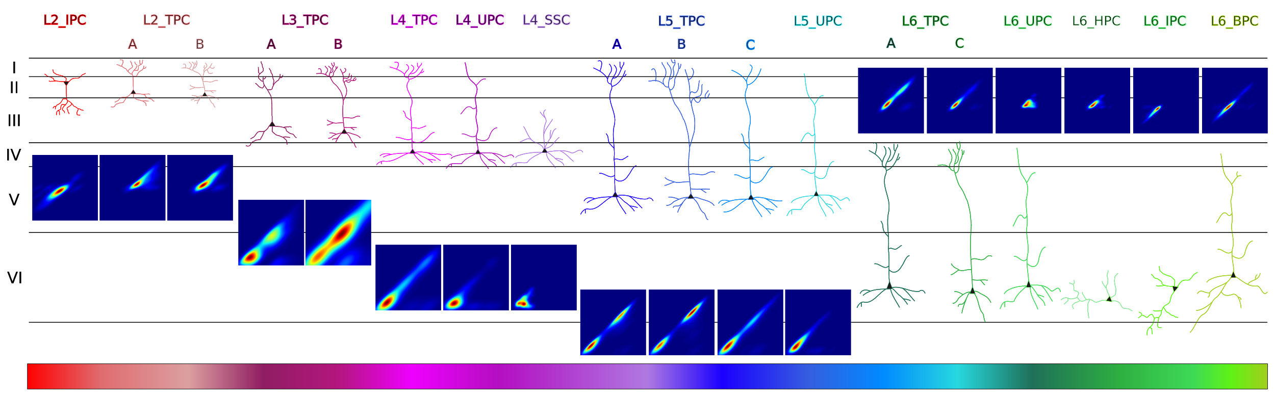
TMD of rat pyramidal cells

Slide 9
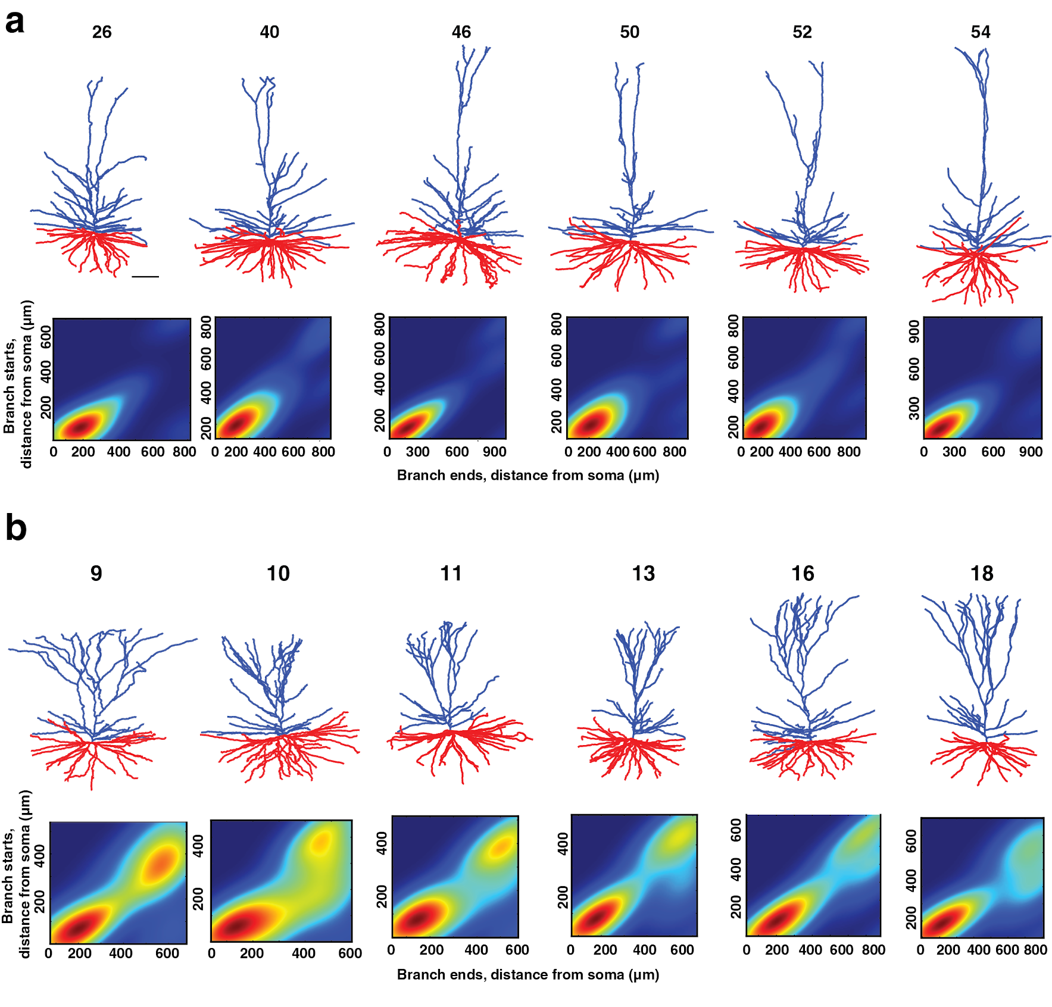
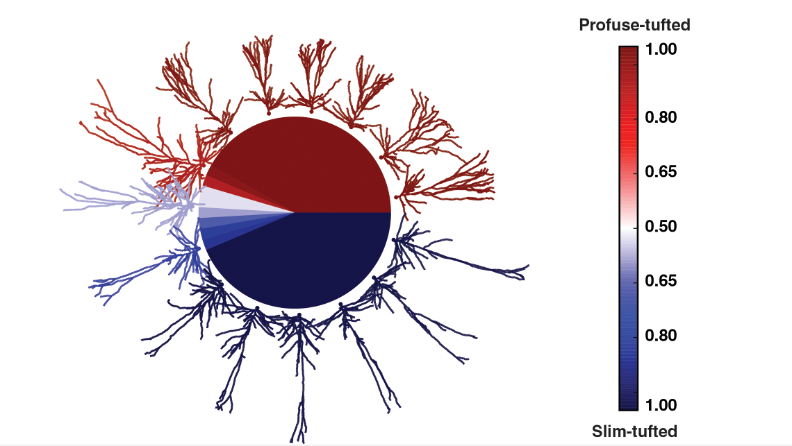
Human pyramidal cells

Slide 10
From barcodes to trees
L. Kanari et al, Computational Synthesis of Cortical Dendritic Morphologies, bioRxiv, 2020.

Slide 11
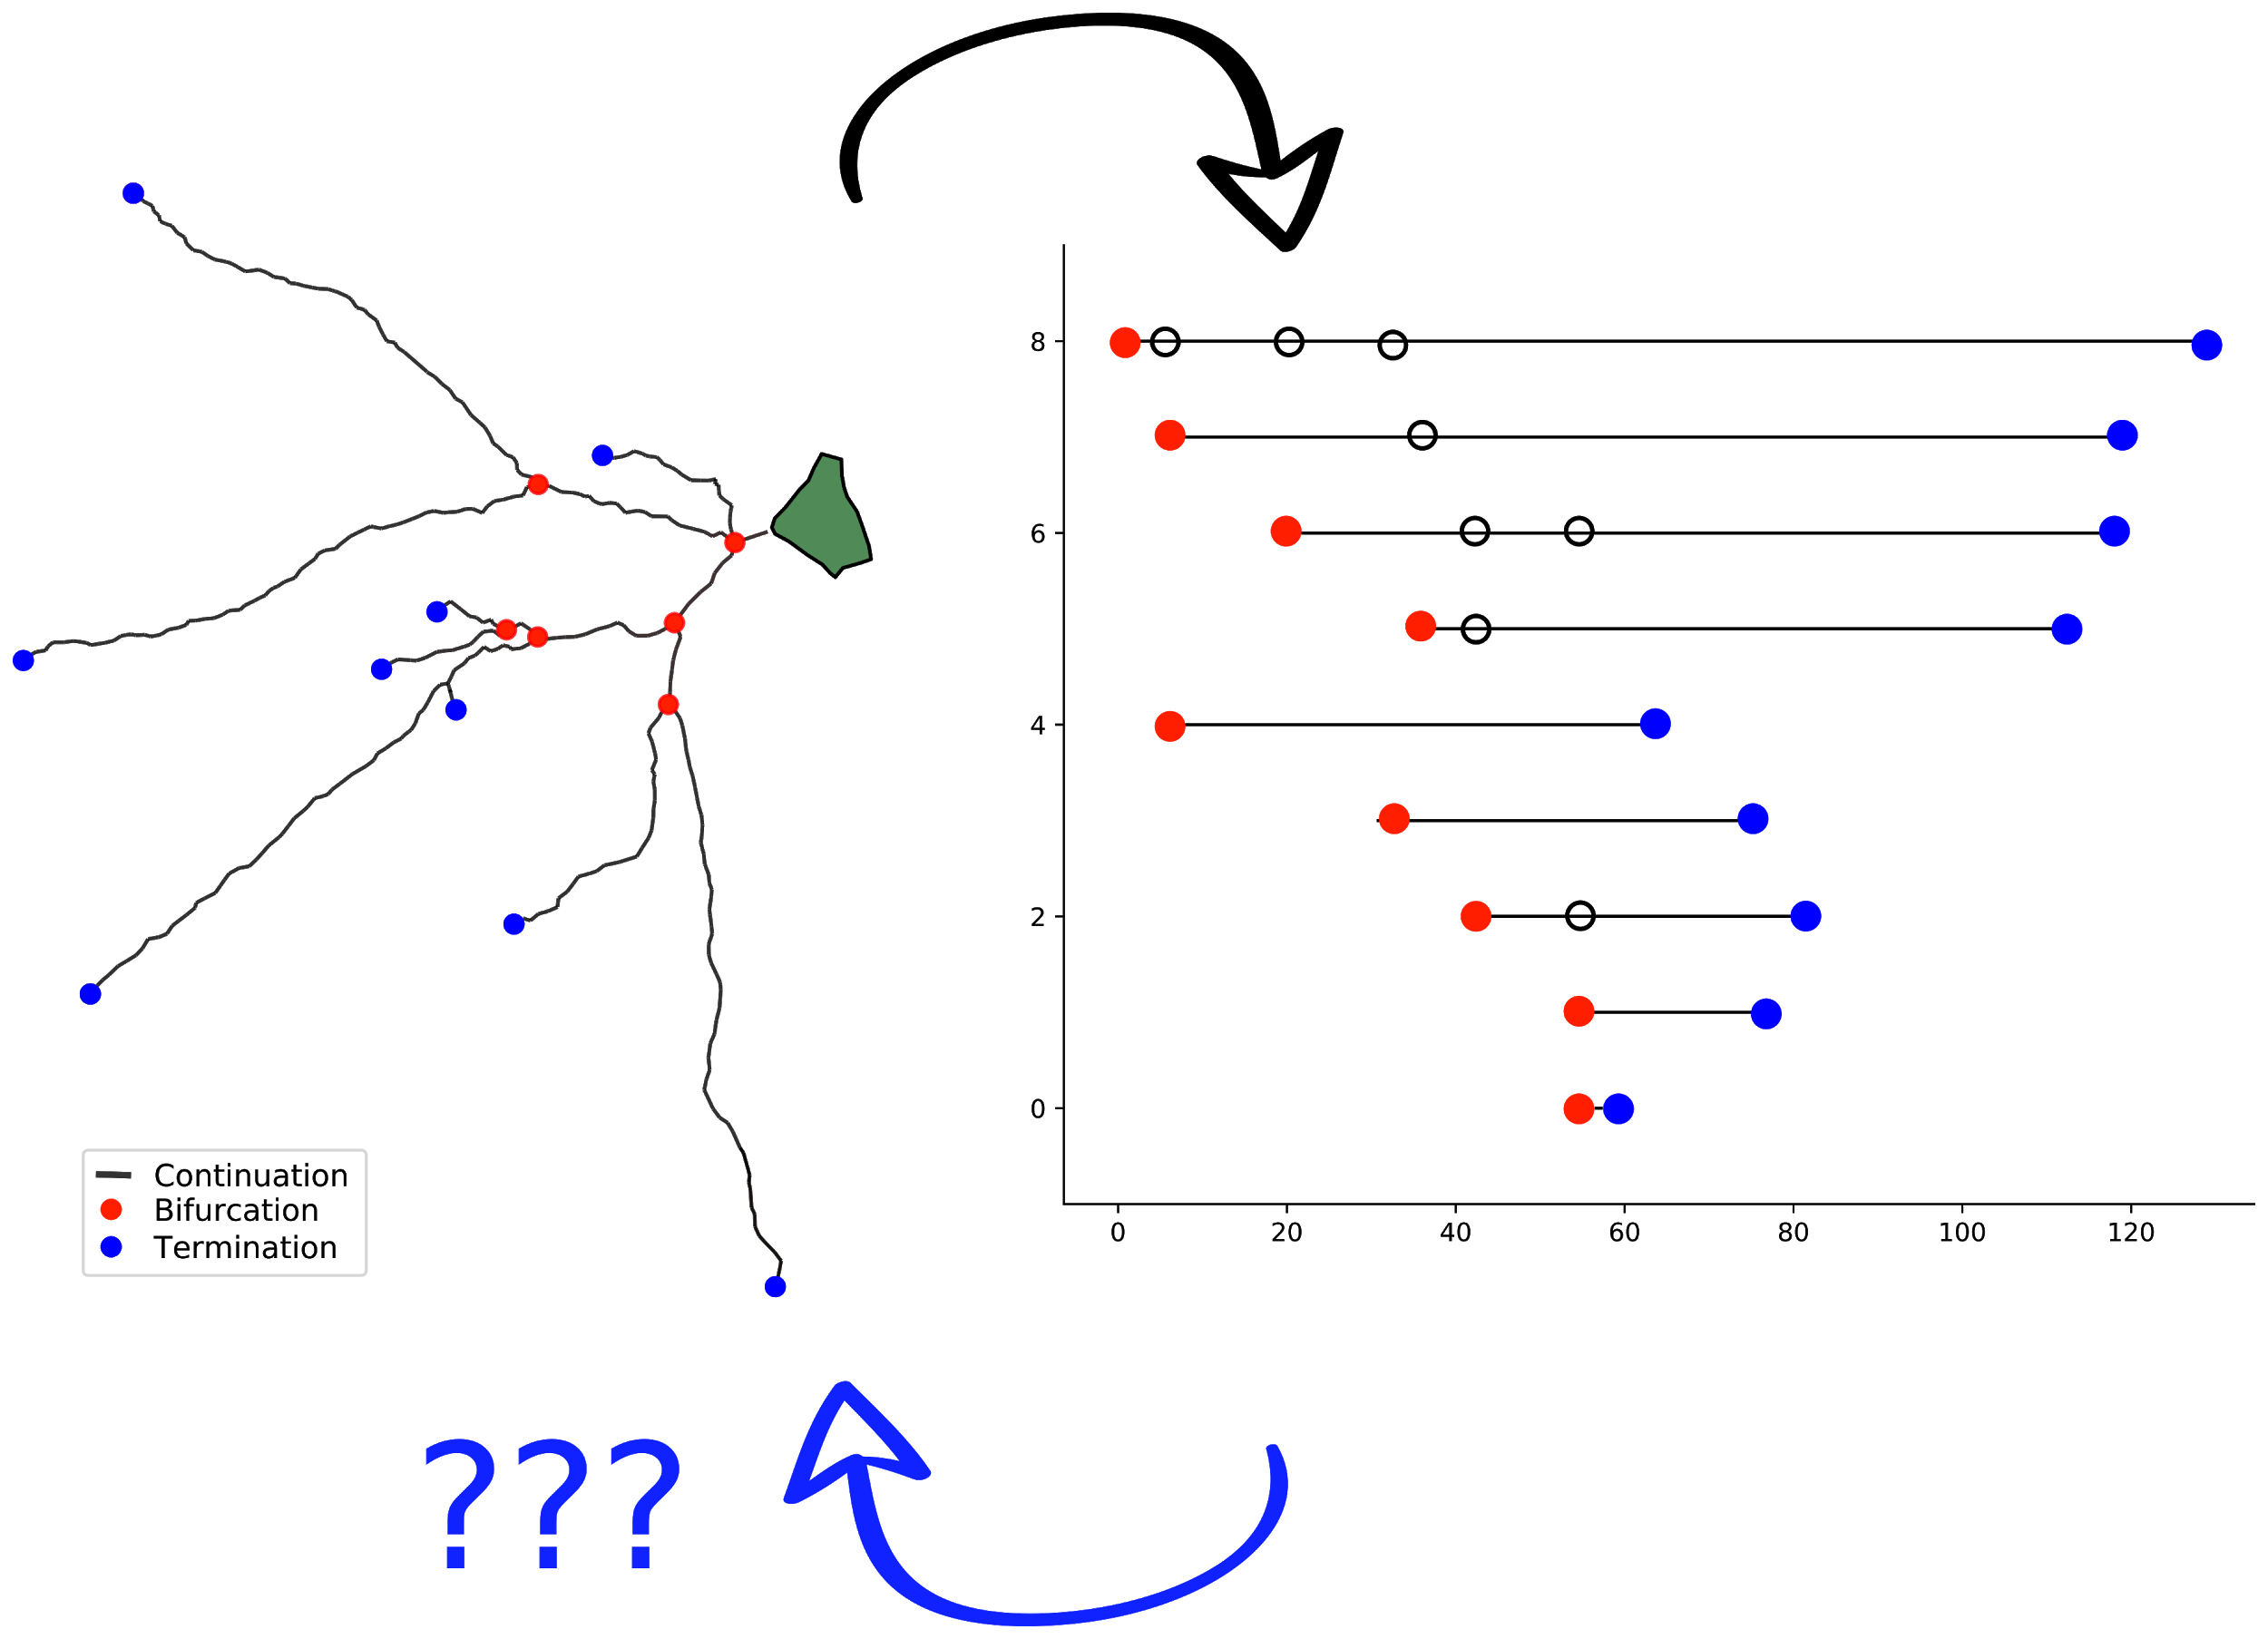
The inverse problem
But why do it?

Slide 12
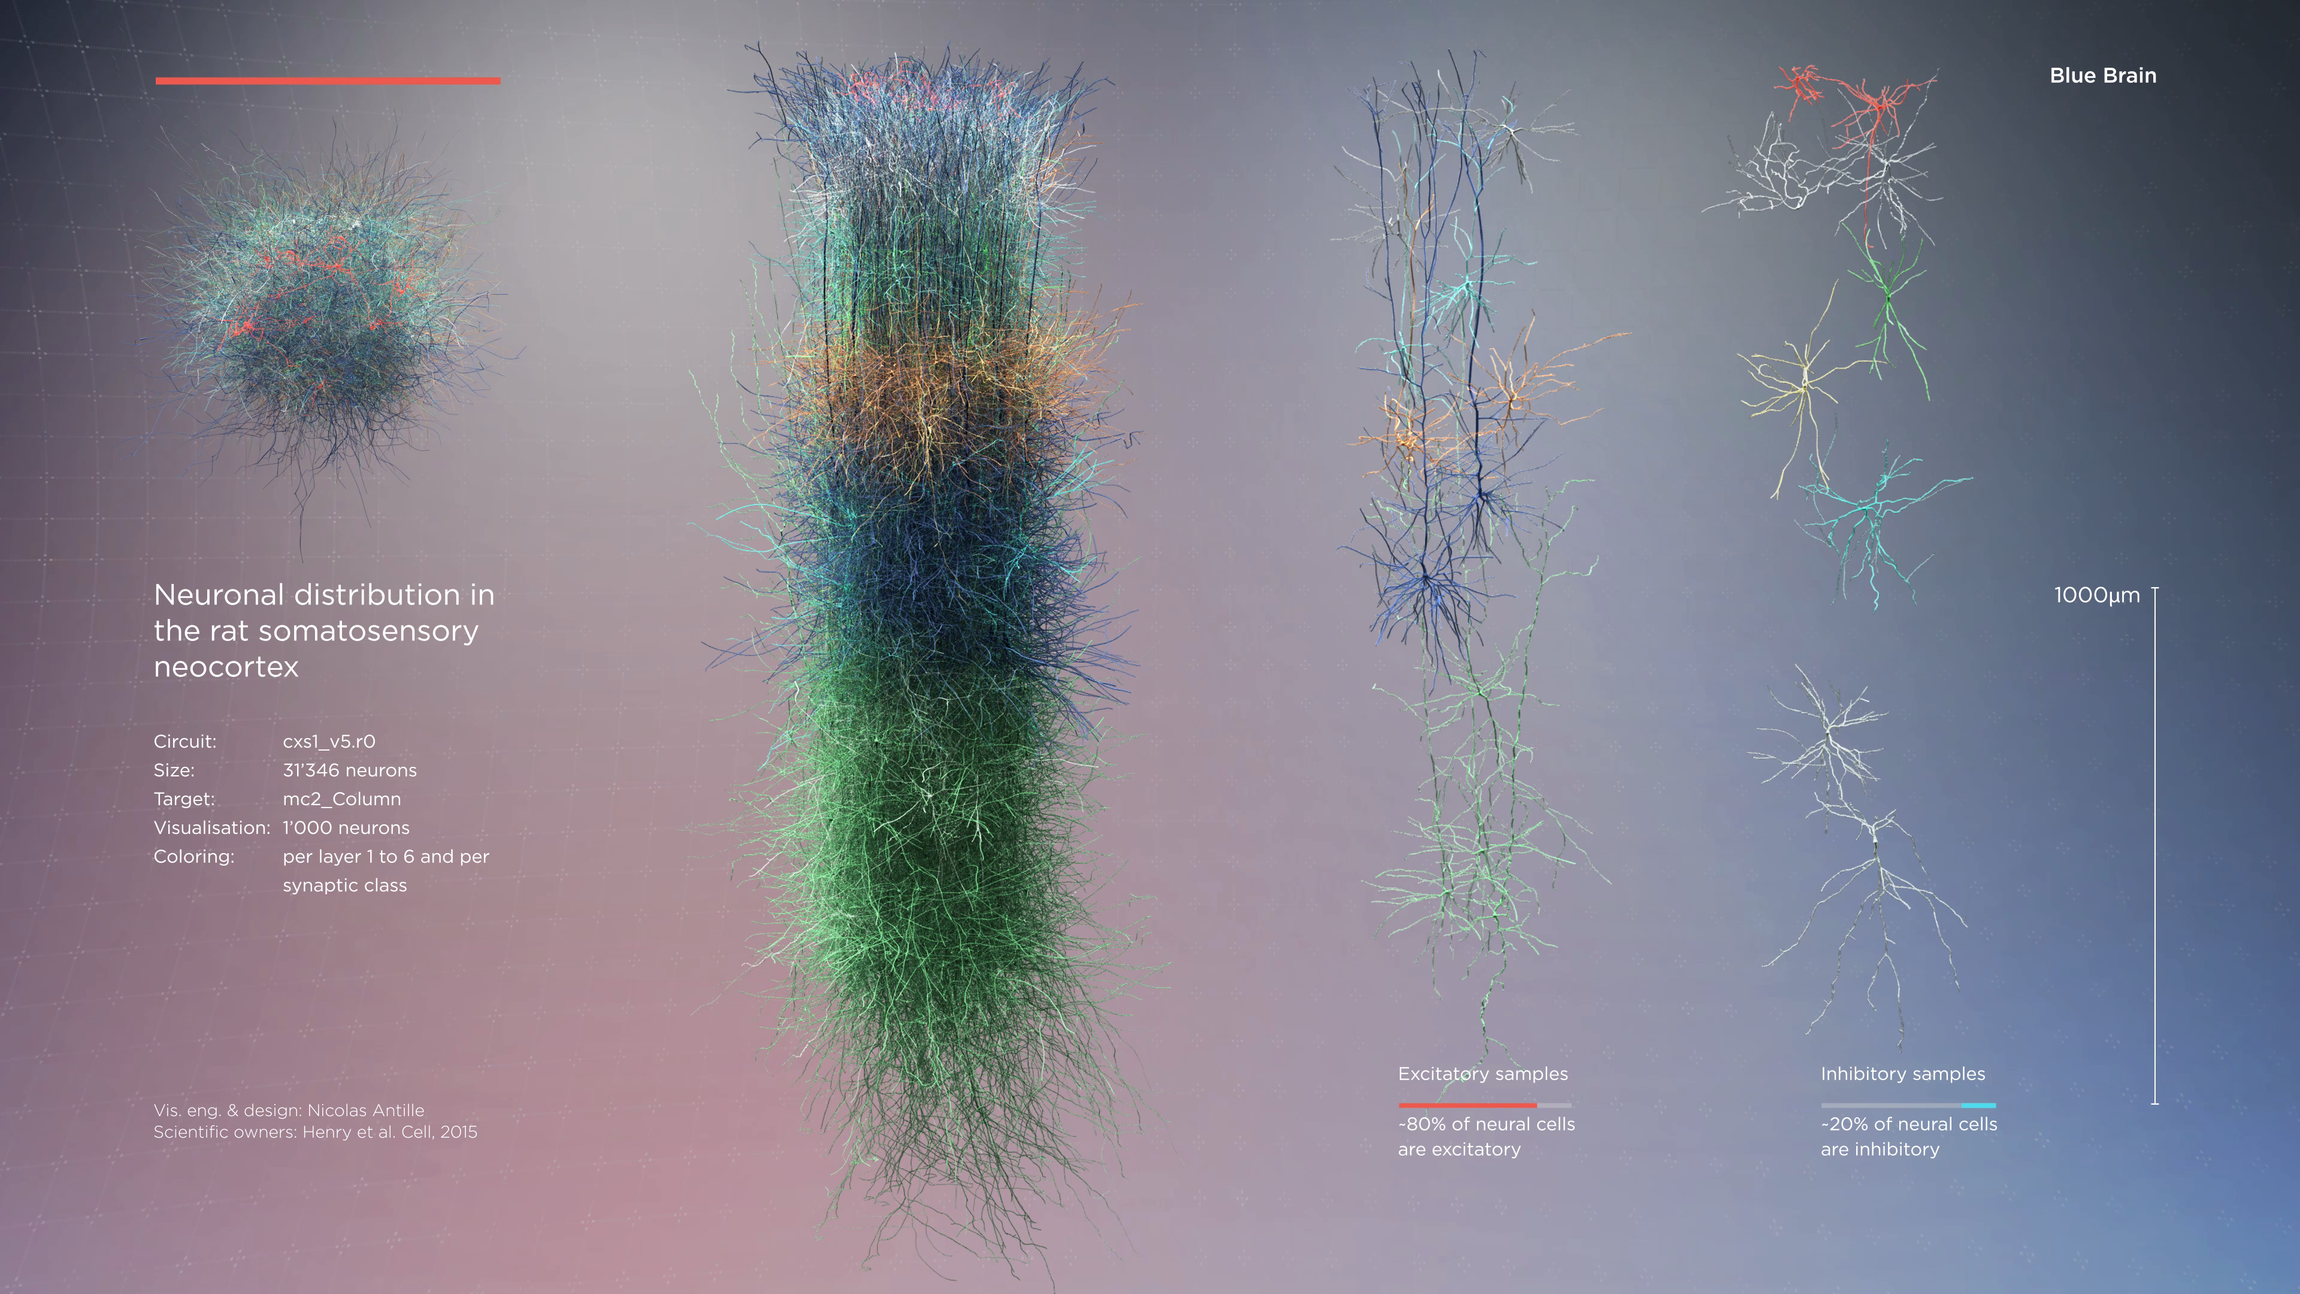
The Blue Brain microcircuit

Slide 13
Stages of neuron growth
Initiation of neurites
Neurite elongation
Axon path-finding
Neurite branching

Slide 14
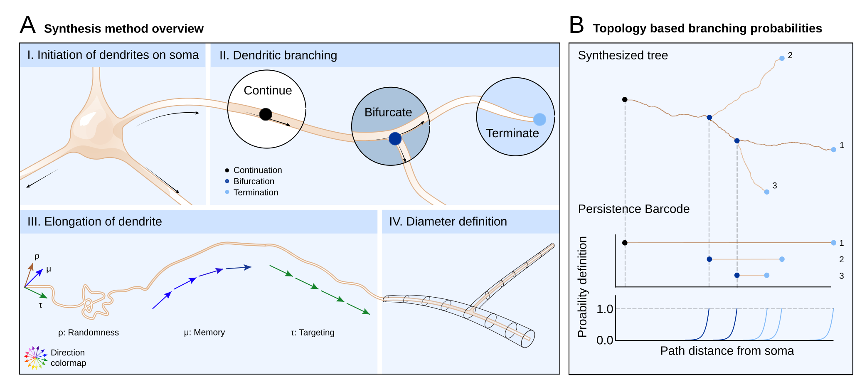
The synthesis algorithm
Crucial parameter: 𝜆
Notes:
Each growing tip is assigned a bar, sampled from the barcode, that includes a starting ra- dial distance B, an ending radial distance T and a bifurcation angle A (see Appendix(TBD)). At each step the growing tip first checks the probability to bifurcate, then the probability to terminate. If the growing tip does not bifurcate or terminate, then the branch contin- ues to elongate. The probability to bifurcate depends on the starting path distance B. As the growing tip gets closer to the radial distance B the probability to bifurcate increases exponentially until it reaches the highest possible value (1.0). Similarly, the probability to terminate depends exponentially on the ending radial distance T.
At a bifurcation, two new branches are generated (Appendix(TBD), Algorithm 5), and the directions of the daughter branches depend on the bifurcation angle A. Depending on the neurite type, different rules are optimal for the bifurcation angles.

Slide 15
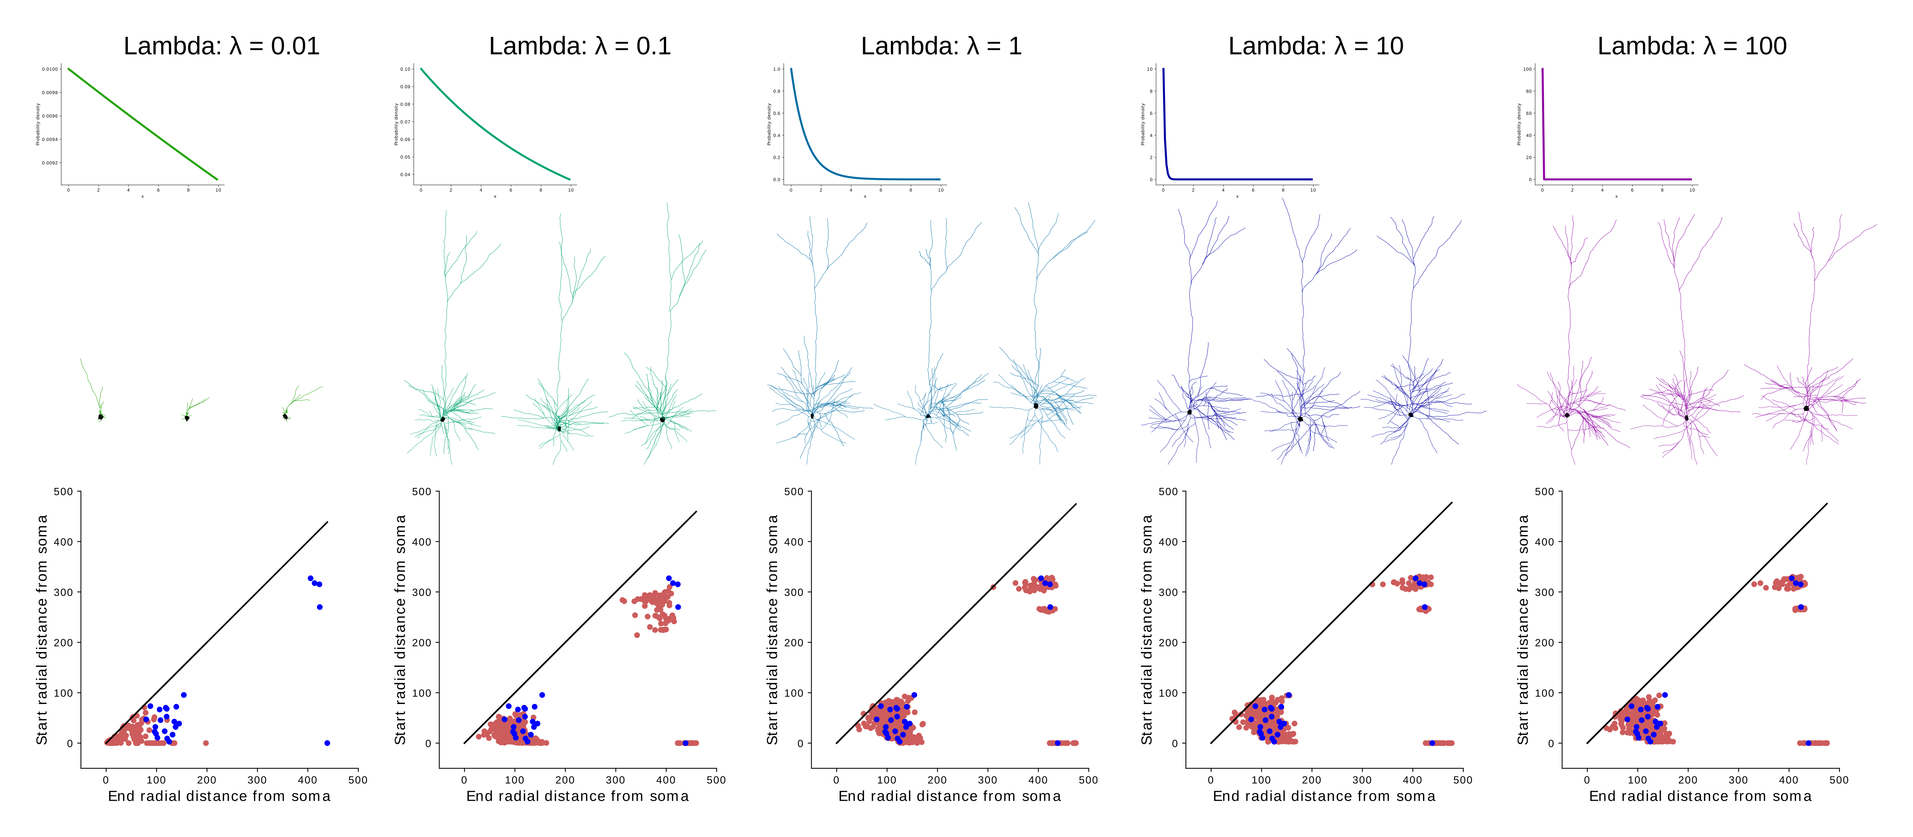
Dependency on 𝜆

Slide 16
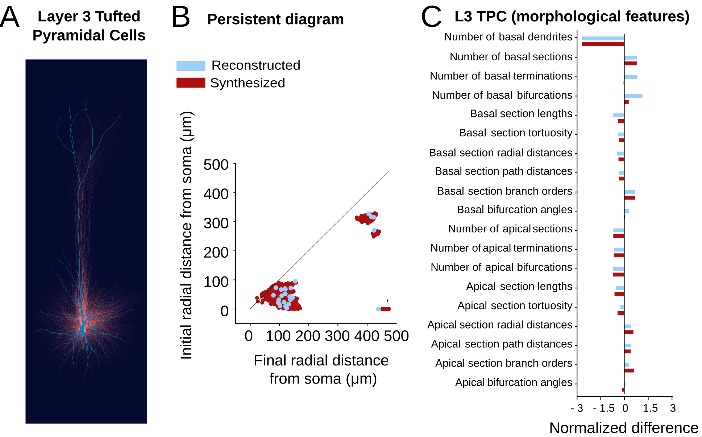
Morphological fidelity

Slide 17
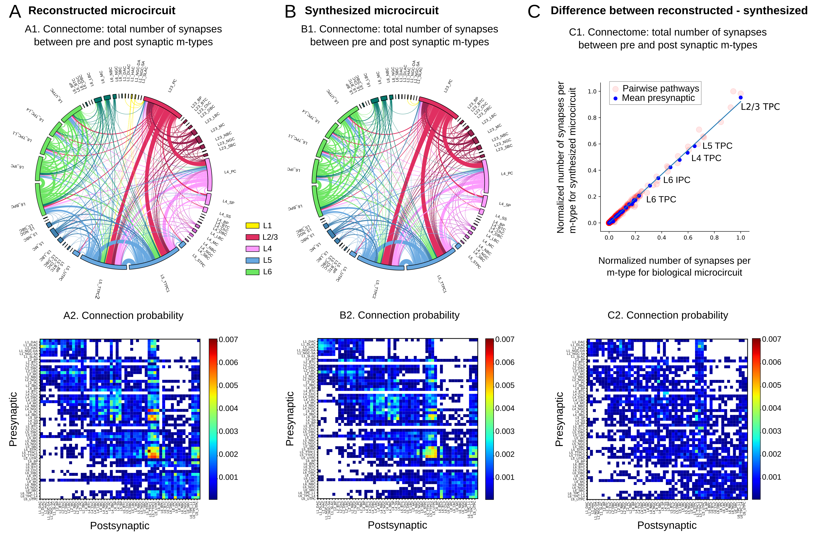
Global connectivity comparison

Slide 18
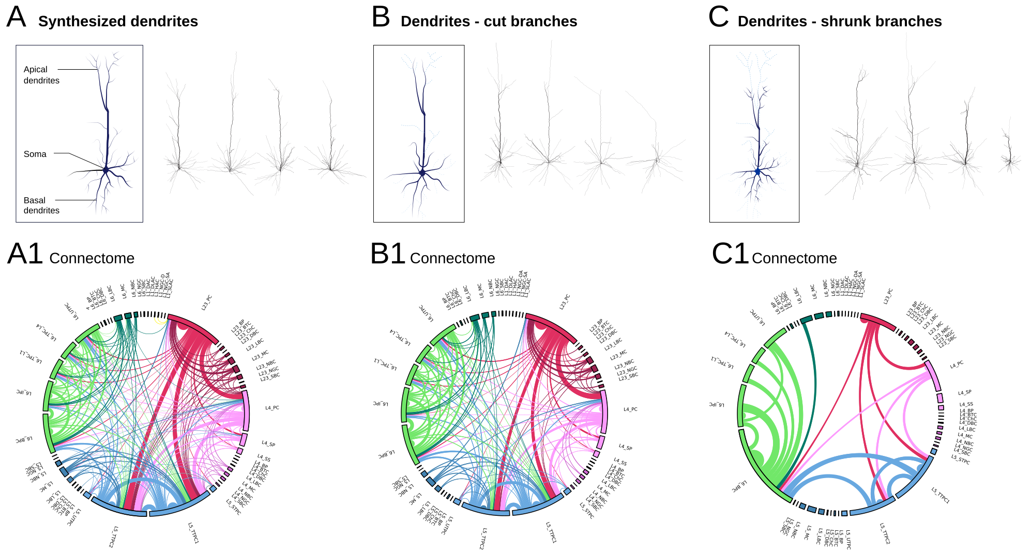
Effect of perturbing barcodes

Slide 19
A mathematical perspective
(Work in progress with A. Garin and L. Kanari)

Slide 20
Geometric trees
A finite rooted tree is a finite acyclic graph with a distinguished vertex of degree 1.
A geometric tree is an emedding of a finite rooted tree in ℝ³.
T = set of geometric trees
T, T’ ∊ T are combinatorially equivalent if they are embeddings of the same finite rooted tree: T ∼_{comb} T’ .

Slide 21
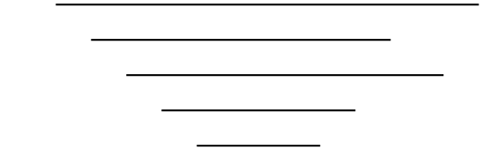
Strict barcodes
A barcode is a finite multiset {(b_{i},d_{i})}_{0≤i≤n} of intervals in ℝ.
A barcode is strict if
  all the b_{i} and d_{i} are distinct, and
  b_{i-1}< b_{i} and d_{i} < d₀ for all i≥ 1.

Slide 22
Strict barcodes
0
B = set of strict barcodes, B_{n} = {𝒷 ∈ B | 𝒷 has n+1 bars }.
∃ B_{n} ⟶ S_{n}: 𝒷={(b_{i},d_{i})}_{0≤i≤n} ⟼ σ_{𝒷} where σ_{𝒷}(i) = #{ j | d_{j} ≤ d_{i} }.
Permutation equivalence: 𝒷 ∼ 𝒷’ iff σ_{𝒷} = σ_{𝒷’} .
1
2
3
4

Slide 23
TMD: T ⟶ B
T ∊ T is a tree realization of 𝒷 ∊ B if TMD (T) = 𝒷 .
For 𝒷 ∊ B , let
R (𝒷) =TMD⁻¹ (𝒷)/ ∼_{comb}
the set of combinatorial equivalence classes of tree realizations of 𝒷.
Properties: 1) 𝒷 ∼ 𝒷’⇔ R (𝒷) = R (𝒷’).
2) #R (𝒷) = ∏_{1≤i≤n} #{ j<i | d_{i}<d_{j} }.
--the realization number of 𝒷

Slide 24
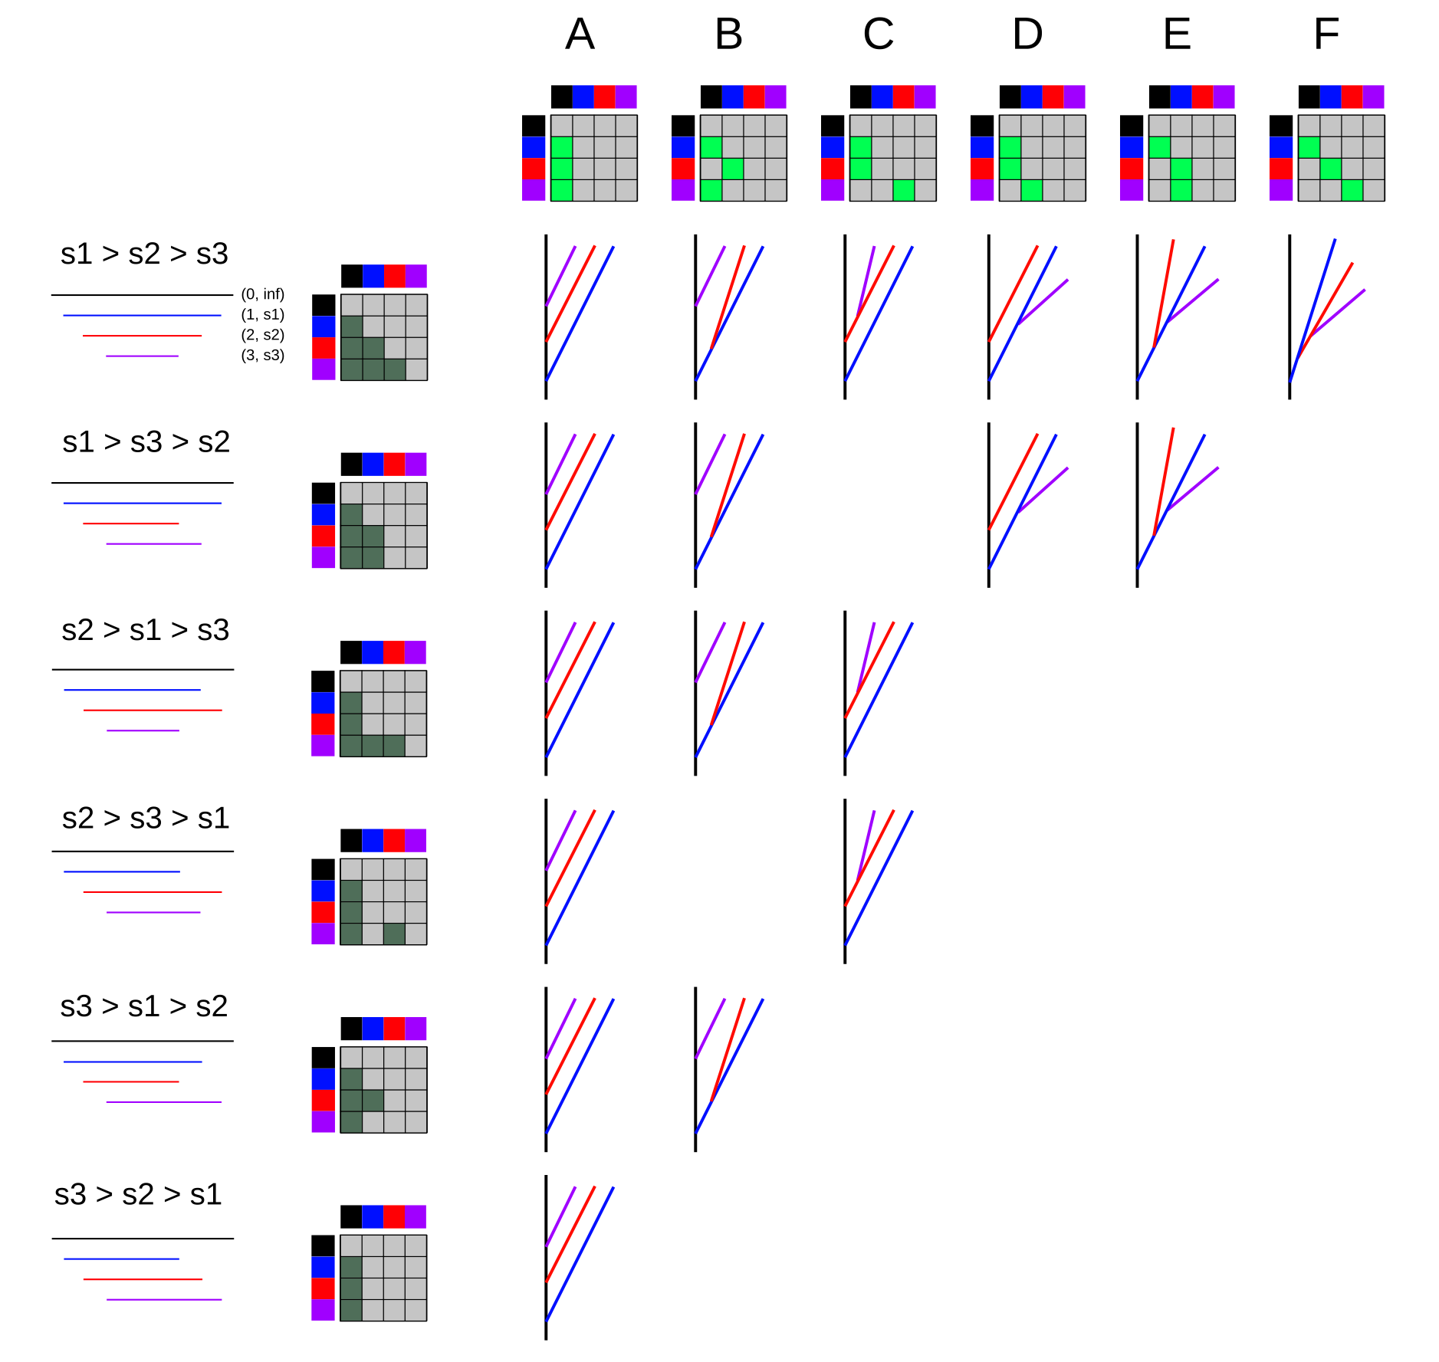
Tree realizations: n =3
All possible types of tree realization of strict barcodes
with four bars.
Columns are combinatorial equivalence classes of trees.
Rows are permutation equivalence classes of barcodes.

Slide 25
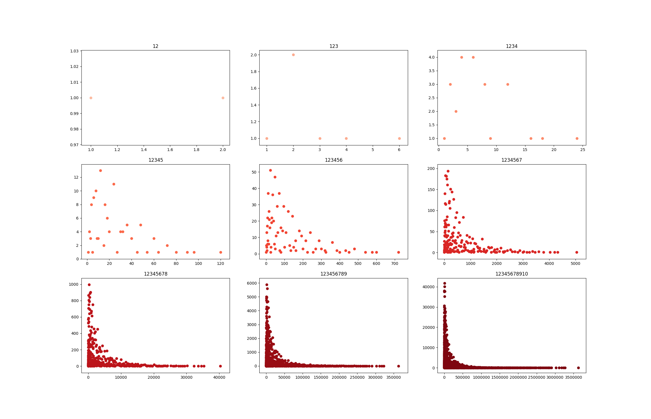
Realization numbers for 2 ≤ n ≤ 10

Slide 26
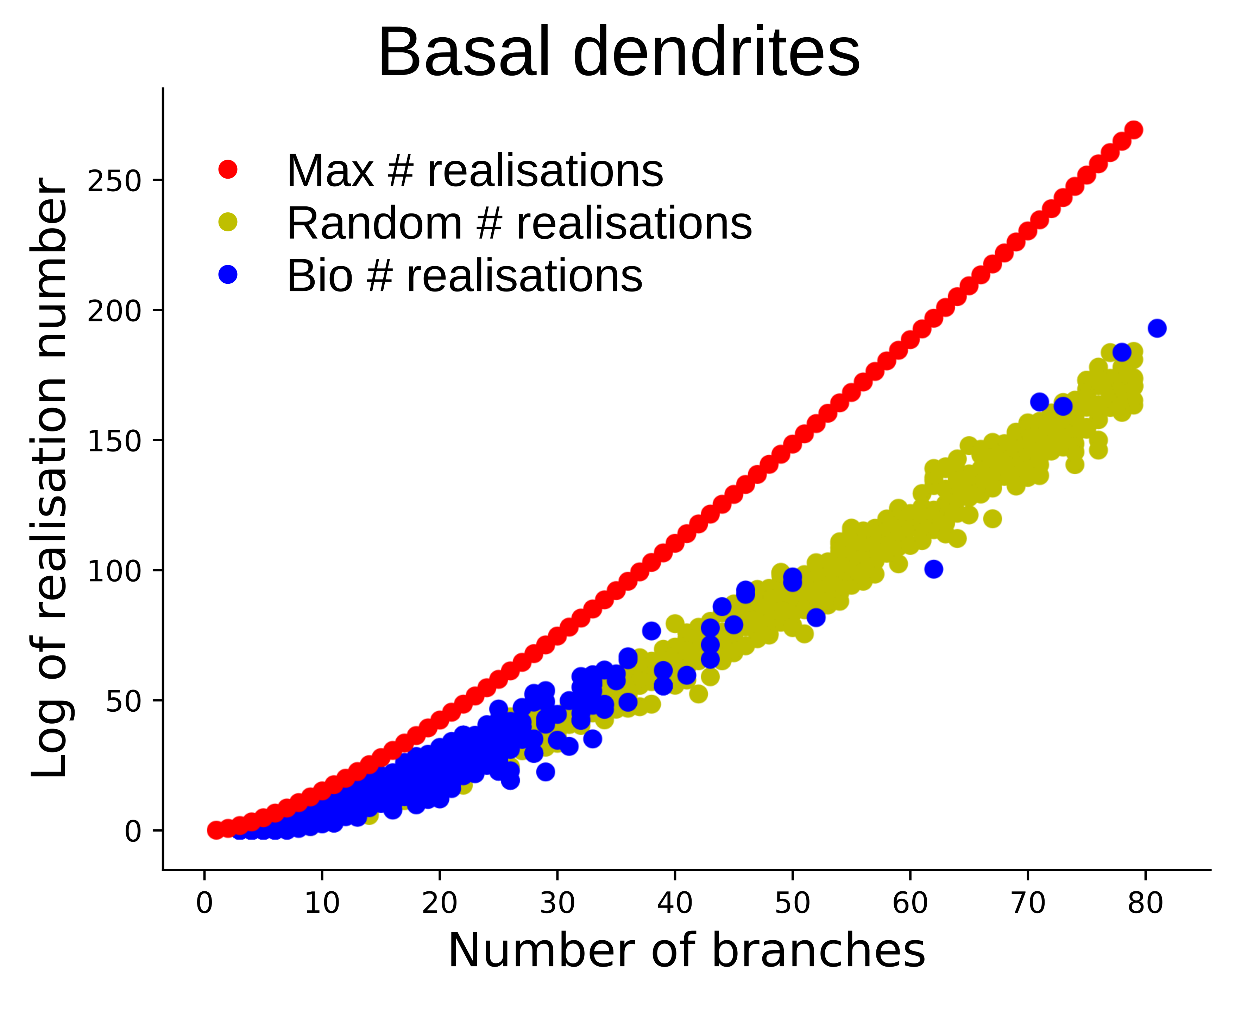
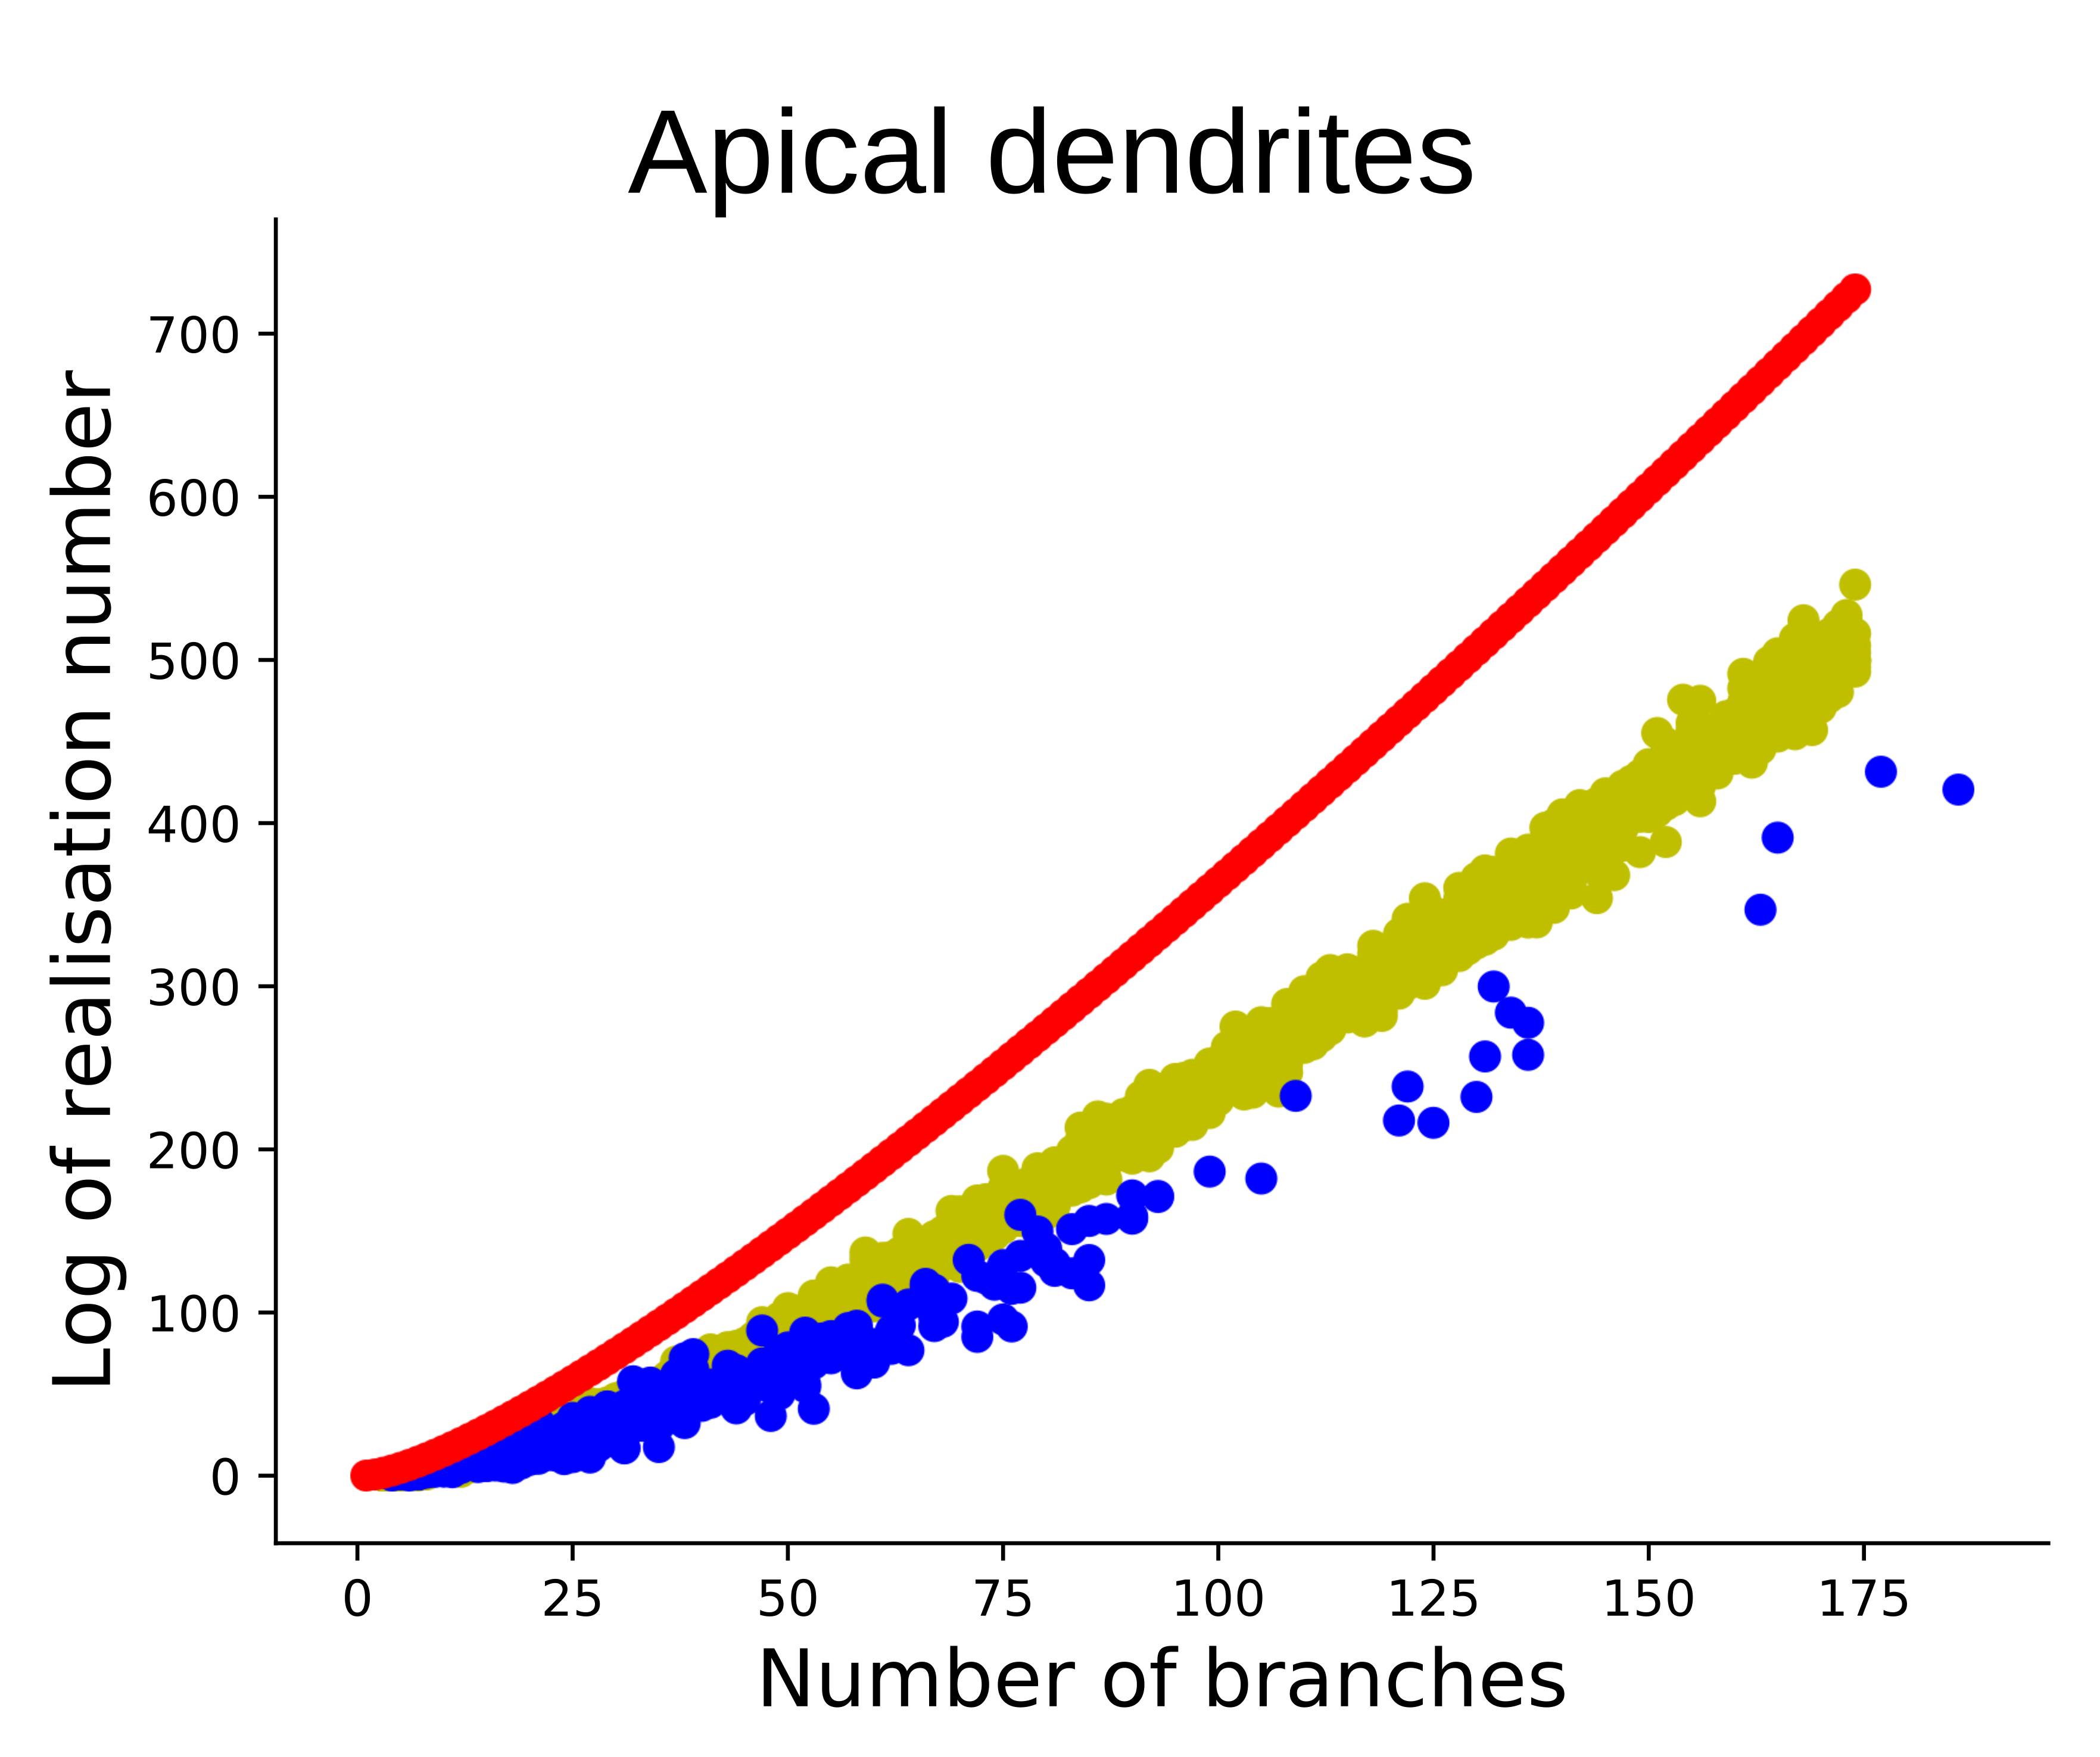
Biological barcodes are special

Slide 27
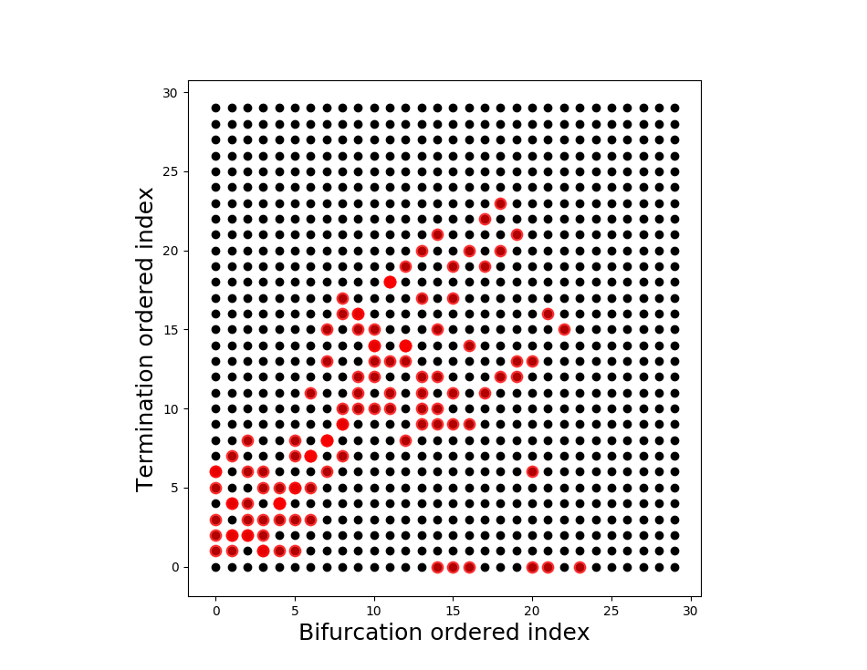
Biological barcodes are special

Slide 28
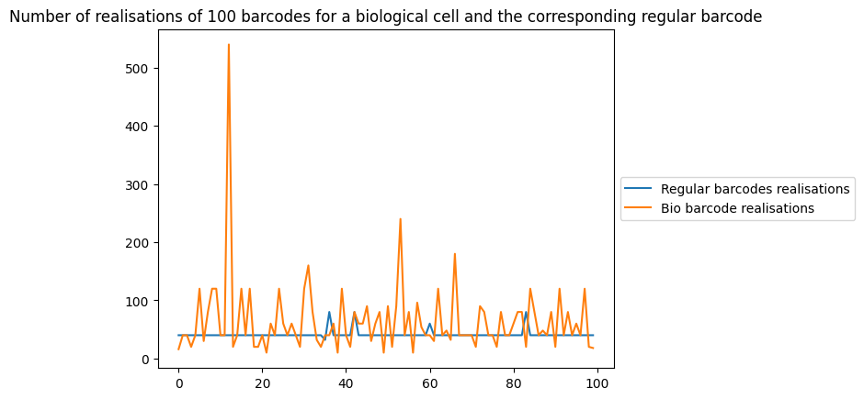
TNS_{𝜆} : B ⟶ P(T )
Source of approximate tree realizations

Slide 29
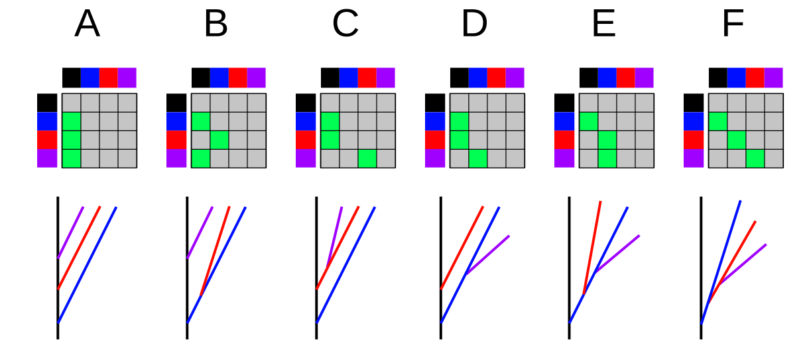
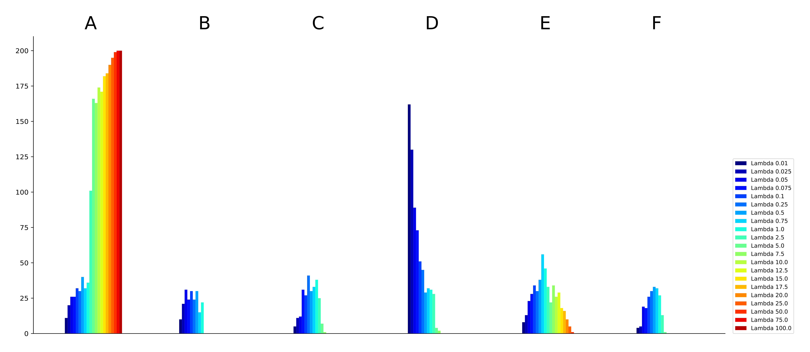
Dependency on 𝜆

Slide 30
Questions
How to characterize the subspace of biological barcodes? Which permutation equivalence classes are biologically realizable?
How sensitive is TNS_{𝜆} to noise? How does this depend on 𝜆?
How to exploit the “cellular” decomposition of the space of strict barcodes into permutation equivalence classes?

Slide 31
The team
EPFL: Kathryn Hess Bellwald, Adélie Garin, Sébastien Morand, Martina Scolamiero (now KTH)
Blue Brain & LNMC: Marwan Abdellah, Nicolas Antille, Lida Kanari, Henry Markram, Julie Meystre, Rodrigo Perin, Srikanth Ramaswamy, Ying Shi, Julian Shillcock
Other collaborators: Pawel Dlotko (Swansea), Ran Levi (Aberdeen), Yun Wang (Allen Brain)

Slide 32
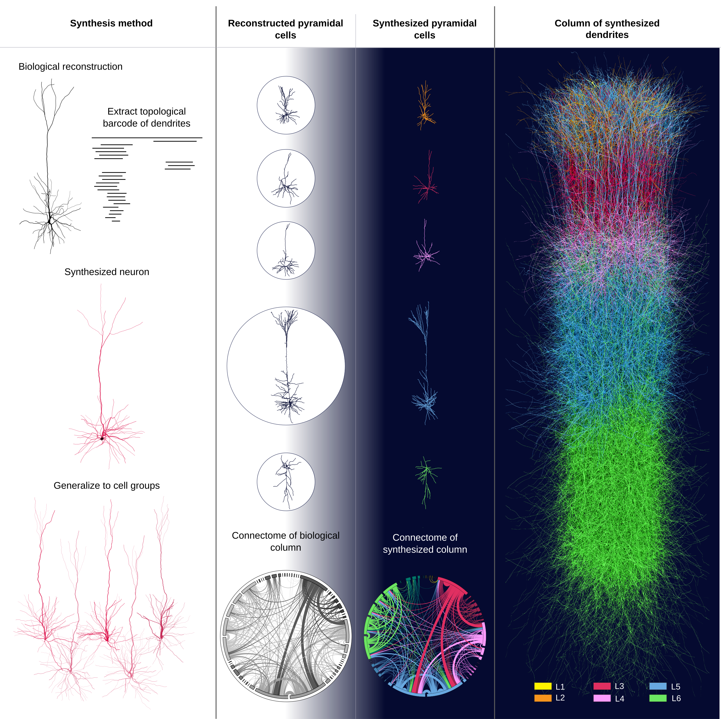
Thank you!

Slide 33
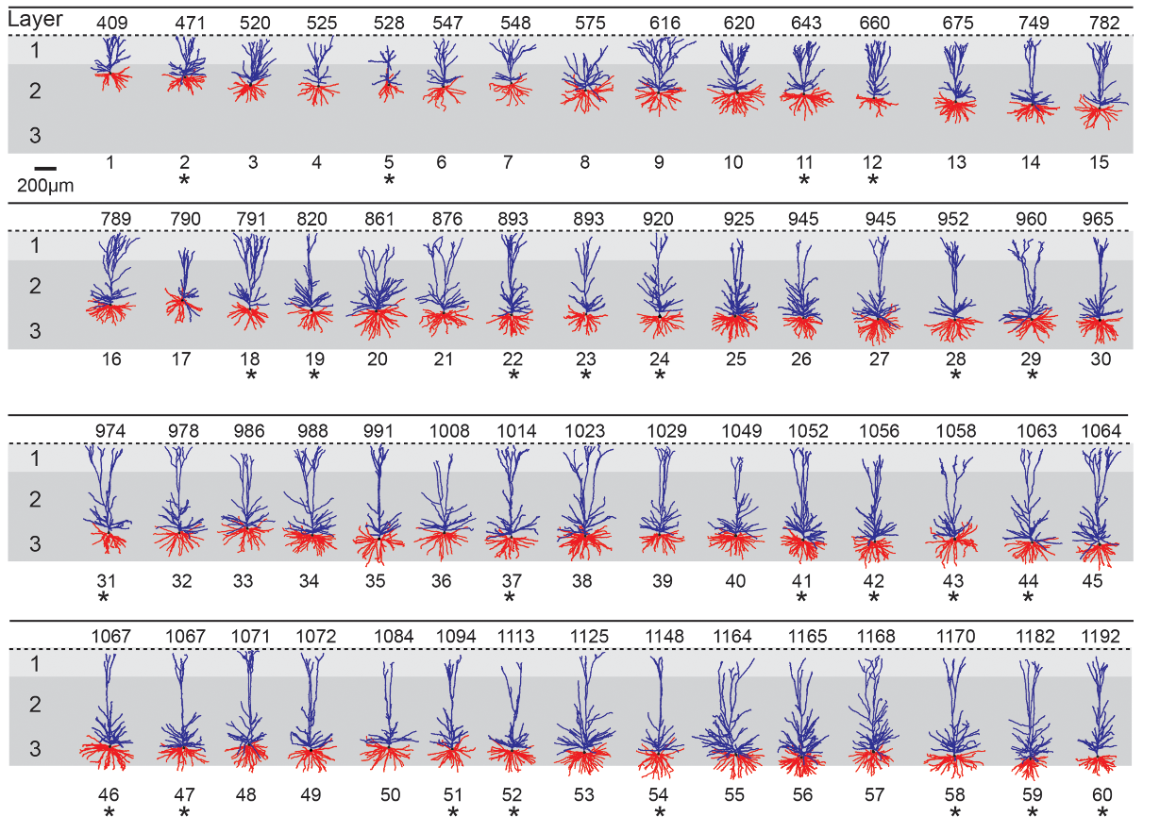
Human pyramidal cells

Slide 34
The synthesis algorithm
Generate the soma, modeled by a sphere, with radius sampled from a biological distribution.
Sample the number of neurites from a biological distribution dependent on cell type.
Initialize each neurite with a trunk attached the soma, at a position sampled from a biological distribution, and with a barcode (augmented with branching angles) sampled from TMDs of biological neurons of that cell type.
Elongate each branch segment by segment as a random walk with memory.
At each step, a growing tip is assigned probabilities to bifurcate and terminate that depend on the path distance from the soma and on the chosen bar code (modified Galton-Watson tree).
Notes:
Each growing tip is assigned a bar, sampled from the barcode, that includes a starting ra- dial distance B, an ending radial distance T and a bifurcation angle A (see Appendix(TBD)). At each step the growing tip first checks the probability to bifurcate, then the probability to terminate. If the growing tip does not bifurcate or terminate, then the branch contin- ues to elongate. The probability to bifurcate depends on the starting path distance B. As the growing tip gets closer to the radial distance B the probability to bifurcate increases exponentially until it reaches the highest possible value (1.0). Similarly, the probability to terminate depends exponentially on the ending radial distance T.
At a bifurcation, two new branches are generated (Appendix(TBD), Algorithm 5), and the directions of the daughter branches depend on the bifurcation angle A. Depending on the neurite type, different rules are optimal for the bifurcation angles.

Slide 35
The elongation step
Each segment is of length 1μm
The direction vector of a segment is
  D = ρR + τT + μM for some ρ + τ + μ = 1
where
  M (memory) is a weighted sum of the previous direction vectors of the branch, where weights decrease with distance from the tip;
  T (target) is chosen at the beginning of each branch and depends on the biological branch angles;
  R (random) is a vector of fixed length sampled uniformly from three-dimensional space at each step.
For computational efficiency the growth of each branch is independent of that of other branches.

Slide 36
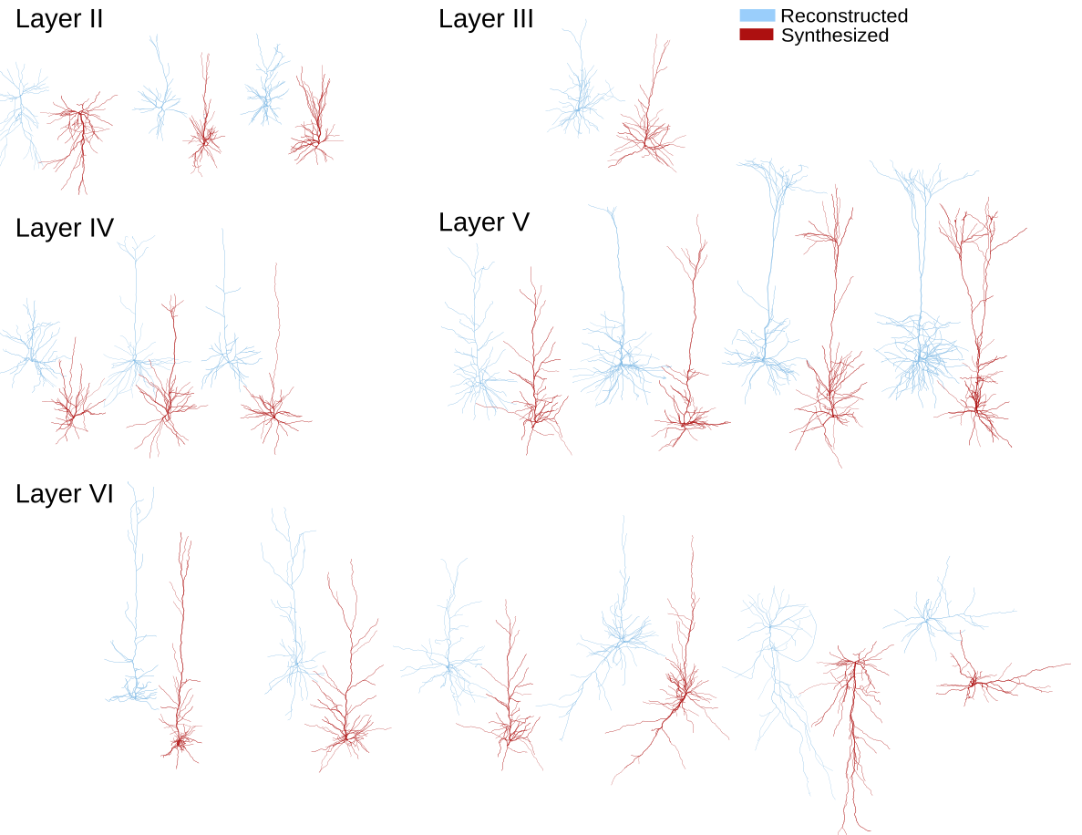
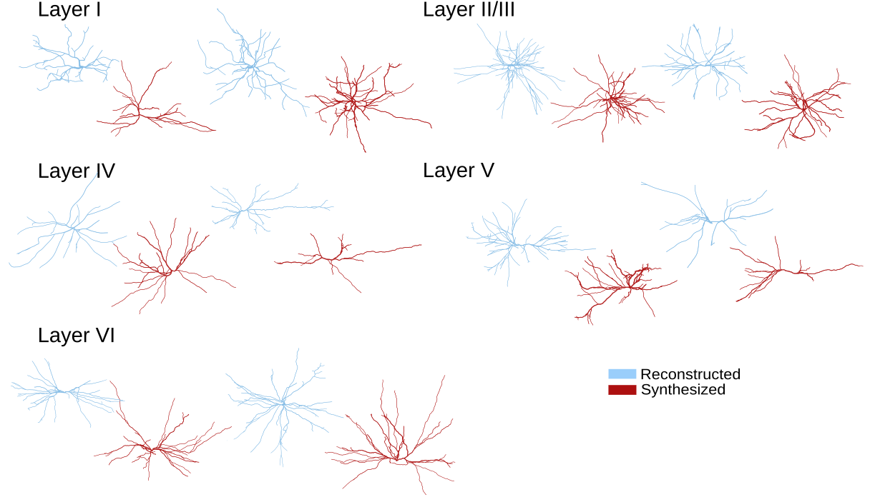
Synthesized neurons
Pyramidal (excitatory) cells
Inhibitory cells

Slide 37
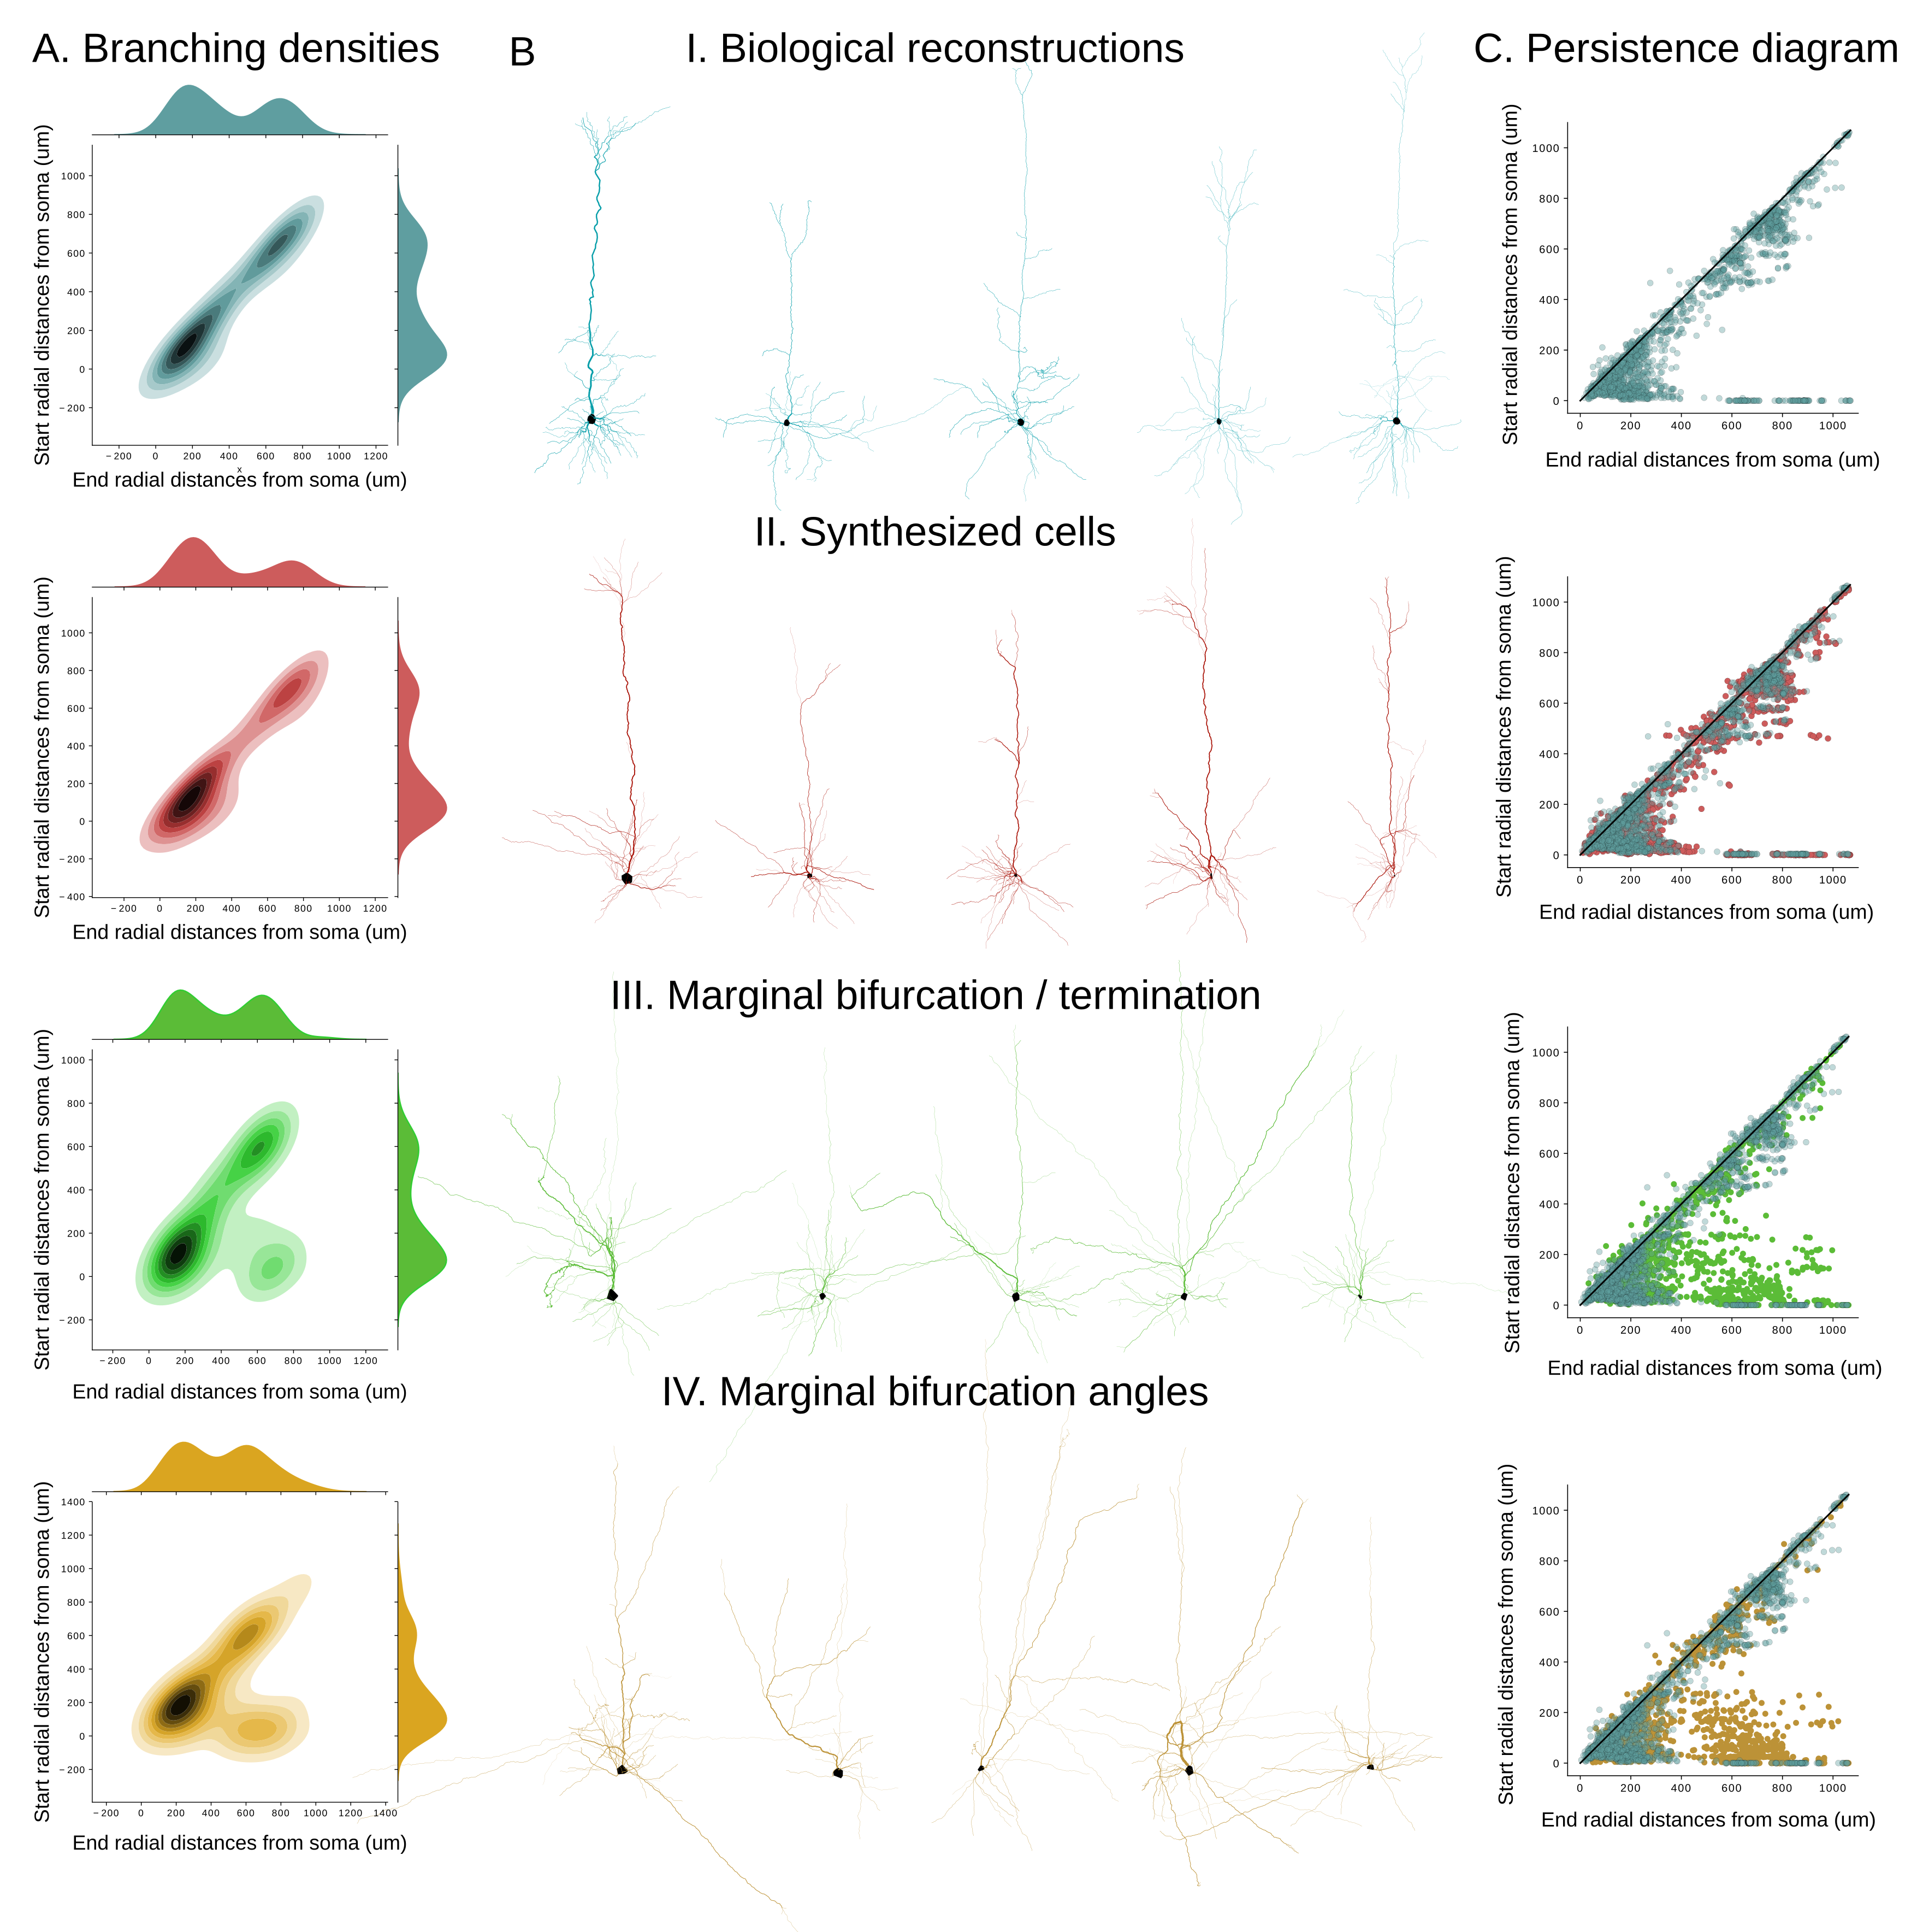
Coupling bifurcation and termination

Slide 38
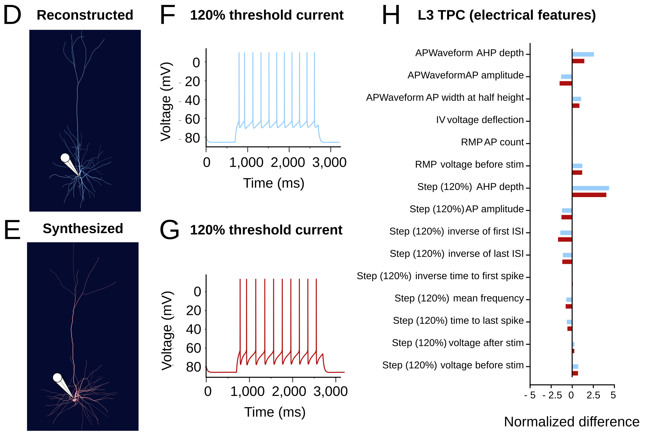
Electrical fidelity

Slide 39
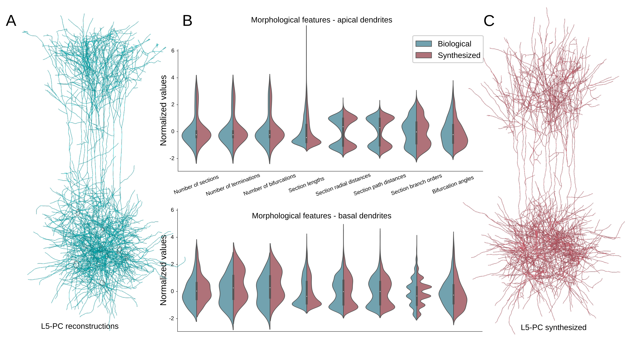
Synthesized populations: L5 PC

Slide 40
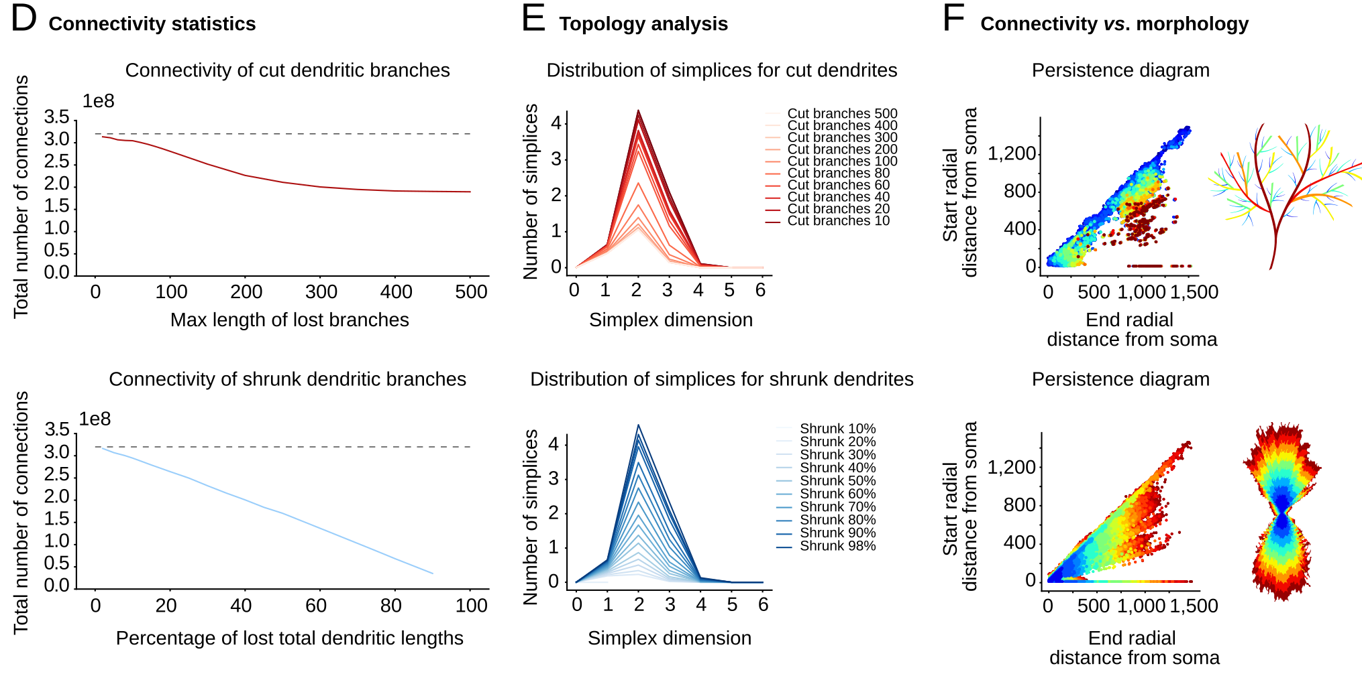
Effect of perturbing barcodes

