Slide 1
Spatial-temporal kriging and Navier-Stokes equations: a prominent example of physics-based analytics
C. F. Jeff Wu
Georgia Institute of Technology
Interplay between physics and data analytics.
Connection between uncertainty quantification (UQ) and statistical surrogate modeling.
Spatio-temporal modeling for injector design: physics-based simulation and data-driven emulation.
Summary remarks.

Slide 2

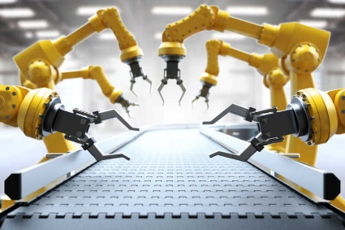
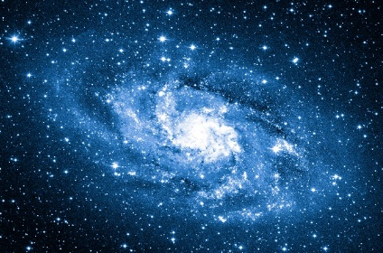
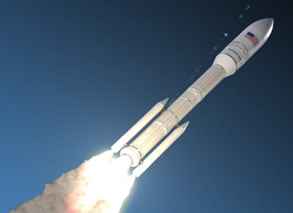
Physics-based analytics
Most “learning” in big-data is driven by the data alone.
Some believe that this is sufficient due to sheer data size, but this is inadequate for many applications:
Manufacturing: Incorporating process physics with analytics allows for better anomaly detection and control,
Astrophysics: Incorporating physical models with analytics allows for interpretable scientific discoveries,
Rocket Design: Incorporating governing physics with analytics allows for improved emulation and instability analysis.
Physics-based analytics

Slide 3
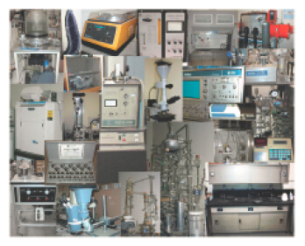
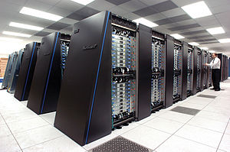
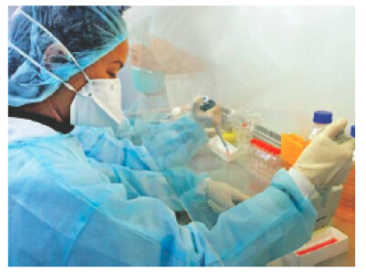

Why computer experiments?
No need for expensive lab equipment and materials, less costly than physical experiments.
Not affected by human and environmental factors.
Study dangerous or infeasible physical experiments, such as ammunition detonation.

Slide 4
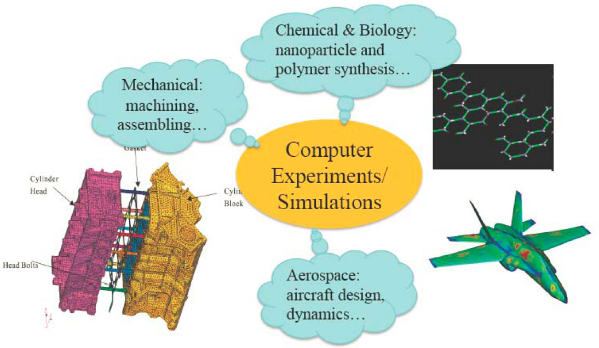
Some examples

Slide 5
Uncertainty Quantification (UQ)
The process of quantifying uncertainties associated with model calculations of true physical QOIs, to account for important sources of uncertainty and quantifying the contributions of specific sources to the overall uncertainty.
Major aspects:
Sensitivity analysis, emulation, construction of reduced models;
Forward propagation of input uncertainties through large-scale computational models;
Inverse problems and parameter estimation;
Quantifying model discrepancy/structural error;
Aggregating these various sources of uncertainty to estimate prediction uncertainty.

Slide 6
Statistical Surrogate Model
prediction, optimization
surrogate model
(Kriging)
more FEA / LES runs
computer modeling
(finite-element simulation, large-eddy simulation)
physical experiment
or observations

Slide 7
Statistical Emulator (Surrogate) and UQ
prediction, optimization
UQ
UQ
Emulator
more FEA / LES runs
Simulator
physical experiment
or observations

Slide 8
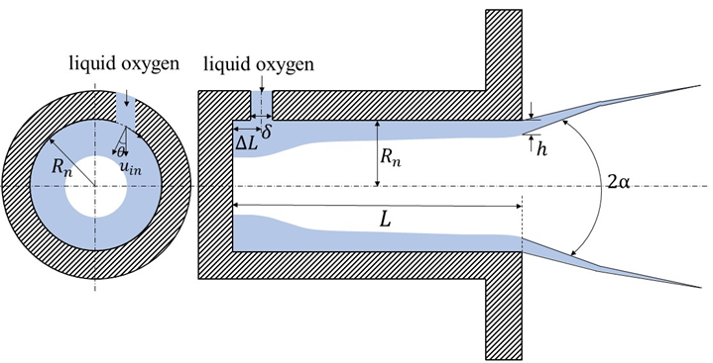
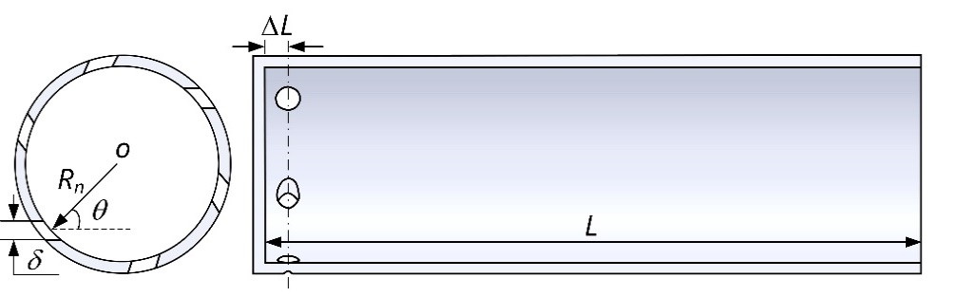
Example of Computer Simulation: Injector design
Configuration:
Open-ended swirl-type monopropellant injector design used in thermal engines (Zong and Yang, 2008)
Liquid oxygen (LOx, at 120 K) is delivered into a gaseous environment (at 300 K)
Velocity and angle of LOx input allow for adequate mixing of fuel and oxidizer

Slide 9
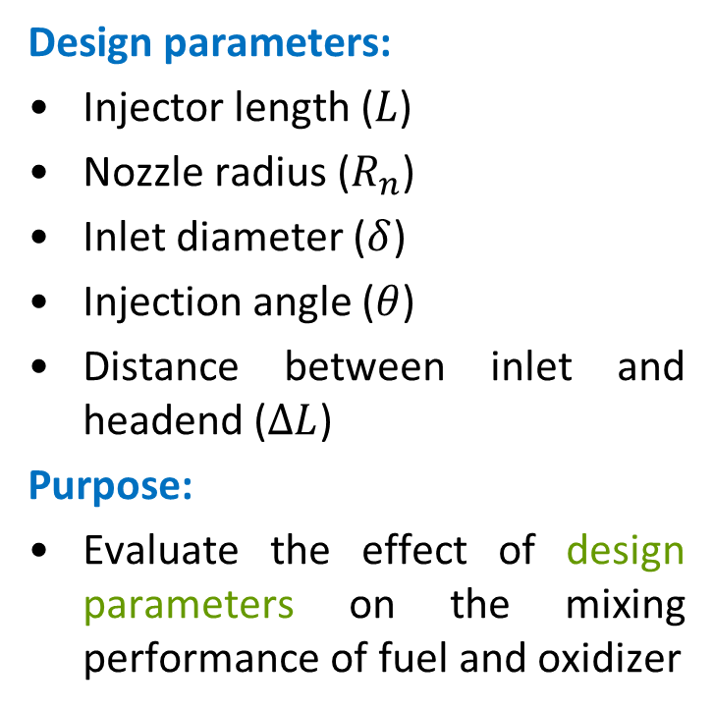
Example of Computer Simulation: Injector design
Design parameters:
Injector length ($L$)
Nozzle radius ($R_{n}$)
Inlet diameter ($δ$)
Injection angle ($θ$)
Distance between inlet and headend ($ΔL$)
Purpose:
Evaluate the effect of design parameters on the mixing performance of fuel and oxidizer

Slide 10
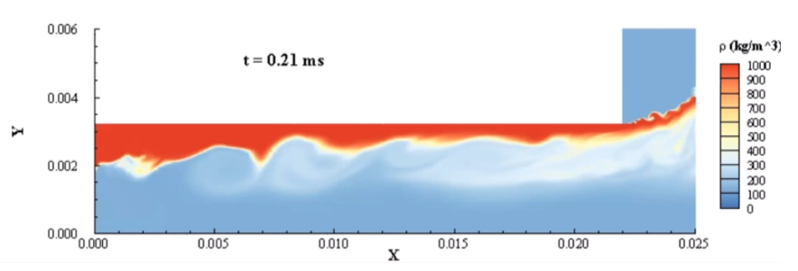
Large-Eddy Simulation output
Figure: Axial-symmetric density flow from large-eddy simulations (LES). The red flow is the input LOx, the blue flow is the gaseous fuel environment within the injector.

Slide 11
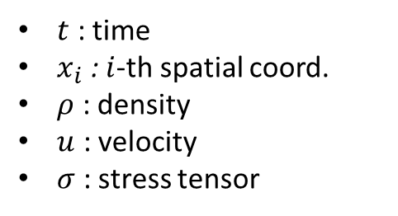
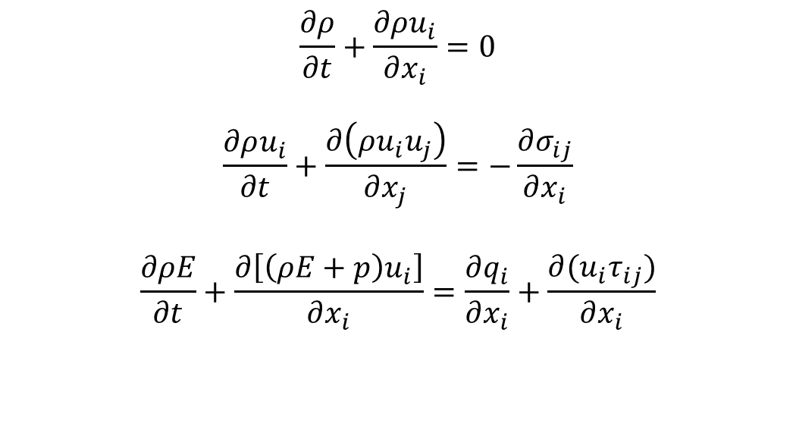
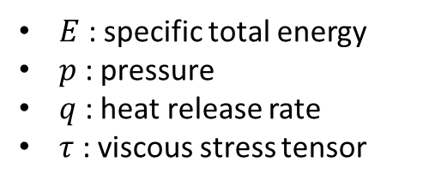
Governing PDEs: Navier-Stokes
Conservation of mass:
$$\frac{∂ρ}{∂t}+\frac{∂ρu_{i}}{∂x_{i}}=0$$
$$\frac{∂ρu_{i}}{∂t}+\frac{∂\left(ρu_{i}u_{j}\right)}{∂x_{j}}=−\frac{∂σ_{ij}}{∂x_{i}}$$
$$\frac{∂ρE}{∂t}+\frac{∂\left[\left(ρE+p\right)u_{i}\right]}{∂x_{i}}=\frac{∂q_{i}}{∂x_{i}}+\frac{∂(u_{i}τ_{ij})}{∂x_{i}}$$
Conservation of momentum:
Conservation of
energy:
Notation:
$t$ : time
$x_{i}$ : $i$-th spatial coord.
$ρ$ : density
$u$ : velocity
$σ$ : stress tensor
$E$ : specific total energy
$p$ : pressure
$q$ : heat release rate
$τ$ : viscous stress tensor

Slide 12
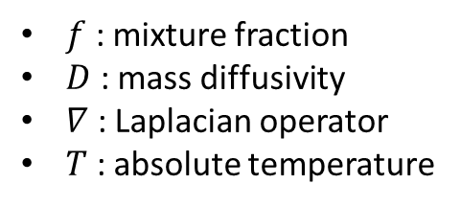


Governing PDEs: Chemistry
$$\frac{∂\overline{ρ}f}{∂t}+\frac{∂\left(\overline{ρ}u_{j}f\right)}{∂x_{j}}=\frac{∂}{∂x_{j}}\left(\overline{ρ}D∇_{j}f\right)$$
Mixture-Fraction transport:
Chemical terms in this transport equation are simulated using elementary reaction mechanisms, with rates following the modified Arrhenius equation:
$$k\left(T\right)=AT^{α}exp(−E_{a}/RT)$$
From this framework, six flow variables are obtained: $u$-, $v$-, $w$-velocity, density ($ρ$), temperature ($T$) and pressure ($P$)
Notation:
$f$ : mixture fraction
$D$ : mass diffusivity
$∇$ : Laplacian operator
$T$ : absolute temperature
$k(T)$ : reaction rate
$A$ : pre-exponential factor
$E_{a}$ : activation energy
$R :$ universal gas constant

Slide 13
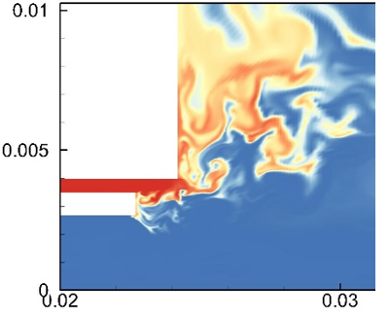
Large and small eddies
A Direct Numerical Simulation (DNS) of the coupled Navier-Stokes equations is too expensive for practical applications, even when parallelized over thousands of computers!
In practice, direct simulation is used for large-scale structures, and model-based approaches are used for resolving small-scale eddies.
DNS
LES
RANS
Relative important of numerics
Increasing model influence
no model
Large eddies
model
limit = DNS
limit ≠ DNS
Small eddies
Image from Deck et al. (2014), Phil. Trans. R. Soc. A.

Slide 14
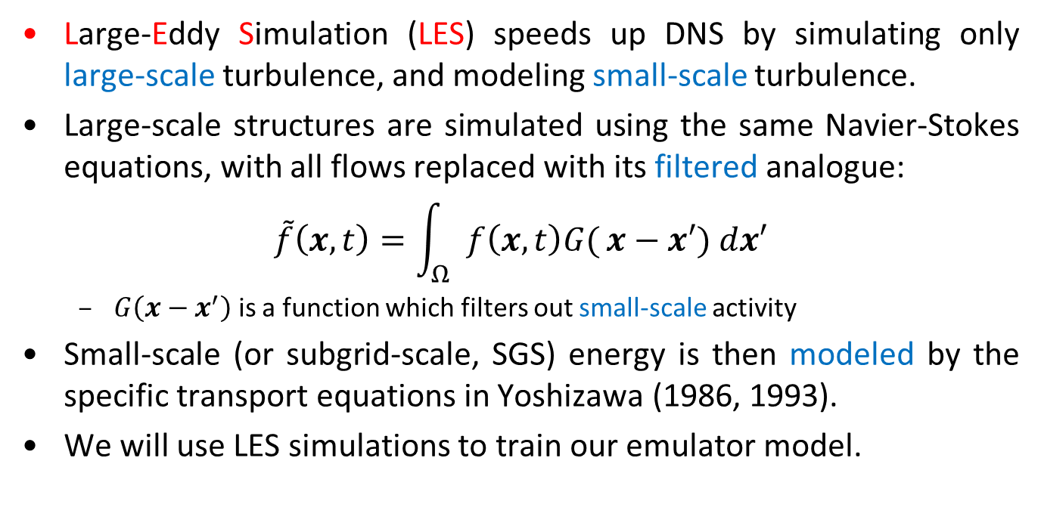
Large-Eddy Simulation (LES)
Large-Eddy Simulation (LES) speeds up DNS by simulating only large-scale turbulence, and modeling small-scale turbulence.
Large-scale structures are simulated using the same Navier-Stokes equations, with all flows replaced with its filtered analogue:
$$\tilde{f}\left(x,t\right)=\int_{Ω}{f\left(x,t\right)G(}x−x′) dx′$$
$G\left(x−x^{′}\right)$ is a function which filters out small-scale activity
Small-scale (or subgrid-scale, SGS) energy is then modeled by the specific transport equations in Yoshizawa (1986, 1993).
We will use LES simulations to train our emulator model.

Slide 15
Why data analytics?
Simulations alone are not enough to survey entire design space:
For each design setting, DNS takes months to simulate, and LES requires several weeks, parallelized over hundreds of processors.
Efficient emulation of flows at un-simulated settings:
Our emulator predicts flows in around an hour, and exploits the same level of massive parallelized computing.
New insights on rocket engine physics:
Machine-learning of physical couplings (e.g., between pressure and velocity) allows engineers to identify key sources of flow instabilities.
Emulator UQ also helps identify key physics contributing to flow instabilities.

Slide 16
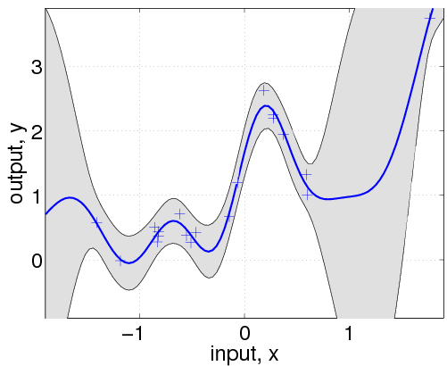
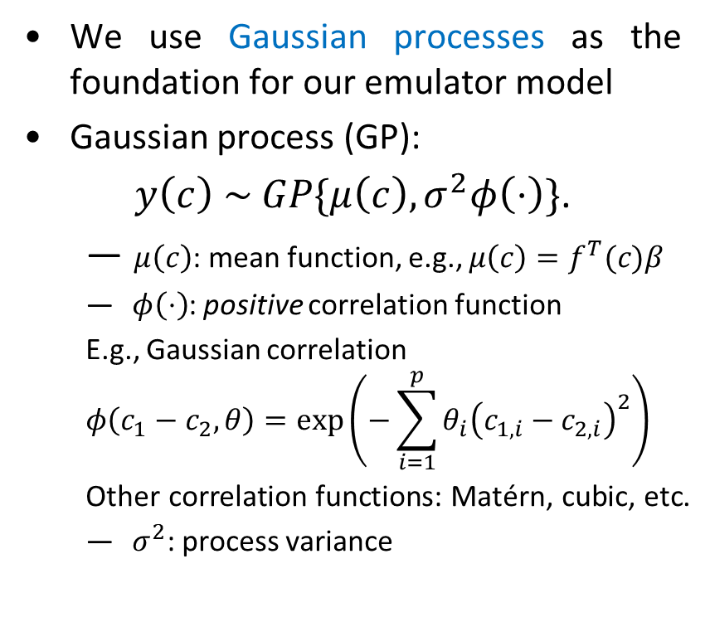
Gaussian Process modeling (Kriging)
We use Gaussian processes as the foundation for our emulator model
Gaussian process (GP):
$y\left(c\right) \sim GP\{μ\left(c\right),σ^{2}φ\left(⋅\right)\}$.
$μ\left(c\right)$: mean function, e.g., $μ\left(c\right)=f^{T}(c)β$
$φ\left(⋅\right)$: positive correlation function
E.g., Gaussian correlation
$$φ\left(c_{1}−c_{2},θ\right)=exp\left(−\sum_{i=1}^{p}{θ_{i}{\left(c_{1,i}−c_{2,i}\right)}^{2}}\right)$$
Other correlation functions: Matérn, cubic, etc.
$σ^{2}$: process variance
c

Slide 17
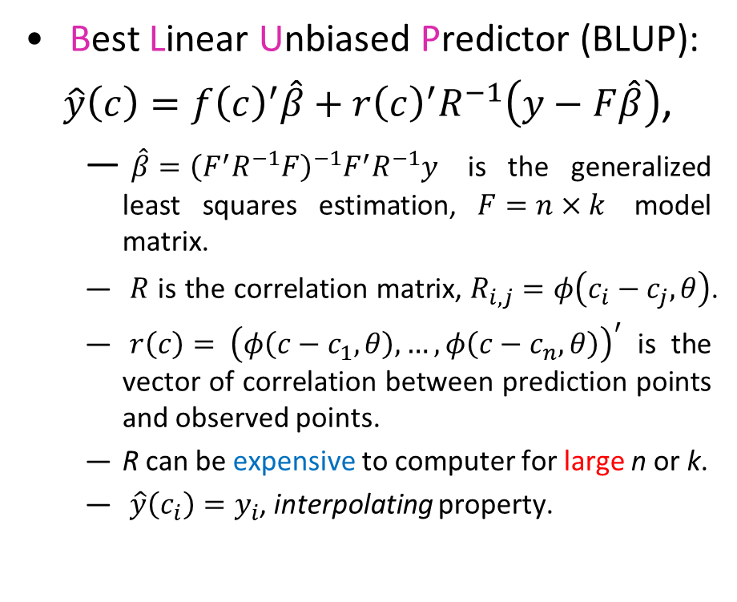
Kriging predictor
Best Linear Unbiased Predictor (BLUP):
$\hat{y}\left(c\right)=f{\left(c\right)}^{′}\hat{β}+r{\left(c\right)}^{′}R^{−1}\left(y−F\hat{β}\right)$,
$\hat{β}={\left(F^{′}R^{−1}F\right)}^{−1}F^{′}R^{−1}y$ is the generalized least squares estimation, $F=n×k$ model matrix.
$R$ is the correlation matrix, $R_{i,j}=φ\left(c_{i}−c_{j},θ\right)$.
$r\left(c\right)=$ ${\left(φ\left(c−c_{1},θ\right),…, φ\left(c−c_{n},θ\right)\right)}^{′}$ is the vector of correlation between prediction points and observed points.
R can be expensive to computer for large n or k.
$\hat{y}\left(c_{i}\right)=y_{i}$, interpolating property.
c

Slide 18
Kriging as Interpolator and Predictor

Slide 19

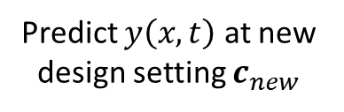
Spatio-temporal Kriging
Here, we are interested in flow kriging (spatio-temporal), rather than kriging of scalar functions.
Not much literature on flow kriging; existing methods (e.g., Hung et al., 2015) may have problems when applied here:
Simulated flow data is massive (~100Gb for each simulated design)
Dimension of spatial grids vary greatly for different input variables!
To address these problems, we look to incorporate physical properties of the fluid flow as simplifying model assumptions.
Predict $y\left(x,t\right)$ at new design setting $c_{new}$

Slide 20
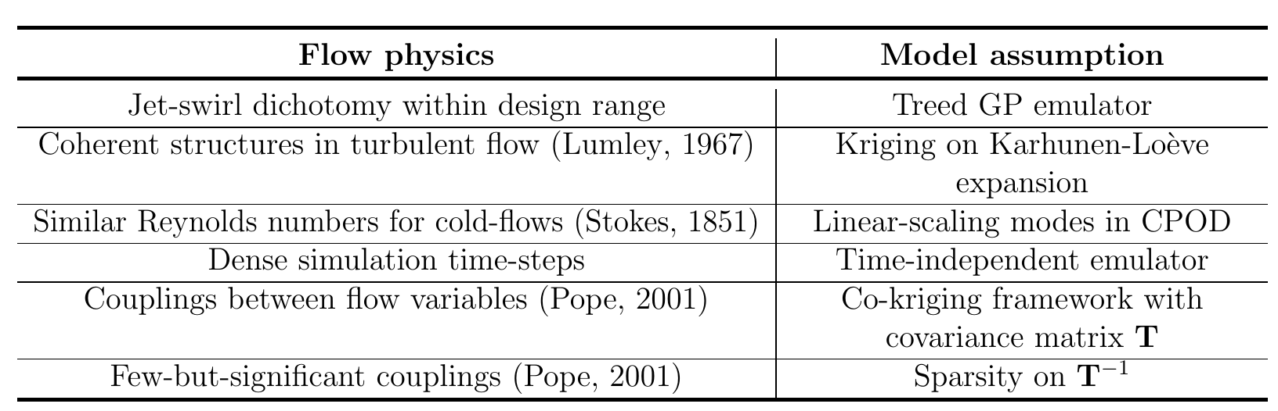
Physics elicitation
This begins with a careful elicitation of the flow physics for the problem at hand:
Figure: Elicited flow physics and corresponding assumptions for the emulator model.
Mak, S., Sung, C. L., Wang, X., Yeh, S. T., Chang, Y. H., Joseph, V. R., Yang, V. and Wu, C. F. J. (2018). Journal of the American Statistical Association, 113(524):1443—1456.

Slide 21
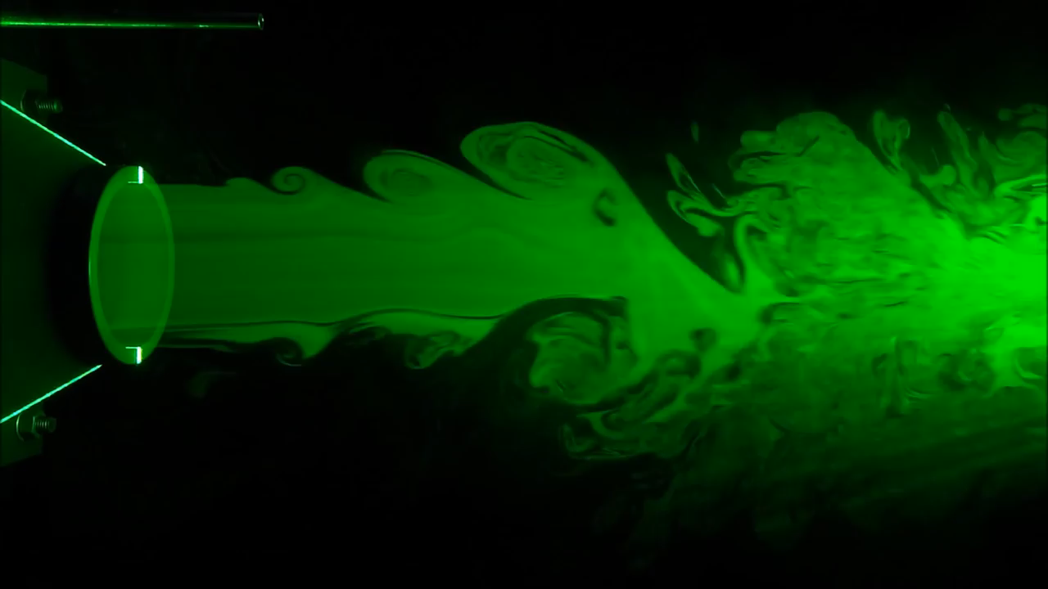
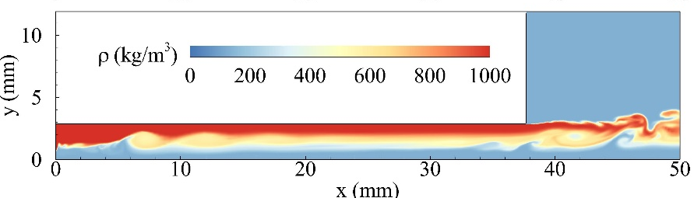
Jet-Swirl dichotomy
From theoretical physics (Pope, 2001) and empirical studies (Bazarov et al., 2004), flows within the injector exhibit either jet or swirl behavior (jet-swirl dichotomy)
Jets and swirls provide different mixing of LOx / fuel:
Jets rely on initial momentum of LOx on injector wall for uniform atomization
JET FLOW:
MOMENTUM

Slide 22
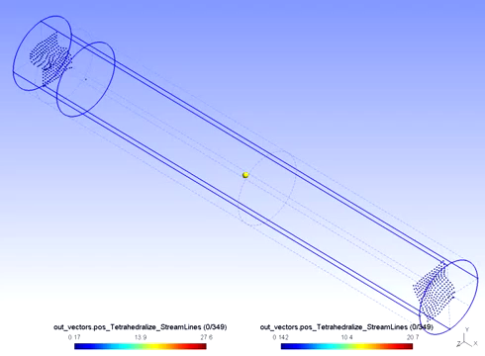
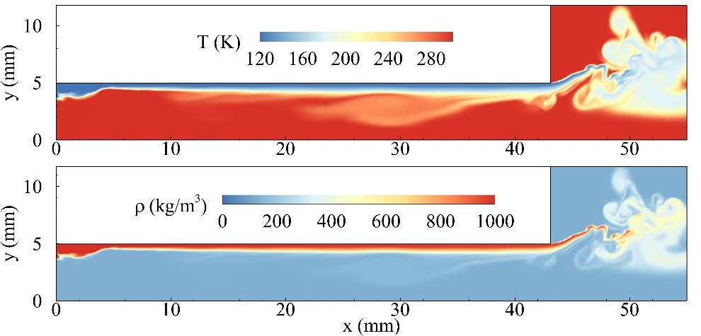
Jet-Swirl dichotomy
From theoretical physics (Pope, 2001) and empirical studies (Bazarov et al., 2004), flows within the injector exhibit either jet or swirl behavior (jet-swirl dichotomy)
Jets and swirls provide different mixing of LOx / fuel:
Jets rely on initial momentum of LOx on injector wall for uniform atomization
Swirls rely on the centrifugal rotation of LOx around injector walls
SWIRL FLOW:
CENTRIFUGAL ROTATION

Slide 23


Jet-Swirl dichotomy
But for a new injector design $c$, engineers don’t know prior to simulations whether it will exhibit jetting or swirling behavior
After simulations, engineers can use data to categorize the new design $c$ as either a jetting or swirling injector
Our emulator model should incorporate this data-driven categorization in order to capture key flow physics
JET FLOW:
SWIRL FLOW:
MOMENTUM
CENTRIFUGAL ROTATION

Slide 24

Treed GP emulator
We model this dichotomy using a treed GP emulator (Gramacy and Lee, 2008):
Learn the jet-swirl boundary by fitting a decision tree (supervised learning)
Fit separate emulators for jet and swirl injectors on the design space
Treed GPs are traditionally used as a tool to approximate non-stationary functions. Here, the treed structure has physical meaning: it captures the underlying jet-swirl dichotomy!
Figure: Fitted decision tree for $n=30$ simulated settings using the MaxPro design (Joseph et al., 2015)
Yeh, S.-T., Wang, X. J., Sung, C.-L., Mak, S., Chang, Y.-H., Wu, C. F. J. and Yang, V. (2018). AIAA Journal, 56(6):2429—2442.

Slide 25

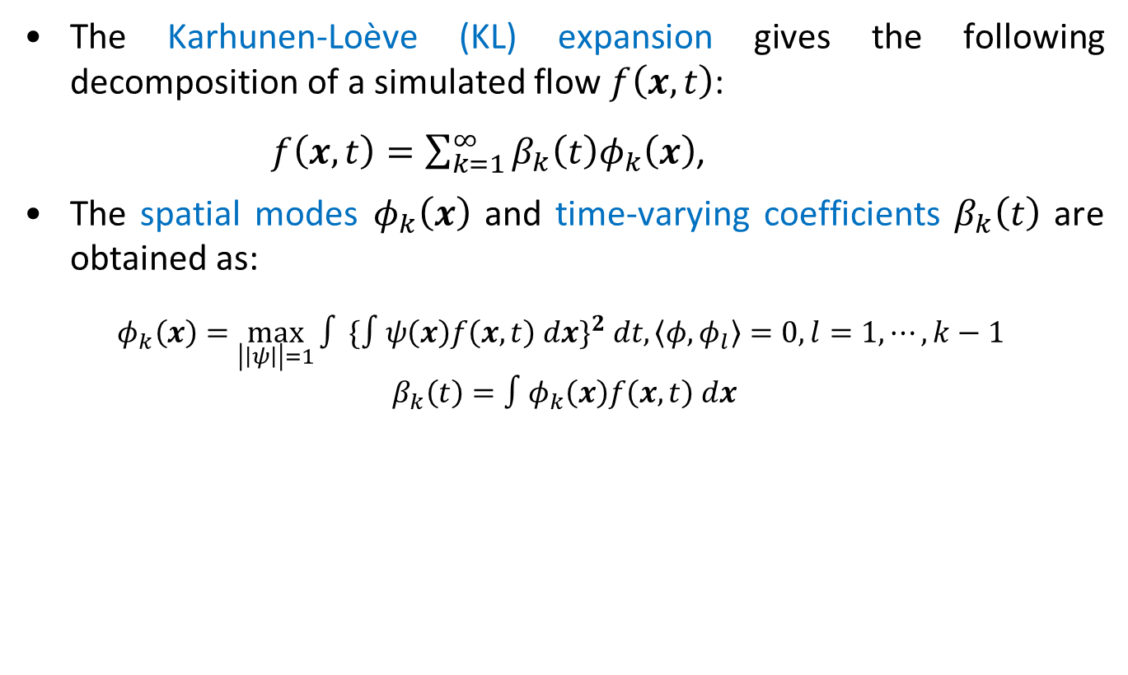

Karhunen-Loève expansion
The Karhunen-Loève (KL) expansion gives the following decomposition of a simulated flow $f\left(x,t\right)$:
$f\left(x,t\right)=\sum_{k=1}^{∞}{β_{k}\left(t\right)φ_{k}\left(x\right)}$,
The spatial modes $φ_{k}\left(x\right)$ and time-varying coefficients $β_{k}\left(t\right)$ are obtained as:
$$φ_{k}\left(x\right)=\max_{\left|\left|ψ\right|\right|=1}{∫}{\{∫ψ\left(x\right)f\left(x,t\right) dx\}}^{2} dt, \left\langle φ,φ_{l}\right\rangle =0, l=1, ⋯, k−1$$
$$β_{k}\left(t\right)=∫φ_{k}\left(x\right)f\left(x,t\right) dx$$
Notation:
$x$ : spatial coordinates
$t$ : time

Slide 26
Using the KL-expansion in emulation
The KL expansion has physical interpretability for flows:
Proper Orthogonal Decomposition (POD) in mechanical engineering.
POD is used extensively for extracting instability structures from turbulent flows (Lumley, 1967). For each POD term, engineers can pinpoint specific instabilities by inspecting dominant frequencies.
Decomposition into separable spatial and temporal terms provides a reduced-basis emulation model
Two computational challenges remain:
How to construct the KL expansion for varying geometries?
How to build an efficient emulator for fine simulation time-steps?
We address this through two simplifying assumptions.

Slide 27
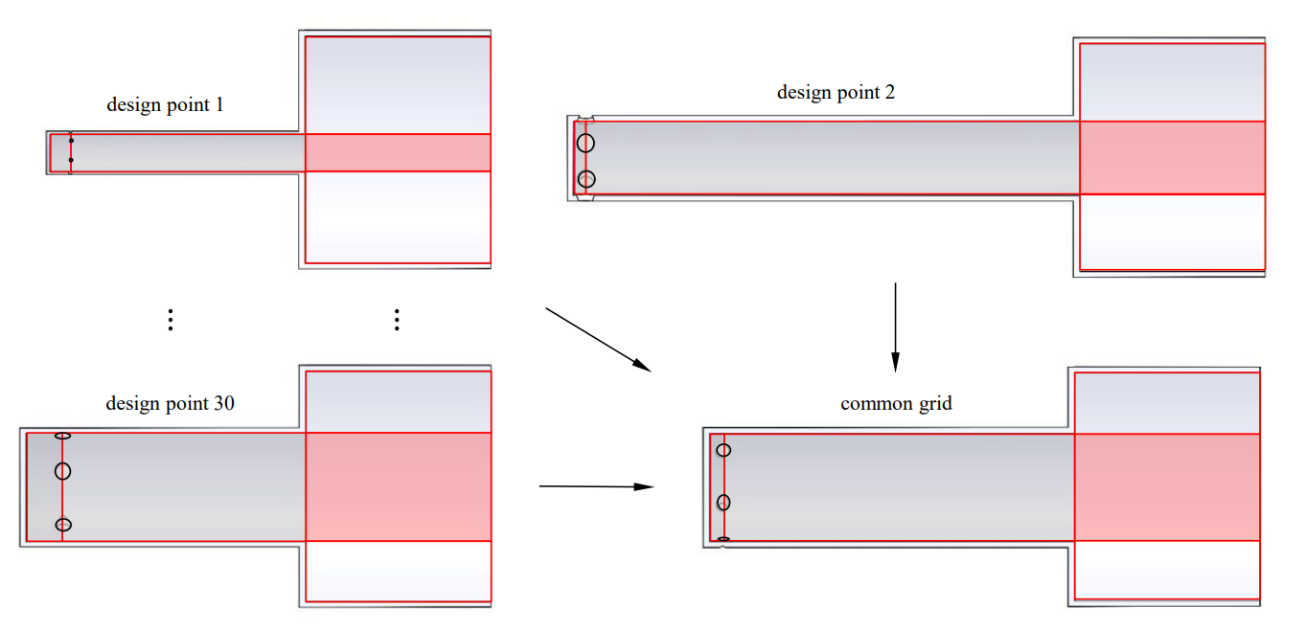
Common POD (CPOD)
Assumption 1: POD spatial modes scale linearly over a physics-based partition of the geometry space
Physically justified by similar Reynolds numbers for cold flows (Stokes, 1851)
Implemented by scaling and interpolating the mesh for all geometries onto a common grid, then performing a single SVD for the KL-expansion
Allows for efficient extraction of common flow instabilities over design space
Design 1
Design 2
Design 3
Common Grid

Slide 28

Time-independent emulator
Assumption 2: Independent emulators for each time-step
Physically justified by time-stationarity of turbulent structures (Lumley, 1967)
Quantifying temporal correlation not of high importance, because:
Simulation time-steps are very dense (order of ms)
Prediction is only required at observed time-steps
Allows for massive computational speed-ups, because the emulators for each time-step can now be trained in parallel

Slide 29
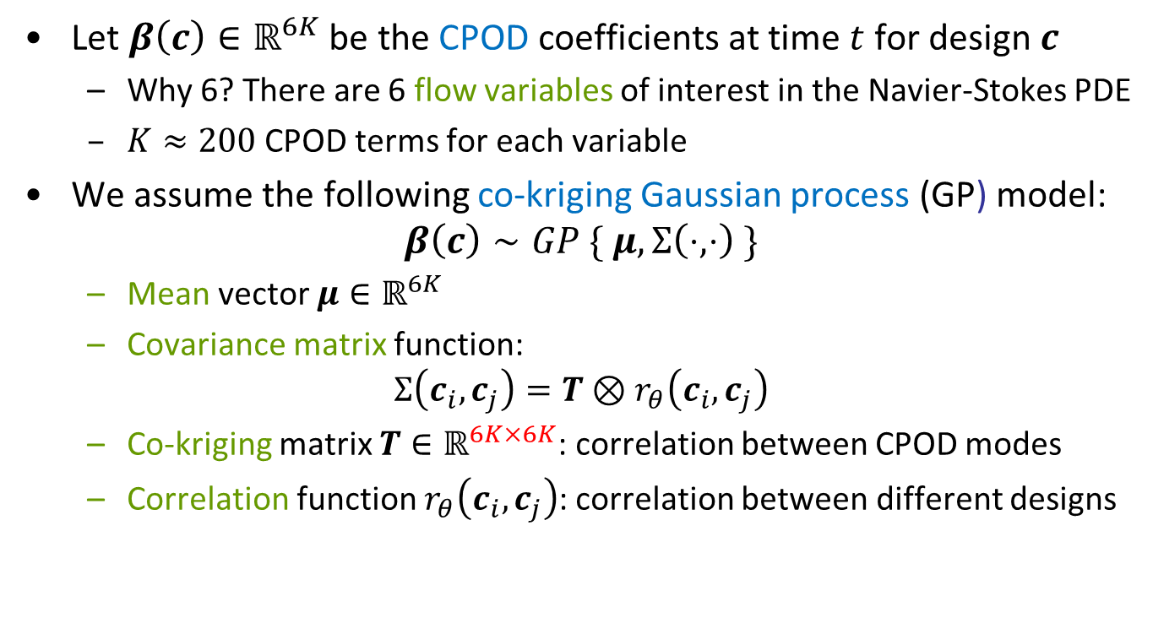
Model specification
Let $β\left(c\right)∈ℝ^{6K}$ be the CPOD coefficients at time $t$ for design $c$
Why 6? There are 6 flow variables of interest in the Navier-Stokes PDE
$K≈200$ CPOD terms for each variable
We assume the following co-kriging Gaussian process (GP) model:
$$β\left(c\right)∼GP \{ μ, Σ\left(⋅, ⋅\right) \}$$
Mean vector $μ∈ℝ^{6K}$
Covariance matrix function:
$$Σ\left(c_{i},c_{j}\right)=T⊗r_{θ}\left(c_{i}, c_{j}\right)$$
Co-kriging matrix $T∈ℝ^{6K×6K}$: correlation between CPOD modes
Correlation function $r_{θ}\left(c_{i}, c_{j}\right)$: correlation between different designs

Slide 30

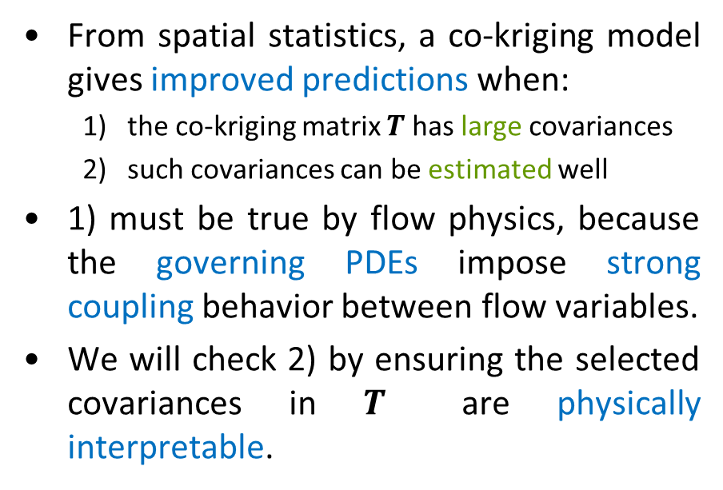
Co-Kriging or not?
From spatial statistics, a co-kriging model gives improved predictions when:
the co-kriging matrix $T$ has large covariances
such covariances can be estimated well
1) must be true by flow physics, because the governing PDEs impose strong coupling behavior between flow variables.
We will check 2) by ensuring the selected covariances in $T$ are physically interpretable.

Slide 31
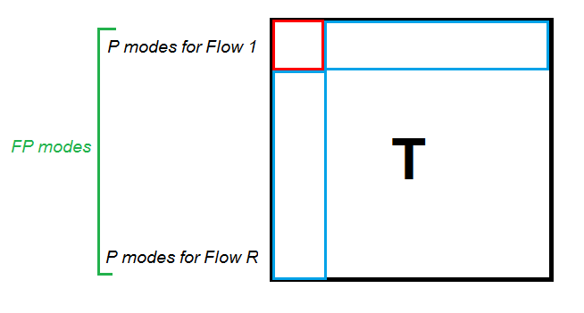

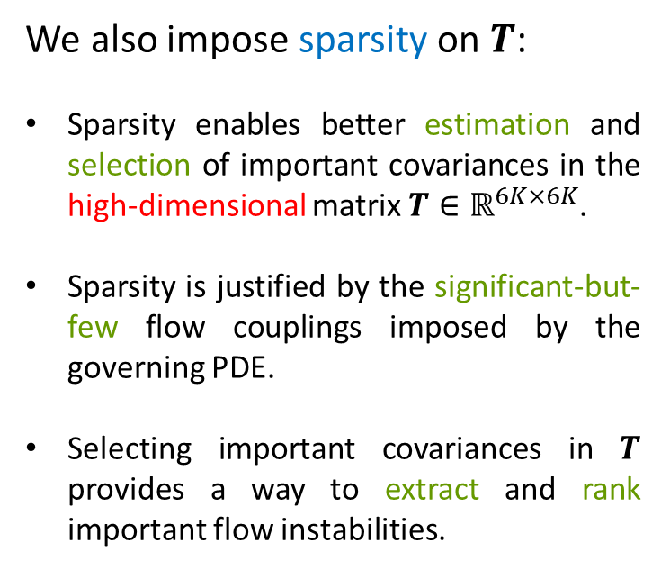

Sparsity and physics extraction
We also impose sparsity on $T$:
Sparsity enables better estimation and selection of important covariances in the high-dimensional matrix $T∈ℝ^{6K×6K}$.
Sparsity is justified by the significant-but-few flow couplings imposed by the governing PDE.
Selecting important covariances in $T$ provides a way to extract and rank important flow instabilities.
Modes for Var. 1
$$⋮$$
Modes for Var. 6
Figure: Co-kriging matrix $T$ for CPOD modes.

Slide 32
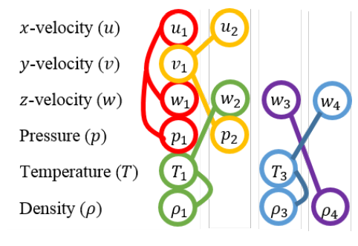
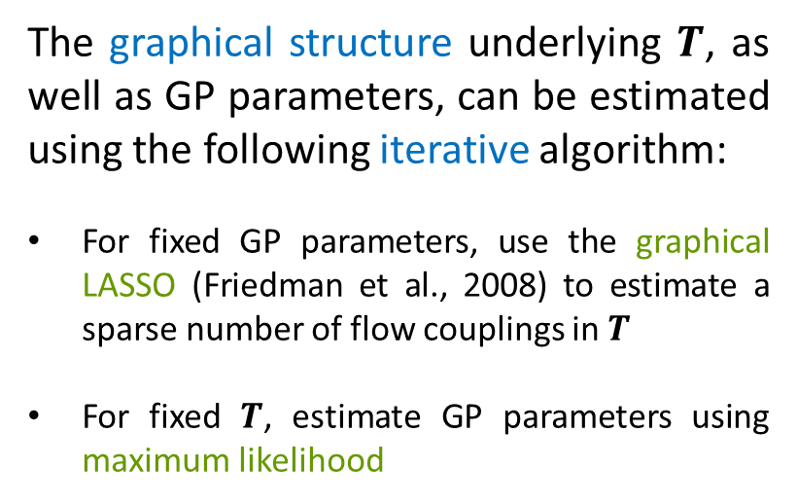
Graph estimation
The graphical structure underlying $T$, as well as GP parameters, can be estimated using the following iterative algorithm:
For fixed GP parameters, use the graphical LASSO (Friedman et al., 2008) to estimate a sparse number of flow couplings in $T$
For fixed $T$, estimate GP parameters using maximum likelihood

Slide 33
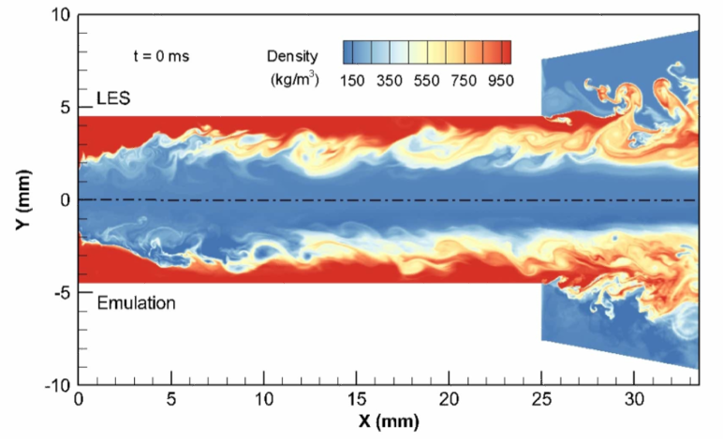
Emulation results – density
Simulation:
Emulation:
Figure: Simulated and emulated instantaneous density flow at new swirl geometry

Slide 34
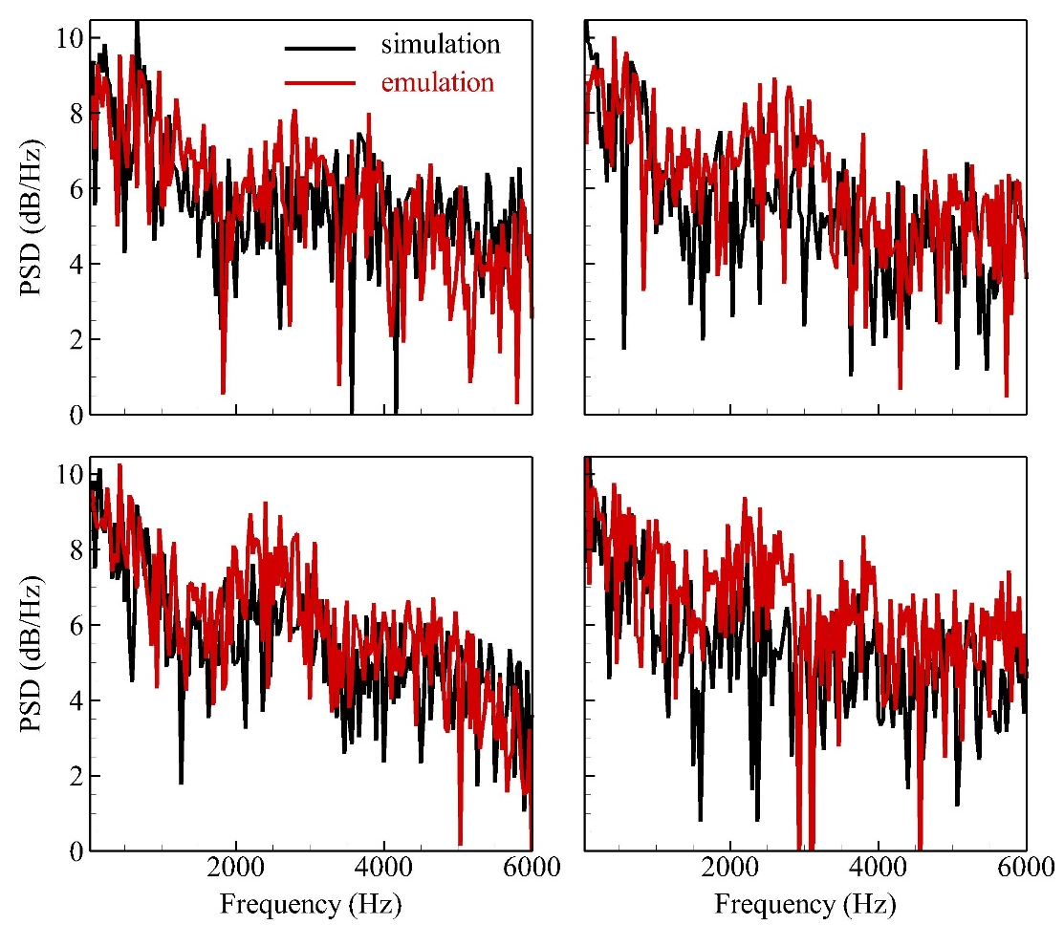
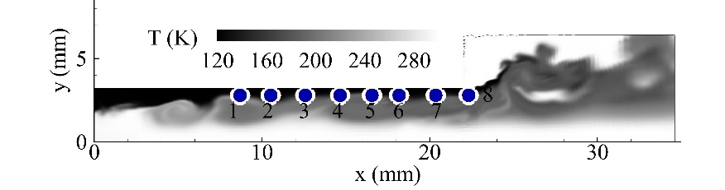
Emulation results – pressure
Figure: (Left) Power spectral densities of pressure flow at new swirl geometry, (Right) Testing probes on LOx film surface.

Slide 35
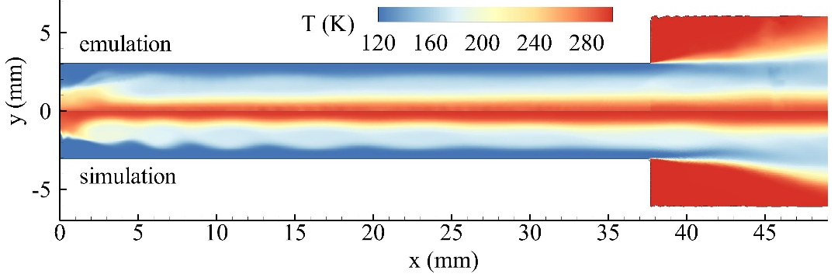
Emulation results – temperature
Simulation:
Emulation:
Figure: Simulated and emulated mean temperature flow at new jet geometry

Slide 36
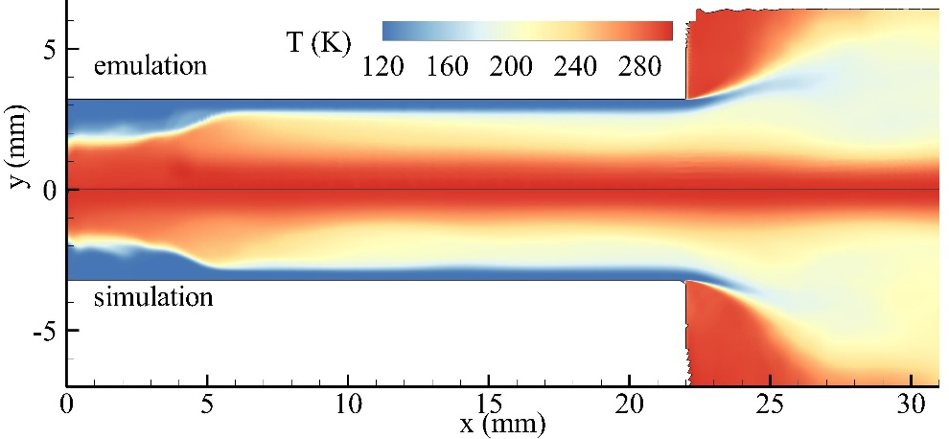
Emulation results – temperature
Simulation:
Emulation:
Figure: Simulated and emulated mean temperature flow at new swirl geometry

Slide 37
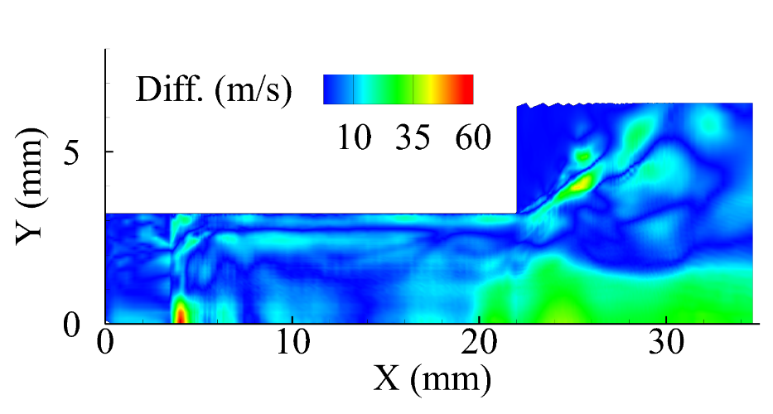

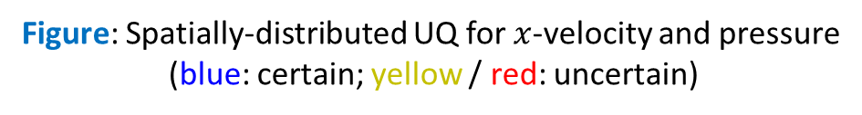
Uncertainty Quantification
Figure: Spatially-distributed UQ for $x$-velocity and pressure
(blue: certain; yellow / red: uncertain)
UQ not only useful for error analysis, but also for extracting flow physics
Regions with high uncertainty have richer dynamic characteristics:
Taper region: high uncertainty splits into two branches (mixing layer & centrifugal instability)
Near inlet: high uncertainty due to flow recirculation of gas core

Slide 38
Computation time
130X speed-up over numerical simulations (LES)!

Slide 39
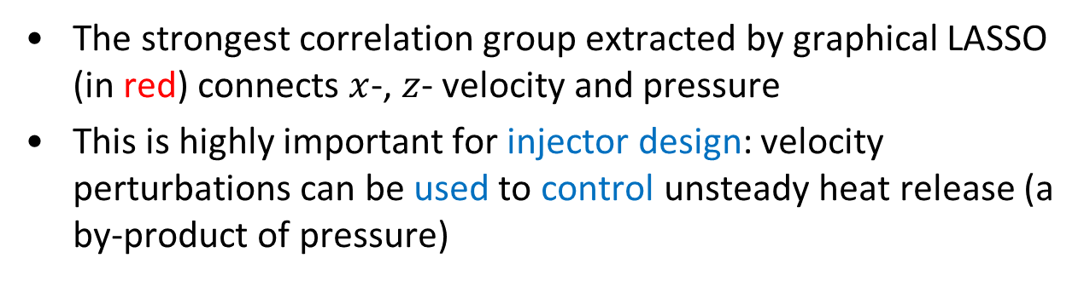
Flow coupling extraction
Centrifugal acceleration of circular flow momentum
Bernoulli’s equation relating fluid speed and pressure
Equation of state and conservation of energy
Conservation of momentum
Figure: Selected couplings for all flow variables. Nodes represent CPOD expansion terms, and edges represent non-zero correlations.
The strongest correlation group extracted by graphical LASSO (in red) connects $x$-, $z$- velocity and pressure
This is highly important for injector design: velocity perturbations can be used to control unsteady heat release (a by-product of pressure)

Slide 40
Recap
Emulation: Visually good ☺, and adequately captures flow physics and dynamics
UQ: Emulator UQ not only quantifies uncertainty, but also reveals important flow instability structures
Correlation extraction: Extracted network of correlated physical structures makes physical sense for engineers ☺, useful for guiding future investigations

Slide 41
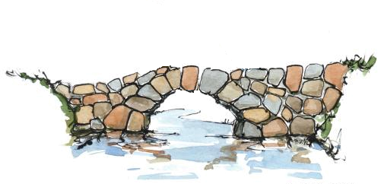

Conclusion
Physics-driven modeling
Engineer
Data Scientist
Data-driven learning and physical knowledge must go hand-in-hand for analytics:
For engineering problems, data should be incorporated with physics to learn the “truth” of the physical world.
Here, we employed this thought process to construct an effective and useful emulator for turbulent flows.
This way of thinking can, and should, be applied to all aspects of big-data analytics.

